Slide 1
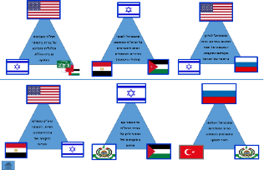
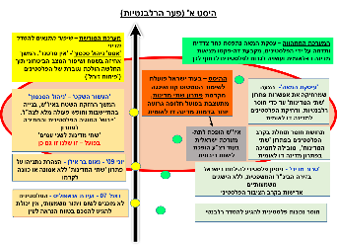
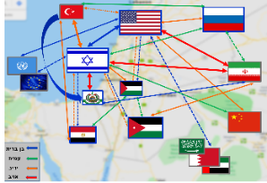
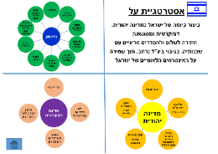
Security Political Simulation
Potentials
Offset
Conceptual Map
Grand Strategy
February 2020
Unclassified
The Israeli Team

Slide 2
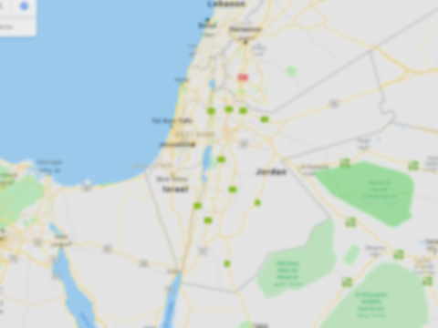
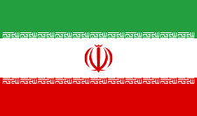
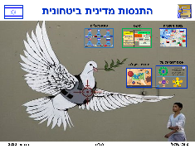
Ally
Colleague
Rival
Enemy

Slide 3
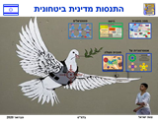
Offset A
The Legacy System
Improving the conditions for a political settlement
'Conflict Management Strategy' - 'No Partner', continued control of the area and Improving the security situation while the weakening of the Palestinians is gradually increasing (‘devaluation‘)
The emergent system – Deal of the Century is seen as one sided and rejected by the Palestinians, de facto establishing a bi-national state and may cause the Palestinians to push for that option
The offset - while Israel is working to maintain the status quo and is not promoting a two-state solution, a worse alternative is actually forming in the form of a bi-national state
Deal of the century-
Proposal that distances the possibility of a ‘two-state’ solution, making it irrelevant and pushing the Palestinians into a bi-national state
'Silent Decade' - 'Conflict Management' Continued control over the area in Judea and Samaria, settlement construction and full freedom of action for the IDF
"Drying" the Palestinian issue and striving for ‘a two-state solution
for two peoples' In practice - this is ours as well
Judea and Samaria becomes an Israeli sub-system while the Gaza Strip becomes a sovereign entity
The sense of futility among Palestinians in the ‘two-state’ solution leads to support for a bi-national state solution
June 09 - Bar Ilan Speech - Netanyahu's declaration on a ‘two-state' solution without faith or any intent to promote it
'Political terror' - Palestinian attempt to fight Israel in the international and legal arena, without significant achievements.
Indifference among the Palestinian public
Dec 07 - Annapolis Conference - Palestinians are not ready for any significant concession, unable to reach agreement in the foreseeable future
Palestinian unwillingness to reach a relevant settlement
Offset B

Slide 4
The Legacy System - Improving Conditions for a Political Settlement
'Conflict Management Strategy' - 'No Partner', continued control of the area and Improving the security situation while the weakening of the Palestinians is gradually increasing (‘devaluation‘)
Political and security action in five domestic arenas in conflict management
The Palestinian system in Judea and Samaria
The Palestinian system in the Gaza Strip
East Jerusalem Arabs (residents) - A Palestinian who seeks to utilize the possibility with Israel
Diaspora Arabs
Israeli Arabs (citizens) - Establishing affiliation with the State of Israel

Slide 5
Offset B
The Legacy System
Prevent order at all costs
'Conflict Management Strategy' - 'No Partner', continued control of the area and Improving the security situation while the weakening of the Palestinians is gradually increasing (‘devaluation‘)
The emergent system – Deal of the Century promotes a ‘two-state solution’ that Israel cannot refuse
The offset - While Israel is working to maintain the status quo, while persuading a sympathetic US government not to give up as Israel did it the past, ‘the two-state’ deal is shaping up so that Israel cannot refuse it
‘Deal of the century’-
A full response to Israeli interests, and the lack of the possibility for Israel to refuse promoting a ‘two-state’ based on this proposal
'Silent Decade' - 'Conflict Management' Continued control over the area in Judea and Samaria, settlement construction and full freedom of action for the IDF
"Drying" the Palestinian issue and striving for ‘a two-state solution
for two peoples' In practice - this is ours as well
Trump starting his position - sympathetic US president, fully clarifying Israeli interests while receiving an attentive American ear
June 09 - Bar Ilan Speech - Netanyahu's declaration on a ‘two-state' solution without faith or any intent to promote it
'Political terror' - Palestinian attempt to fight Israel in the international and legal arena, without significant achievements
Dec 07 - Annapolis Conference - Palestinians are not ready for any significant concession, unable to reach agreement in the foreseeable future
Palestinian unwillingness to reach a relevant settlement
Offset A

Slide 6
Collaboration based on security and economic alliance and Arab support for the deal
Potential for leverage on PA and Hamas under common political (economic and security) interests
The potential for balance and stability in the area under the agreement of two powers and Israel's unique position
Political, security and economic triangle of cooperation and the positioning of Egypt
Covert dialogue with PA officials as a leverage on Hamas' aggression
The potential for escalation around a conflict of interests in support of the Shiite axis

Slide 7
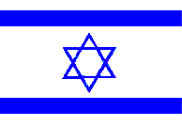
Grand Strategy
Security
Independence
Freedom of Response
Safe borders
Deepening relations with Egypt and Jordan
Multidimensional freedom of action
Demilitarized Palestinian State
Control of the passageways
Israeli military supremacy
Maintaining contact with the US
Normalizing relations with moderate Arab countries
Reinforcing Israel's existence as a Jewish, democratic and prosperous state, striving for peace and political arrangements with its neighbors, with wide international backing, while preserving Israel's national interests.
Democratic State
Jewish majority
Equal rights for all citizens
No to an apartheid state
Improving minority integration
Jewish State
Jewish majority
Recognition of Israel as the nation-state of the Jewish people
Law of Return
Diaspora Jewry
Historical affinity
Heritage Sites
Non-waiver of the Temple Mount

Slide 8
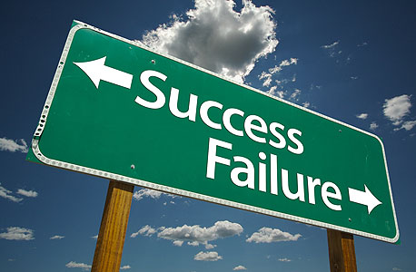
TOP 5 – Interests
Maintaining Israel's security and stability in its immediate vicinity.
Preserving Israel's Jewish and democratic identity.
Significantly not harming the strategic relationship with the US.
Placing elements that prevent / eliminate the reality of a
bi-national state.
Strengthening Israel's regional partnerships, the close ones (Jordan and Egypt) and the distant.
Red lines
Success factors

Slide 9
Strategy Success/Failure Metrics
Loss of American support
Preserving the existing situation in the field, without promoting ‘one-state’ limiting measures
Collapse of stability in Judea and Samaria over time (not necessarily related to the PA)
Substantial deterioration in relations with Jordan and Egypt
Significant weakening of the coalition against Iran
Reaching an agreement while not crossing the red lines
Implementing one state preventive measures, even in the absence of Palestinian cooperation
Preserving the Strategic Alliance with the US
Strengthening existing alliances with Egypt and Jordan (in Essene or visually)
Promoting relations with moderate Sunni countries
Preservation of Government Stability in Israel

Slide 10
Actions for Realizing the Strategy
Designing a Strategic Alliance
Keeping a unique and continued relationship with the US president in favor of strategic coordination
Opportunities and Alliances
Identifying factors and stakeholders with common interests for strengthening Israel’s interests
Military and Economic Leverage
Removing Hamas from its comfort zone by preventing a round of fighting and using leverages on the population in Gaza
Media Announcements
While in control and close escort during any action
Decision Making Flexibility
Complete preparation for incidents, responses and for the collapse of some of our basic assumptions

Slide 11
Updates and Changes to the Strategy
Step A – No significant change to the strategy
Any action by Hamas in Judea and Samaria will be countered with a response in the Gaza Strip
Step B –
Initial Strategy
Preserving the relationship with the US
Severing the Chinese-Turkish relationship
Russia as a stabilizing factor against Turkey
Strengthening the PA on the expense of Hamas
Strengthening ties with the Sunni states in favor of brining back the coalition against Iran to the International front stage.

Slide 12
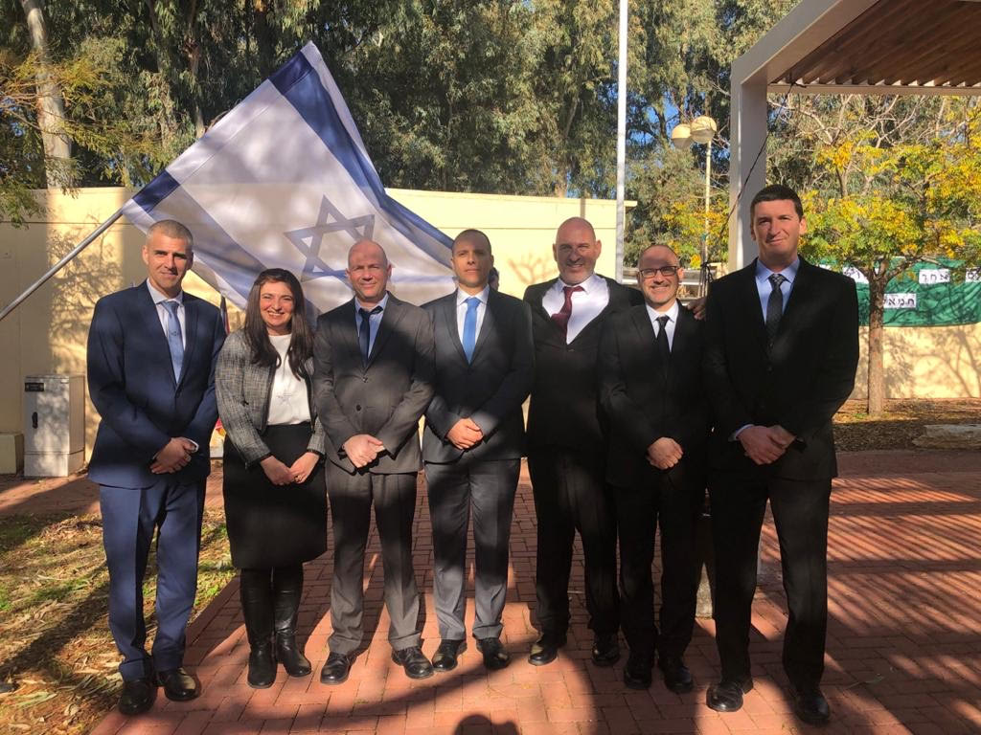
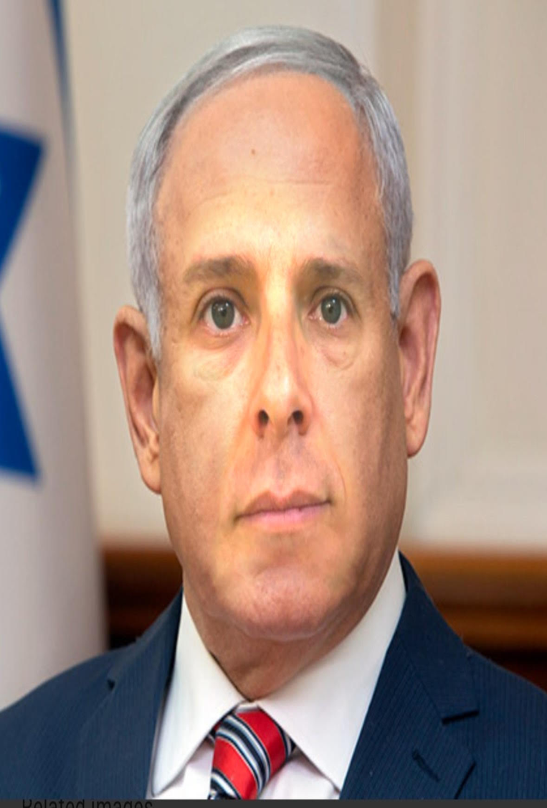
Lessons Learned
Lessons for Improvement
Reducing the preparatory time in the plenum and having it before the Judea & Samaria tour.
Increasing the time spent on working on the design in the team.
Incorporating preparatory seminars in media orientation and negotiation skills.
The Cabarnet system is complex and crowded, not allowing the utilization of the processes that took part during the simulation.
Lessons for Preservation
The methodological process of the design approach was carried out accurately and professionally, with full cooperation. The process allowed to maintain the strategy throughout the simulation.
The actual experience, involving several groups with different interests, is critical and creates a dynamic that requires critical thinking and necessary adaptations
Setting a number of offsets expands the discussion and deepens the insights in relation to our strategy.
Researching a subject by various participants from different disciplines proves itself time after time.

