Slide 1
Hashemite
Kingdom
We achieved our goal, On the day you revived for us, A revolution gives us our motivation! Flying over the shoulders of the highest comets.
نحن أحرزنا المنى يوم أحييت لنا نهضة تحفزنا تتسامى فوق هامِ الشهب
Respectfully yours, Jordan - the Great Officers of State

Slide 2
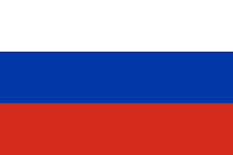
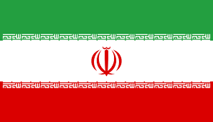
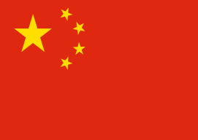
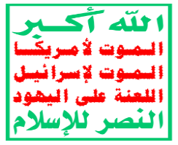
System & Players
ה
USA
Russia
Palestinians
Iran
Turkey
Israel
PA
UK
EU
Special Relationship
UAE
Egypt
PIJ
Hamas
Islamic States
China
מעצמות
Morocco
Neighbors
Jordan
Iraq
Quds Force
Hezbollah
Syria
IS
Houthis
Al-Qaeda
Shiite Militia
Lebanon
Saudi Arabia
Domestic Terror and on the borders
דעאש

Slide 3
Jordan – Advantages and Disadvantages
Exclusivity over the holy sites
Strategic Depth
Longstanding special relationship with Israel and the USA
Delicate Domestic Situation
Economy in Distress
Internal and External Threats
Refugees
No resources, no water

Slide 4
Offset in light of Emerging System in the Scenario
While Jordan is a regional stabilizer (refugee absorption, buffer zone, alternative for Turkey) and sees itself as a patron to Palestinians and of special status in the holy places, its international status has eroded and is not a significant player in setteling the conflict.
Increase Jordan’s value as a regional player of unique significance on the Palestinian issue as a means of the overall interest – regime survival

Slide 5
From Design to Action
Smart and quiet operation, much as possible, to maximize as goals and minimize damage, while being alert to reaching red lines
Patron, not the Solution
Temple Mount is Ours
Our strength is in our weakness and niceness

Slide 6
Stage One - Summary
Security Strategy
Economic Strategy
Political Strategy
V
X
Maintaining internal stability.
An Israeli and American defense umbrella is enshrined in the agreements.
Blocking Iran (within and beyond).
Continued Western and modern military force building
V
Full compensation for the absorption of the Palestinians from 48 onwards - $ 15 billion.
Doubling US aid.
Fixed water supply to meet all of Jordan needs at a low cost.
Massive investment in infrastructure, energy, industry, trade and tourism.
Financing the refugee issue from Syria, Iraq and Lebanon.
Intermediate status on a four-way channel - USA Jordan - Israel Palestinians
Demonstrating Power to the Jordanian Public (Regime Stability)
Jordan’s exclusivity on Temple Mount
International border with Israel
Without population exchange and territories in Jordan
X
V
V
V
X
V
V
V
V
X
V
We have become valuable in the eyes of the United States, Israel and Saudi Arabia. In practice, we are not a significant player on the Palestinian issue.

Slide 7
Strategic analysis for the second stage of the scenario
Jordan s of value to the Deal of the Century (not "first line"). The Palestinian issue is not the focal point. Most of our goals have been achieved so far (political, security, economic).
A possible offset - a different system emerges from the opening scene - US and China blocs.
In this context, there may be interests that are external to Jordan, but as a result, the understandings and achievements we have brought to this point will be overridden.
Planning - to be a valuable player in the region (a substitute for Turkey, attractive in both political and security spheres) and to preserve the economic achievements reached thus far.
X
1. Transfer of US bases from Turkey to northeastern Jordan.
2. Jordan-US Security Defense Alliance.
3. Validation of economic understandings from the first stage (Aqaba-Haql, water, aid, compensation).
4. Weakening Egypt in order to replace it as a mediator
X
V
X

Slide 8
Results and Lessons Learned
The government is stable; Temple Mount is in our hands; significant economic achievements, our political status remains in place (our strength is in our weakness); our alliances with Israel and the US are solid, we have discovered other players (Saudi Arabia), we did not take a hit from the deal (borders, refugees)
Jordan's Priorities – Regime Survival First. The economy – the key to everything.
Dominance in the religious realm of Temple Mount – importance cannot be overstated
Given strategic (certainly global) changes, Jordan has little to offer
Competition between Jordan and Egypt over US heat has emerged.
American sensitivity to China was apparent.
Exercise -
Small yet good team physically located far from occurrence thus compromising the dynamic pace Excellent computerized system that meets the needs

Slide 9
From Amman with Love
Ibrahim bin Keinan
Allah Yerahmu
Queen
Michal
Benny
the Typist
Princess
Anat

