Slide 1
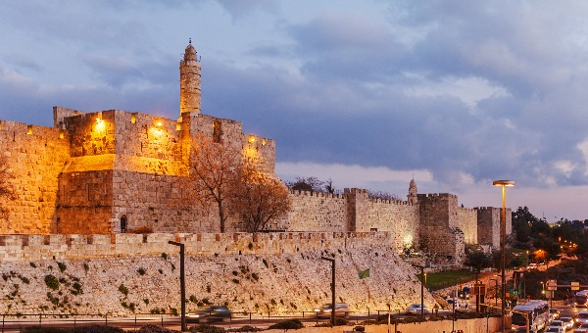
Jerusalem 2020
Jerusalem Institute for Policy Research

