Slide 1
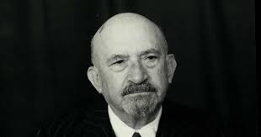
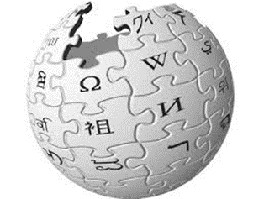
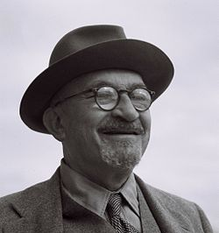
Chaim Weizmann
The Forgotten Father

Slide 2
Statesman and Scientist
Rails of Vision

Slide 3
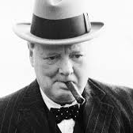
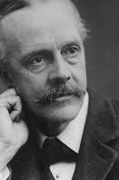
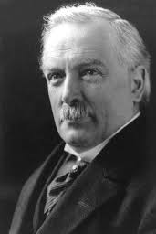
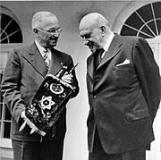
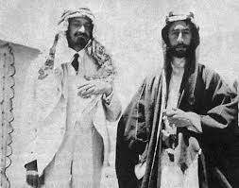

Slide 5
Statesman
Synthetic Zionism 1907
Balfour Declaration 1917
1922 Mandate
Jewish Agency 1929 and another Election In 1935
UN and the Partition plan 1947
President of the state of Israel
1948-9
MACDONALD EPISTLE
CANCELATION OF THE WHITE PAPER
1931

Slide 6
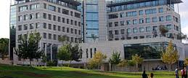
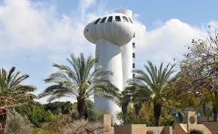
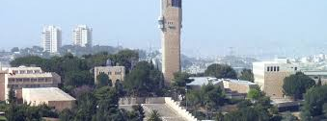

Slide 7
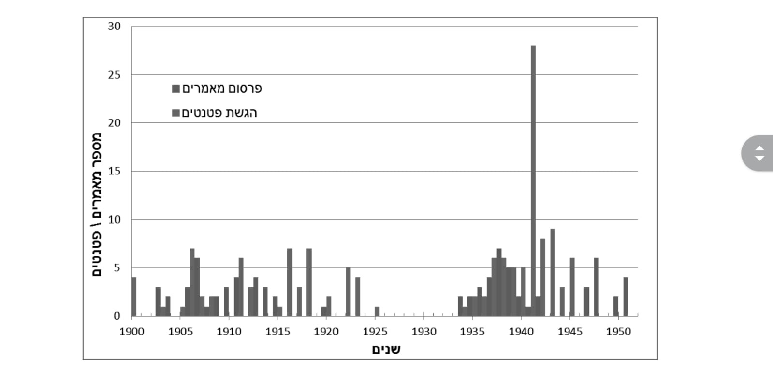
220 registered patents

Slide 8
The Scientist
The discovery of acetone 1914
Establishment of the Hebrew University
1925
Establishment of the Technion 1924
Establishment of the Daniel Ziv Institute
1934
Establishment of Weizmann Institute
1949

Slide 9
February 1949 Things said during the opening meeting of the constituent Assembly
"... Science and research are the foundations of all human creation. All good work we have done in science and research among the nations of the world we must now mobilize for our homeland ..."

Slide 10
Statesman and Scientist Summary
Weizman - the beginning of Israeli diplomacy
A major influencer in all decision-making nodes that required outside involvement; Pragmatic action
The father of science, research, R&D and academic culture in the State of Israel
Beginning in the 1930s a high friction with Ben Gurion regarding the leadership of the Zionist Organization

Slide 11
November 1952 Ben Gurion's obituary eulogizes Weizmann
"Yesterday morning, the Hebrew nation's minister in his generation, the first president of Israel, the knight of chemical science, the man of magic, inspiration and supreme authority ...
For decades served as the focal point ... and legalized the rebirth of the State of Israel, when no one did it before ... The only international personality in the world that was entirely Jewish - was the personality of Dr. Haim Weizman "

