Slide 1
Avoiding Traffic
Omer Moav
https://www.facebook.com/alon77g/videos/10155214023209581/?hc_location=ufi
https://www.ted.com/talks/travis_kalanick_uber_s_plan_to_get_more_people_into_fewer_cars#t-56626

Slide 2
Theory of external effects taxation
Pigovian tax
The optimal tax is equal to the external cost
Pigovian tax internalizes external costs and results in efficient allocation (maximum welfare)
Since demand for car use is not entirely rigid (far from it), Pigovian tax (congestion tolls) will improve allocation
The Pigovian tax approach and the approach of paying for a scarce resource are equal.

Slide 3
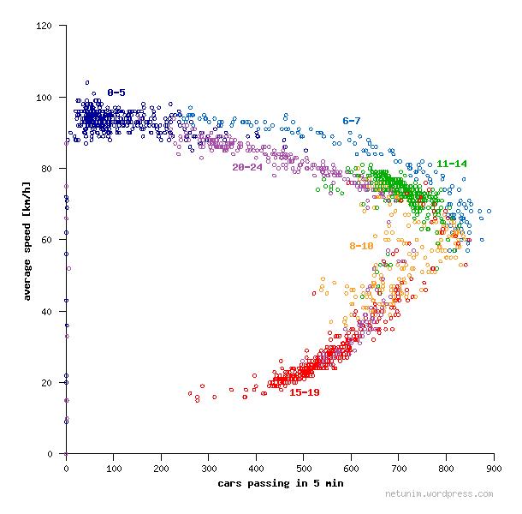
Traffic between the Arlozorov and HaShalom Interchanges - May 2013
(Source: A Traffic Case Study)
Notes:
https://netunim.wordpress.com/tag/%D7%AA%D7%97%D7%91%D7%95%D7%A8%D7%94/

Slide 4
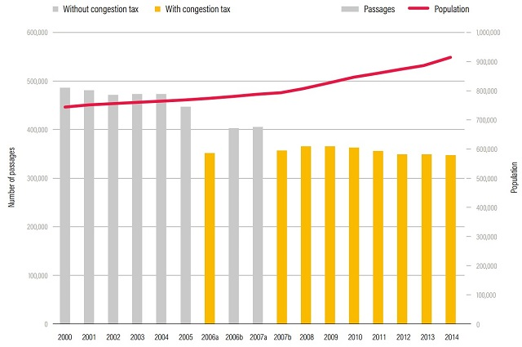
התנועה בקטע בין מחלפי ארלוזורוב והשלום - מאי 2013
(אשר מאיר, פורום קהלת)
Vehicle Traffic in Stockholm
Notes:
https://netunim.wordpress.com/tag/%D7%AA%D7%97%D7%91%D7%95%D7%A8%D7%94/

Slide 5
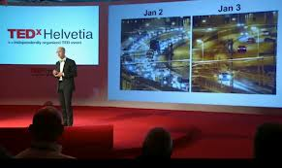
https://www.facebook.com/alon77g/videos/10155214023209581/?hc_location=ufi
Vehicle Traffic in Stockholm
תנועת כלי רכב בשטוקהולם

Slide 6
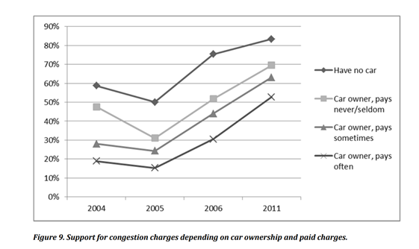

Slide 7

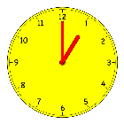
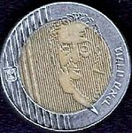








A Story to Illustrate the Improvement of Welfare from Congestion Tolls
Toll Improves welfare!
Waiting Time?
Welfare Improvement?

Slide 8
What is Behind the Public's Distaste for Congestion Tolls?
Lack of Understanding (the idea that demand is rigid and needs a "reasonable" alternative for any private car user who views "the price of the road" as a punishment, not a price for using the product)
Lack of sufficient alternatives
Fear of hurting the weak
Fear of another tax burden
The idea that transportation should be subsidized
Ignoring the improvement in public transport

Slide 9
What Happens if the Government Distributes Bread to the Public for Free?

Slide 10
Summary: The welfare of the public in Israel can be greatly improved
Road price (congestion toll)
Investment in transportation infrastructure
Removing barriers that prevent private market initiatives in the public / cooperative transportation sector

