Slide 1
Challenges of Economic Growth: How do narrow interests and ignorance dictate public policy
Omer Moav
January 2020

Slide 2
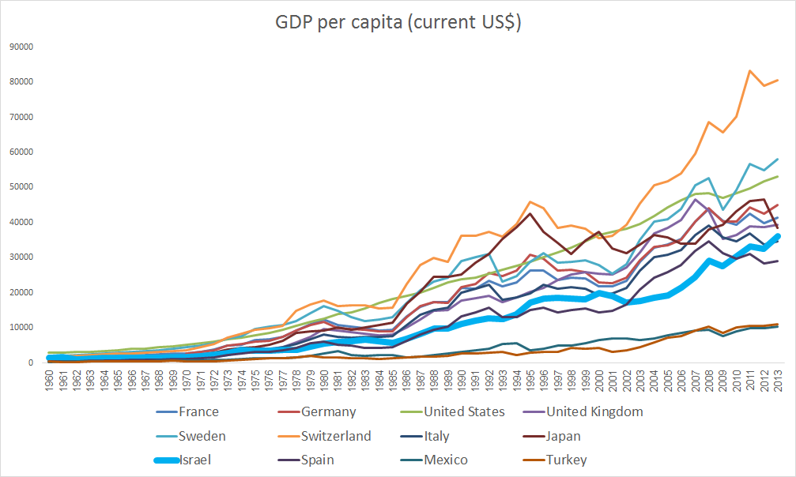
Israel: Can’t we be more successful?
מקור: הבנק העולמי

Slide 3
What Dictates Policy?
Survival….
And what about Ideology?

Slide 4
Policy: Objectives and Means
Objective: Welfare and Minimizing Poverty
Policy objective: Public welfare, with emphasis on improving the condition of the weak. Focusing on reducing poverty rather than reducing inequality.
The way: Increased labor productivity and lower consumer prices

Slide 5
Policy: Objectives and Means
Means:
1. Free International Trade
During the 1990s many products were made available for import: iron and steel for construction, chemicals, pharmaceuticals, fertilizers, film, tires and leather goods, footwear, ceramics, glass, motors, electrical conductors, textiles and more.
To this day, there are many barriers on imports, especially agriculture and food products. Barriers are not just quotas and taxes, they are also standards, regulation and bureaucracy, domestic produce preference and reciprocal procurement requirements in government and public tenders.

Slide 6
Policy: Objectives and Means
1. Free international trade
2. Flexibility in the labor market (revoking tenure)
3. Publicly Financed Private Schools (and vouchers)
4. Privatization / outsourcing
5. Reducing transport regulation and adopting congestion fees
6. Reducing tax rates and eliminating exemptions and benefits
7. Reducing the right to strike
8. And more reforms that increase economic freedom ...

Slide 7
Israeli Public Opinion:
69% of Israelis support a social-democratic approach to social services (investing in social services, raising the minimum wage)
20% identify more with the capitalist approach on economic and social issues
(Somewhat problematic survey by the Berl Katzanelson Foundation)

Slide 8
The Chicago Boys Reform in Chile
1. Free international trade
2. Focus on reducing poverty not inequality
3. Privatization of Government Companies
4. Labor market flexibility
5. Personal pension
6. Mining property rights
7. Parental authority in choosing schools
8. Freedom of choice in health
9. Private infrastructure
10. Independence of a central bank

Slide 9
 | 2010 © www.josepinera.com

Slide 10
The case of Sweden
(lecture by prof. John Hassler)
After a century of growth in the highest rate in the world, economic slowdown from the 1970s
Excess regulation
Marginal taxation at excessively high rates
Determining wages regardless of performance, inflation
Lack of enough competitiveness
Unsustainable budget policy
“Success breeds stupidity”

Slide 11
The Reform
Massive government spending cuts
Central Bank independence
Cutting corporate taxes, reducing marginal tax from 90% to 50%, expanding the tax base and consolidating value-added tax rates
New base wage agreement - based on export industries
Reform of the pension system - an existing system that does not place a burden on future generations
Large-scale privatization: trains, communications, taxis, schools, mail, electricity

Slide 12
Swedish Real GDP per capita relative to average of peers*
* AUS, AUT, BEL, CAN, DEN, FIN, FRA, GER, GRC, ICE, IRE, ITA, JAP, KOR, MEX, NTH, NEZ, NOR, POR, SPA, SWE, SWI, TUR, UK, US

Slide 13
Labor Unions in Sweden
From an interview in The Marker with the chief economists of the two largest labor organizations in Sweden:
"Increasing productivity and efficiency is the way to economic prosperity ... This is the way we want our economy to grow. It's the best way to get high wages for workers."
Notes:
קישור לראיון של גיא רולניק:
http://www.themarker.com/markerweek/thisweek/1.2262810

Slide 14
Labor Unions in Sweden
"Companies that can't afford to pay the bottom threshold of raising wages should disappear ... The idea is to save the sailor, not the ship."
Notes:
קישור לראיון של גיא רולניק:
http://www.themarker.com/markerweek/thisweek/1.2262810

Slide 15
Labor Unions in Sweden
"In the past, we had a textile industry, and it completely disappeared. We had shipyards, and we didn't have any more… It didn't lead to an increase in unemployment, but an increase in efficiency and productivity."
Notes:
קישור לראיון של גיא רולניק:
http://www.themarker.com/markerweek/thisweek/1.2262810

Slide 16
Labor Unions in Sweden
"It is not difficult to dismiss people in Sweden. Collective layoff, for example during a recession; is very easy to layoff."
"I don't think the tax system should be based on corporate taxes, and they shouldn't be a big part of the tax base, because they're very mobile."
Notes:
קישור לראיון של גיא רולניק:
http://www.themarker.com/markerweek/thisweek/1.2262810

Slide 17
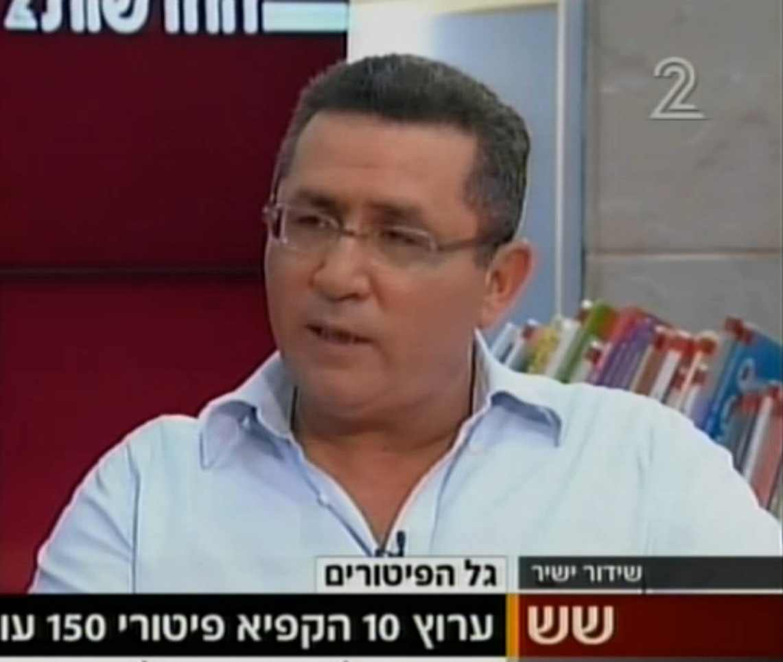
Labor Unions
Out of two interviews with Ofer Eini:
"... They want a free market, unrestrained competition, take the story of customs abolition: Once customs tariffs are eliminated, foreign products will be cheaper than products manufactured here, and then what happens, factories will lose, especially factories in the periphery, will have to close and dismiss workers. . "
"Take for example the communications market where they lowered prices and open the market to competition ... What do you think will happen in this industry? Already you see the first swallow of hundreds of people laid off, I think it will reach thousands of people ..."
Notes:
קישור לראיון אחד (שתי הנקודות הראשונות):
http://www.mako.co.il/news-channel2/Six-Newscast/Article-1b5d1dbfdce4931017.htm
והראיון השני (שתי הנקודות האחרונות):
http://www.globes.co.il/news/article.aspx?did=1000815380 לחפש מישהו מוורוויק, אנדרו אזוולד שכתב מחקרים Oswald
מסכם מחקרים, כתב שזה פוגע ביצירתיות מי צריך בטחון תעסוקתי תכלת

Slide 18
Labor Unions
"... We can make do with corporate tax rates higher than 25%. We didn't see that corporate tax cuts led to a revolution. They would take a few percent more of the companies and that would generate several billion more."
"... I will oppose any harm to workers, whether it is a training fund, a wage freeze or a reduction in wages. If the Prime Minister will choose that path and try to do what he did in 2003, he will encounter our resistance in full force.”
Notes:
קישור לראיון אחד (שתי הנקודות הראשונות):
http://www.mako.co.il/news-channel2/Six-Newscast/Article-1b5d1dbfdce4931017.htm
והראיון השני (שתי הנקודות האחרונות):
http://www.globes.co.il/news/article.aspx?did=1000815380 לחפש מישהו מוורוויק, אנדרו אזוולד שכתב מחקרים Oswald
מסכם מחקרים, כתב שזה פוגע ביצירתיות מי צריך בטחון תעסוקתי תכלת

Slide 19
International Trade

Slide 27
Import and Export
“And the most aggravating thing is the Minister of Finance’s “magic solution”: to enable import of dairy products. Flood the country with cheap dairy products from Turkey, from example. That would of course be a deadly solution, right off the cuff which will surely lead to factories closing and workers sacrificed at a fashionable alter like the cottage cheese uproar. The exact opposite needs to happen: No to import but rather encouraging and actively helping export of Israeli cottage chees and other products to Europe.”

Slide 29
Import and Export
Millions of Dollars
Export
Import

Slide 30
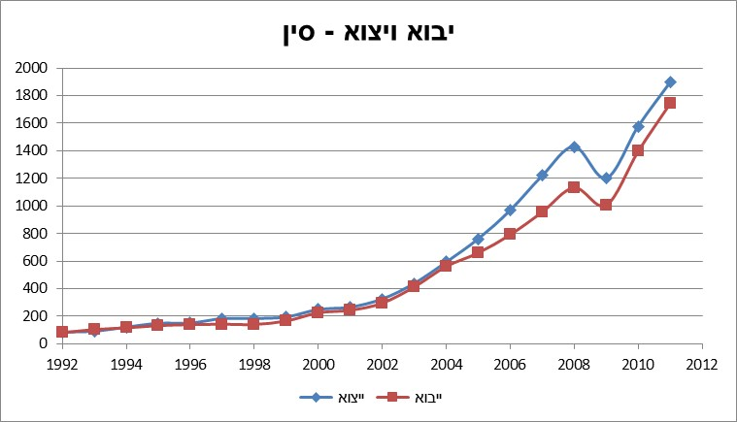
Import and Export
Import and Export - China
Export
Import
Source: United Nations Commodity Trade Statistics Database

Slide 31
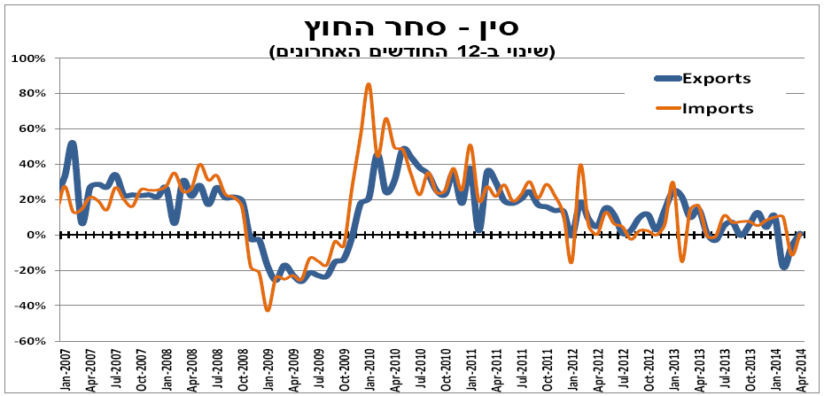
Import and Export
China – Foreign Trade
(change over the last 12 months)
Source: Weekly Macro-economic Overview, Harel Group Finance and Research Department

Slide 32
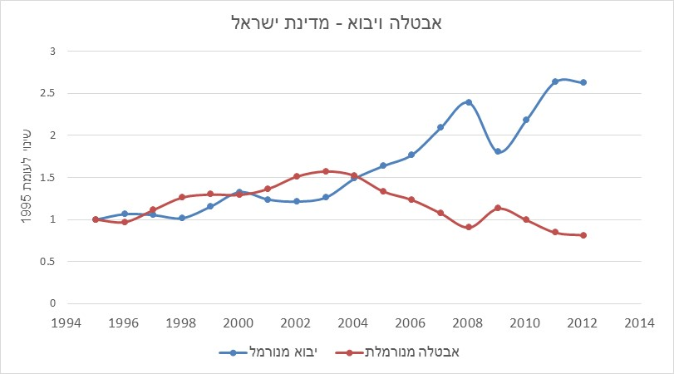
Import and Unemployment
“Unfortunately, just about every attempt to quantify the overall employment effect of trade is an exercise in futility. This is because the impact of trade on the total number of jobs in an economy is best approximated by zero. Total employment is not a function of international trade.” Irwin, Douglas. Free Trade Under Fire. Princeton University Press, 2009. p. 104.
Import and Unemployment
Change in Relation to 1995
Normalized Import
Normalized Unemployment
Source: CBS, Bank of Israel

Slide 33
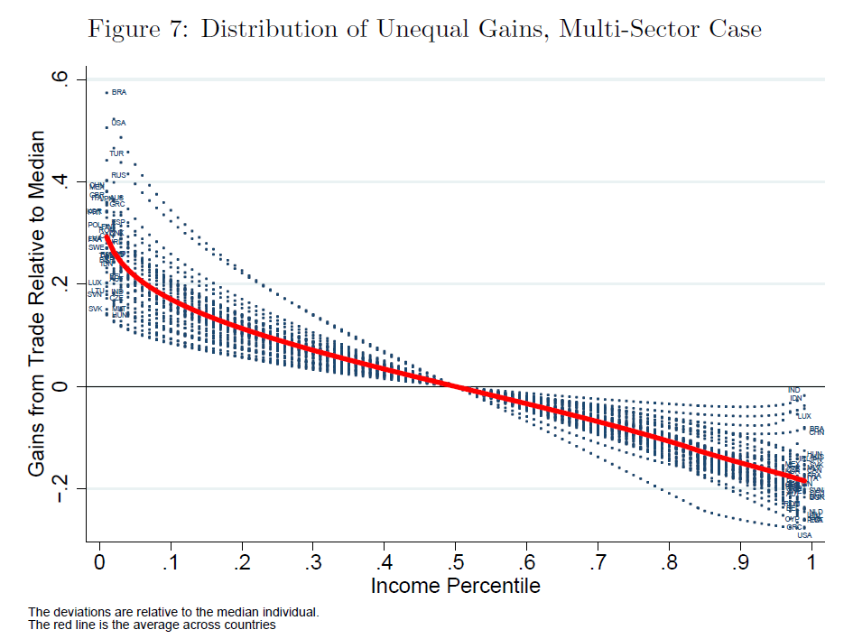
Who Gains from Import?
Poor people benefit from much richer commerce, especially in countries with high inequality.
According to recent studies, the gain of the poor as consumers outweigh the potential damage to their wages as a result of opening up the economy to trade.
Source: Khandelwal, A., & Fajgelbaum, P. (2013). Measuring the Unequal Gains From Trade. In 2013 Meeting Papers (No. 456). Society for Economic Dynamics.

Slide 34
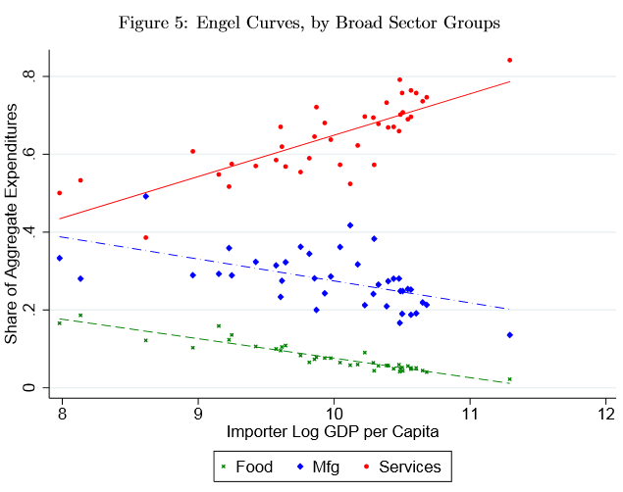
Who Gains from Import?
Main reason for the result: access to cheap imported products.
Poor people are more likely to consume (relative to their income) marketable products whose prices fall as the economy opens for imports.
Source: Khandelwal, A., & Fajgelbaum, P. (2013). Measuring the Unequal Gains From Trade. In 2013 Meeting Papers (No. 456). Society for Economic Dynamics.

Slide 35
How to “Grow Hondas”
There are two ways to make cars. We can build them in Detroit, or we can grow them in Iowa. To grow cars, we first grow the ingredients they are made of - wheat. We put wheat on ships and ship them to the ocean. When the ships return, they already have Hondas on them. Growing Hondas is a form of production- we use American farmers instead of American car components to build them.
What happens on the other side of the ocean is irrelevant; The effect would be the same for us if there was a machine in the heart of the ocean turning wheat into vehicles.
Protective Customs are indeed a way to protect American workers - from other American workers.
David Friedman - "Hidden Order"

Slide 36
Parking and Transportation

Slide 42
Housing

Slide 43
Housing Prices
Subject | Israel | OECD | Difference
Stages in receiving a construction permit | 20 | 16 | 25%
Construction permit process duration | 235 days | 166 days | 42%
Cost of receiving a construction permit as a percentage of the annual income per capita | 104% | 62% | 68%
Stages in property registry | 7 | 4.8 | 46%
Duration of property registry process | 144 | 33 | 336%
Cost of asset registry as a percentage of the property value | 5% | 4.4% | 14%
Real Estate Taxes as a percentage of the GDP | 3.2% | 1.8% | 78%
Real Estate Taxes as a percentage of all tax | 9.4% | 5.4% | 74%
Source: Doing Business project; World Bank
Notes:
מקור – פרויקט doing business של הבנק העולמי:
http://www.doingbusiness.org/

Slide 44
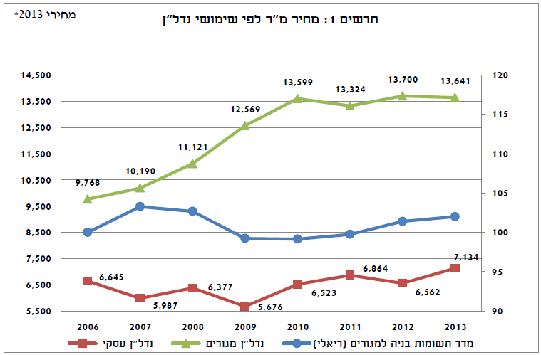
Housing Prices
2013 Prices*
Figure 1: m2 price for Real Estate purposes
Commercial
Residential
Index of Residential Construction Inputs
מקור: יורי שרמן, אנה אייזנברג-בן לולו, "האם לרשויות מקומיות יש תמריץ שלילי להגדלת האוכלוסייה בשטחן?", מכון גזית גלוב לחקר נדל"ן, המרכז הבינתחומי הרצליה 2014

Slide 45
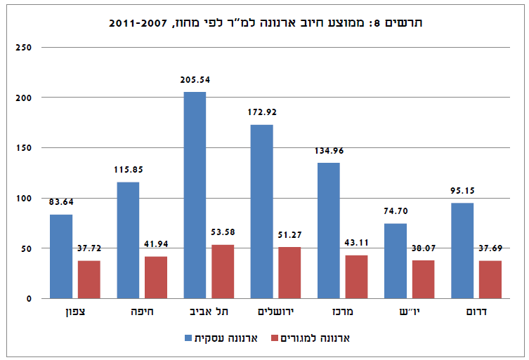
Housing Prices
Figure 8: Average Property Tax Rate per m2 by District 2007-2011
North
Haifa
Tel Aviv
Jerusalem
Center
Judea & Samaria
South
Business Property Tax
Residential Property Tax
מקור: יורי שרמן, אנה אייזנברג-בן לולו, "האם לרשויות מקומיות יש תמריץ שלילי להגדלת האוכלוסייה בשטחן?", מכון גזית גלוב לחקר נדל"ן, המרכז הבינתחומי הרצליה 2014

Slide 46
Average Annual Household Income and Expense by City 2006-2011
Bnei Brak
Bat Yam
Givatayim
Herzliya
Holon
Kfar Saba
Netanya
Ra’anana
Rishon LeZion
Ramat Hasharon
Hod Hasharon
Ramat Gan
Tel Aviv-Yafo
2013 Prices*
Income
Expense

Slide 47
Housing Prices
"A few years ago, and you my fellow ministers remember that, we said, and I said in the south, 'Buy apartments - not only in Be'er Sheva, buy apartments also in Dimona, Yeruham, buy apartments.’
PM Netanyahu (December 2016) for his predictability of his government's failure to curb housing prices

Slide 48
Housing Prices
“There are some economists… who object to reducing VAT. That’s fine because VAT reduction is not meant for economists…”
(Yair Lapid justifying his plan for 0 VAT on apartments)
“In the end, they will go down too, just as an elevator is bound to go down as well”
(Moshe Kahlon, proving that housing prices will go down)
Notes:
הציטוט – מעמוד הפייסבוק של יאיר לפיד

Slide 49
Housing Prices
Zero VAT
Buyer’s Price Program
Third Apartment Taxation

Slide 50
Rent Regulation
Shortage
Bad Maintenance
Black Market
Destruction of the rental market
Compromising employment mobility

Slide 51
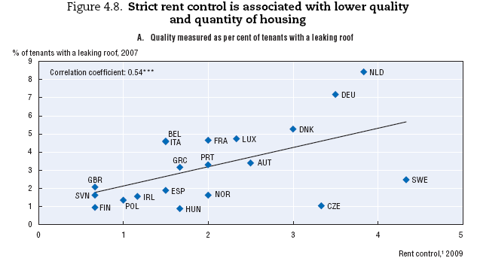
Rent Regulation
Source: Andrews, D., Sánchez, A. C., & Johansson, Å. (2011). Housing and the economy: policies for renovation. Economic Policy Reforms 2011: Going for Growth. OECD
Notes:
מקור:
דוח OECD שהורדתי, www.oecd.org/dataoecd/42/11/46917384.pdf
Andrews, D., Sánchez, A. C., & Johansson, Å. (2011). Housing and the economy: policies for renovation. Economic Policy Reforms 2011: Going for Growth. OECD

Slide 52
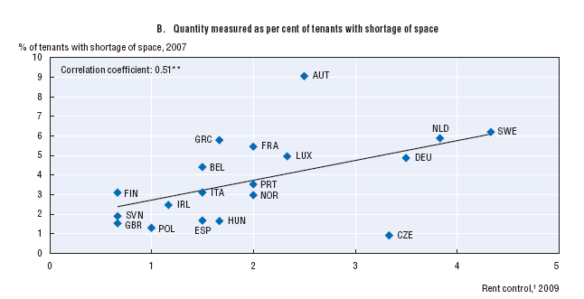
Rent Regulation
Source: Andrews, D., Sánchez, A. C., & Johansson, Å. (2011). Housing and the economy: policies for renovation. Economic Policy Reforms 2011: Going for Growth. OECD
Notes:
מקור:
דוח OECD שהורדתי, www.oecd.org/dataoecd/42/11/46917384.pdf

Slide 53
Rent Regulation
Source: Andrews, D., Sánchez, A. C., & Johansson, Å. (2011). Housing and the economy: policies for renovation. Economic Policy Reforms 2011: Going for Growth. OECD
Notes:
מקור:
דוח OECD שהורדתי, www.oecd.org/dataoecd/42/11/46917384.pdf

Slide 54
Rent Regulation
“There are, effectively, two rental markets in Manhattan. Roughly half the apartments are under rent regulation, public housing or some other government program. […] most housing programs tie government support to an apartment unit, not a person. […] It creates enormous incentive for people to stay in apartments that no longer fit their needs […]. […] those who are lucky enough to have a rent-regulated apartment can live in the best parts of the city for next to nothing and everyone else is shunted aside.”
Notes:
מקור:
http://www.nytimes.com/2013/07/28/magazine/the-perverse-effects-of-rent-regulation.html?pagewanted=all&_r=2&

Slide 55
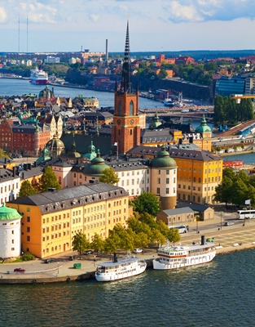
Rent Regulation
“A charming one-bedroom apartment in what may be Stockholm's trendiest neighborhood for a mere 410 rent-controlled euros a month: sound too good to be true? It is.
And the catch was steep. To lay his hands on the rental contract, Johannes, a 36-year-old engineer, had to pay a whopping 130,000 kronor (15,000 euros) under the table.
Notes:
שבדיה:
http://www.swedishwire.com/economy/5978-stockholm-egalitarian-rental-boost-black-market

Slide 56
Rent Regulation
Berlin: Market Forces Are Challenging Affordable Housing
While Israel praises the rental system in Berlin, the lack of affordable housing in the city reaches half a million apartments and is growing at the rate of 4,500 a year, while rents in the free market are also rising rapidly.
Although the regulator is trying to tackle the problem, it is unable to preserve the affordable housing ideal in the city
16:30 I 26.04.2014 I By Avi Goldberg
"... The hot spot of the Berlin housing market is apartments vacated due to tenants' leaving. Here, the owner of the apartment may pay higher rent, as they see fit and according to the rules of the free market (...) Property owners do a lot to get renters out of the apartments in order to sell them at market prices or rent them at free market prices.
Usually, apartment owners exert economic pressure, inter alia by installing improvements in the apartment, mainly in the area of energy savings, thus placing the tenant a financial burden - which is reflected in compulsory participation at the rate of 11% of the costs, or alternatively negotiating a one time eviction fee for leaving the apartment.”
Notes:
ברלין:
http://www.themarker.com/realestate/1.2304284

Slide 57
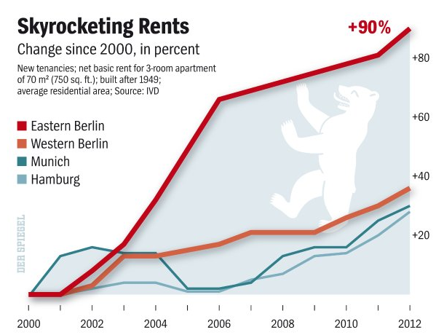
Rent Regulation
מקור: Spiegel online international
Notes:
מקור:
http://www.spiegel.de/international/germany/bild-859420-408913.html
להוסיף שקף על דמי מפתח, ועל ניו יורק, בנו יותר בתי יוקרה

Slide 58
Israel – The Landlord and Tenant Law 1954
A dreadful law that transferred assets from landlords to tenants, thus leading to neglect and further damage to the rental market.
Bad laws are hard to repeal…

Slide 59
“In many cases rent control appears to be the most efficient technique presently known to destroy a city—except for bombing.” Assar Lindbeck
Economic Sciences Nobel Prize Laureate;
And Architect of the Swedish Welfare State, Karl Gunnar Myrdal:
“Rent control has in certain Western countries constituted, maybe, the worst example of poor planning by governments lacking courage and vision.”

Slide 60
“A Rent Affair” PAUL KRUGMAN
“Sky-high rents on uncontrolled apartments, because desperate renters have nowhere to go -- and the absence of new apartment construction, despite those high rents, because landlords fear that controls will be extended? Predictable.”
“Bitter relations between tenants and landlords, with an arms race [] to force tenants out [] and constantly proliferating regulations designed to block those strategies? Predictable.”

Slide 61
Financial Press in Israel?
"Calcalist" "The Regulation that Could Benefit with the Tenants.
About six months too late, the Treasury and Ministry of Justice are preparing the Fair Rental Memorandum [] if the law were implemented in 2011, renters would save on price increases of about 20%.
"Globes" "A new bill purports to transform apartment rental"
The article presents only the claims of the bill's supporters
"The Marker" "Experience in the world shows: Rent control can also hurt renters"
The content of the article mainly presents the propositions of the law but also the reservations

Slide 62
YNET
"A fair rent bill will create stability and fairness in the rental market," Lapid said today. "With its help we can provide tenants with certainty about the price of their apartment for more than a year, we can make sure that the leased apartments are worthy of living. We will encourage the establishment of a rental registry - which will contain a database of lease agreements."
Minister of Justice Tzipi Livni added: "The law stipulates that a worthy residential apartment should be more than 26 square meters in size, with running water, electricity, sewage, []."

