Slide 1
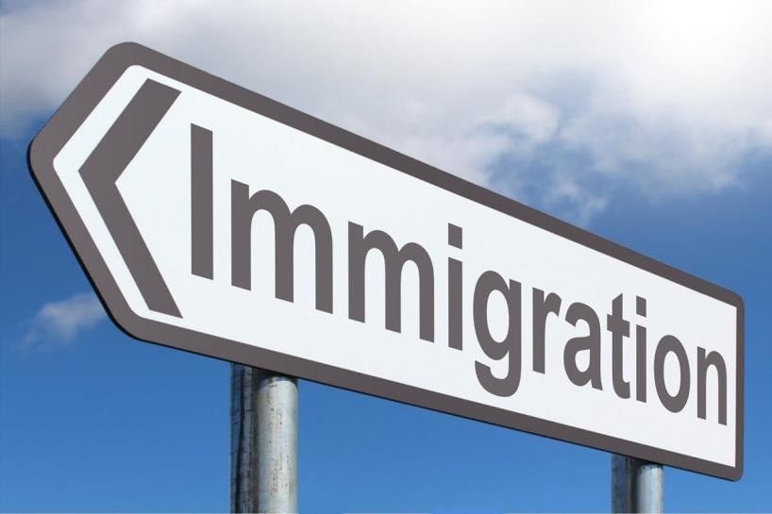


Migration and Mobility
Prof. Karin Amit
Head of the Masters program in Migration and Social Inclusion
Ruppin Academic Center
INDC October 2019

Slide 2

Who is a Migrant?*
Migrant - according to the UN, a migrant is a person who lived
In a foreign country (not born in it) over one year regardless of the motives for moving and the circumstances.
There is no clear consensus on the concept (the period, motives).
"Migrant" is a concept that includes various types of internationals transitions
(asylum seeker / refugee, a migrant in the Israeli context, working immigrant, etc.)
By this general definition, according to the UN, there are currently a quarter of a billion migrants in the world

Slide 3



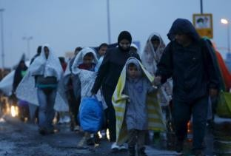
The classic distinction between types of migrants relies on the motivation For migration:
Definitions of Migrants
Economic migrant- leaves the country of origin to the destination country
Freely chosen to improve his quality of life and financial condition
(May be documented / legal or not, skilled migrant worker / not).
Asylum seeker or Refugee-
A refugee is an asylum seeker that has proved to be in a life threatening situation as a result of persecution due to race, religion, nationality, political outlook, affiliation with a specific social group or as a result of wars and conflicts in their country of origin. This definition of the refugee status by the UN does not apply to
Cases of natural disasters or economic crises.

Slide 4
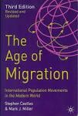

International Migration
According to Castles & Miller (2013), in their book "Age of Migration" we are in the midst of a new era - the era of migration.
It could be said that this era began after World War II came to an end, with industrialization increasing in the Western world and increasing capital - which led migrant workers and refugees to move from less developed countries to developed countries:
USA, Canada, Australia and European countries.

Slide 5
The basic models for understanding the phenomenon of migration were economic models developed in the US.
Migration and Economic Mobility
The focus of the models was "economic migrants" and their integration test was
In economic terms and with emphasis on the labor market. The questions examined in this regard:
At the micro level:
How many years since migration (YSM) are required for a migrant to reach the same salary as the wage of a native with the same qualifications?
What variables contribute to reducing the labor market gap between the migrant and the native? Language, education, relevant skills, etc.

Slide 6

At the macro level:
Migration and Economic Mobility
To what extent do migrants (from different groups) contribute to the destination country's economy (economic growth, at the level of specific occupations / branches)?
To what extent do migrants (from different groups) contribute to the origin country's economy (sending funds - remittances, international business relationships)?

Slide 7


Migration and Economic Mobility
The assumption in these models is that the economic migrant pays an economic and social price upon arrival in the destination country (USA), which is expressed at relatively low levels of salary upon arrival. The migrant believes it will pay off and has the motivation to succeed– every year in the destination country improves their status…
Findings from studies up to the late 1970s reinforced these claims and led to a very optimistic view of the economic integration of international migrants in the US and the entire world (Chiswick, 1979).

Slide 8

Migration and Economic Mobility
Sociological models dealing with understanding the social mobility of migrants through the migration time variable:
The melting pot model
The ethnic continuum model
Standing In line model
The flood model

Slide 9


The Melting Pot Model
American model "The Melting Pot" - the melting pot, also called the assimilation model in the professional literature.
This model expresses a thinking that migrants are expected to assimilate during their life in the new country and no differences should be found between them and the natives within a generation (up to 25 years) in the labor market or society.

Slide 10


Immigration Time - The Ethnic Succession Model
The ethnic succession model “Succession - Model” refers to the ethnic stratification as representing the order of arrival of the various groups to the receiving country and the perception that “the early bird gets the worm".
According to this dynamic model, ethnic stratification is created by migration waves as each new ethnic group is absorbed at the bottom of the employment ladder and receives the least rewarded and sought-after positions. Ethnic groups already in the system are pushed upwards with the introduction of a new group.
Hence, the status of each group corresponds to its time of arrival in the destination country.

Slide 11


Migration Time –
The Queuing Model
According to this model, the time has come for the
According to this model, there is a significance to the timing of the migrant’s arrival, but the argument is that he can change his position in the “queue“ according to his characteristics and skills.
Hence, migrants with higher socio-economic characteristics (education, profession) can change their position in the queue.
The importance of the characteristics can vary according to periods and the situation of the receiving society. For example: In certain periods, there may be a preference for certain professions (for which the queue is shortened) and not others.

Slide 12


Migration Time –
Flooding Model - Overflow
A model that focuses on migrants arriving during mass migration periods, as part of a large migration overflow ("flooding" of immigrants).
Migrants arriving as part of the migration overflow are pushed to the bottom of the social ladder (regardless of their qualifications).
As soon as these migrants come and go to the bottom - there are opportunities for advancing and improving the social status of veterans.

Slide 13


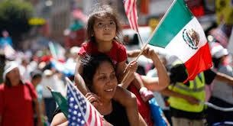
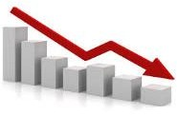
Migration and Mobility - the Policy Aspect
The US immigration policy of 1920 is based on the introduction of quotas by countries, mainly European countries. Some of these migrants are refugees from European wars. During this period, most immigrants are from Europe.
Changing policy to family unification policy in 1965 changes the profile of immigrants (immigration to Hispanic, African, and Asian immigrants), and so does their economic integration pattern - less successful.

Slide 14

In 1990, the United States adds a policy based on qualifications.
Migration and Mobility - the Policy Aspect
Recently, the Trump administration has introduced a number of regulations that restrict entry and retention of skilled migrants as well:
H-1B work visa restrictions that allow hiring of non-citizen experts
Restricting green-card acceptance based on economic integration prospects

Slide 15


Migration and Mobility - the Policy Aspect
Canada, until the 1960s is an immigration country that mainly absorbed British and French immigrants. In 1966 the policy changed to a point system based on skills (education, language, profession) and wealth.
Australia, a country that, until 1973, gave priority to British and Europeans and advocated "White Australia" policy - changed its policy and allowed immigrants to enter without ethnic restriction, similar to Canada - a skills-based method.
These countries, like the countries that sign the UN Refugee Convention 1950, receive defined refugee quotas each year.

Slide 16



Migration and Mobility - the Policy Aspect
The US, Canada, and Australia are classic migration states. Immigration is seen as part of their ethos (in various variations).
Canada and Australia also have a demographic realization that immigrants are indispensable to economic and social development. In these countries there is a "multicultural" policy that requires socio-cultural reference to minority groups and immigrants.

Slide 17



Do immigrants integrate?
Migration and Economic and Social Mobility
The classic immigration countries: The US, Canada and Australia have accumulated evidence over the years from numerous studies on:
The positive economic contribution of migrants (at the macro level).
Successful economic integration of migrants (at the micro level).
However, and especially in the later waves of immigration, which also include undocumented migrants and asylum seekers, there is also evidence of:
Socioeconomic difficulties that certain groups of migrants have.
These difficulties persist even in the second and third generation of migrants.
Alongside the difficulties and differences on an economic basis, socio-cultural differences are reinforced.

Slide 18

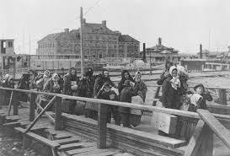
Migration and Economic and Social Mobility
What is happening in Europe?
For many years European countries were mainly countries from which migrants left to the classic migration countries.
The significant departures were of European refugees as a result of wars and conflicts in Europe.
And economic migrants who wanted to enter a new world of opportunity.

Slide 19

Western European countries become target countries for migrants with the end of the Second World War (1945):
Migration in Europe - Policy Aspects
1. “Guest” workers migration - from the periphery of Europe (Middle East, Ireland and Finland) to Western Europe. Most of them are young men that were recruited for rehabilitation projects after the war, with the assumption that they are temporary.
2. Immigration of former colonial workers. Some held citizenship of the target country and some arrived illegally.
Despite the temporary intentions and lack of "migration ethos" in European countries - some of the migrants and their families settled in Europe (chain migration).

Slide 20
Migration in Europe
In the early 1970s, globalization accelerated and brought about global economic changes.
There was an increase in the number of migrants to specific countries in Western Europe and Scandinavia (Turks and migrants from the former USSR to Germany, Muslim migrants to Sweden and Denmark etc.).
At the same time, a second generation and a third generation of migrants are emerging in Western European countries and we see more research evidence of social and cultural economic difficulties in taking them in.

Slide 21

Migration in Europe
Since the 90's:
There is a significant decline in birth rates in European countries
Increase in life expectancy - population aging
Accelerated economic development of various European countries
(And becoming a "European Union" )
An increasing economic need of European countries for migrant workers
The desire of migrants (migrant workers and refugees) to immigrate to Europe

Slide 22
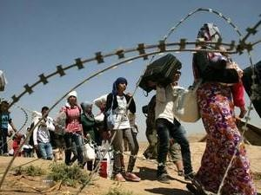
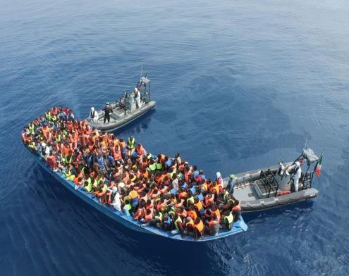
Over the past decade, and in an accelerated manner in the last six months, as a result of wars / conflicts / economic difficulties in the Middle East and Africa
Migration in Europe
A flow of asylum seekers / refugees from the Middle East (Iraq, Syria) arriving either by land or by sea
An influx of migrants (asylum seekers and economic migrants) (from Africa - usually by sea)

Slide 23
Although most European countries are members of the "EU"
And signed on various treaties (the Schengen Treaty for Free Movement, the United Nations Refugee Convention, the Dublin Charter for the Responsibility of the First Safe State to which the Asylum Seeker Arrives, etc ..)
Migration in Europe - Policy Aspects
Each of the European countries has an independent immigration policy along with different integration / absorption conditions for migrants.
One of the major challenges facing Europe - reaching consensus on immigration policy - in light of current and future global changes.

Slide 24
In 2015, there was a peak in immigration to Europe (flooding migration) following the crisis in Syria.
Migration in Europe - Policy Aspects
Germany has taken an open approach to accepting asylum seekers. But German and European public opinion on the issue has led to a significant change in attitude.
Some of the solutions currently offered in discussions between European countries to address the burning issue - are economic and military solutions outside Europe:
Increasing money flow and economic involvement in African countries that send migrants (The Malta Convention).
Military involvement in Middle Eastern conflicts.
Economic agreement with Turkey to prevent the entry of migrants through it

Slide 25
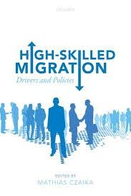
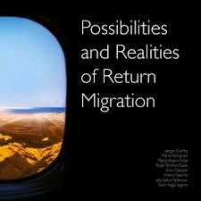
Migration and Economic Mobility
Keep in mind that many European countries along with other countries in the world (Japan, Canada) are in demographic distress and need migrants.
There are attempts to attract (and compete) for migrants from a particular profile.
There are attempts to recruit migrants from the diasporas.

Slide 26



Migration and Mobility – Trans-national Migration
Halfway in halfway out…
Trans-national immigration refers to the tendency among migrants, especially in recent decades, to maintain ties / affiliation with their country of origin in parallel with their integration into the target country (Bartram, Poros & Monfort 2014)
Maintaining ties with the country of origin is made easier by accelerated globalization processes and the development of advanced technological means (transport, telephone and internet).

Slide 27


Migration and Mobility – Trans-national Migration
Halfway in halfway out…
There are a number of transnational patterns in the labor market that are challenging the economic and social mobility of migrants:
Multi-local Migrants: The migrants who work (physically) in their country of origin and live on the line between the destination country and the country of origin-- basically managing a life in more than one geographical location.
Trans-national Migrants: Different employment patterns of migrants connecting the country of origin to the destination country.

Slide 28
Transnational Migrants- and Ethnic Economics:
Migration and Mobility – Trans-national Migration
Halfway in halfway out…
Ethnic business in ethnic enclaves (China Town)
Economy "dominated" by an ethnic group - it is the dominance of an ethnic group (migrants) in a particular sector without being the "owners".
For example, doctors of Indian origin in the United States and the United Kingdom, dominance of migrants from the USSR in the nursing professions, therapists from the Philippines in different countries, etc.
Sending funds to your country of origin (remittances)
Providing service to the audience in the country of origin - employment (physically in the target country within organizations / affiliates from the country of origin and providing service to the audience in the country of origin)

Slide 29

Sending money to the country of origin (remittances) World Bank data
Migration and Mobility - Transnational Migration
Halfway in halfway out…
Migrant remittences inflows US$ million
800,000
700,000
600,000
500,000
400,000
300,000
200,000
100,000
-

Slide 30

Transferring Funds from the Receiving Country to the Country of Origin- Remittances
According to data from the World Bank, there were 690 $ billion migrant money transfers in 2018
For developing countries these funds account for a significant percentage of their GDP (India, China, Philippines, Mexico etc.)
World Bank calculators:
http://www.worldbank.org/en/topic/migrationremittancesdia 
sporaissues/brief/migration-remittances-data

Slide 31

The many expressions of trans-national migration and the vast amount of information that the public is exposed to regarding immigration worldwide - challenges the basic discussion of questions that many immigration scholars have dealt with:
Immigration and Mobility in the Global and Trans-national Era
What is the right way of defining a “migrant” today?
Are in the current period created from different migration positions (More desirable and less)?
How to measure migrants mobility correctly?
31

Slide 32



