Slide 1
Lecture to INDC Participants – March 2020

Slide 2
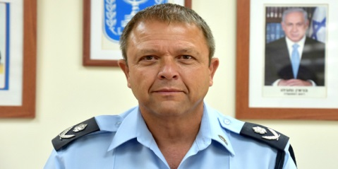
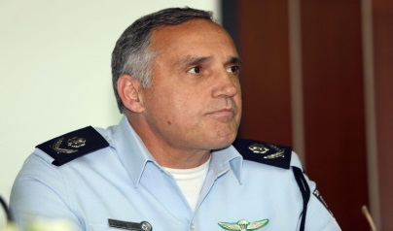
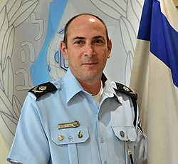
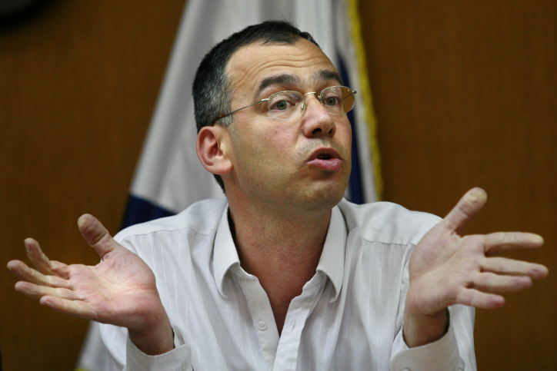
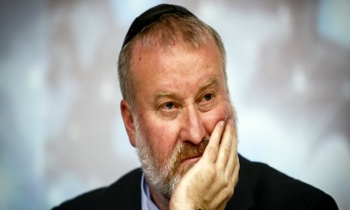
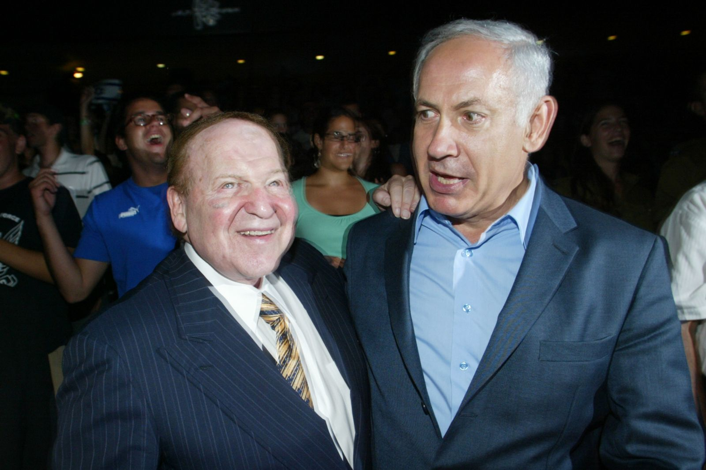
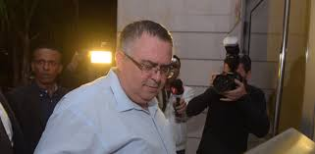
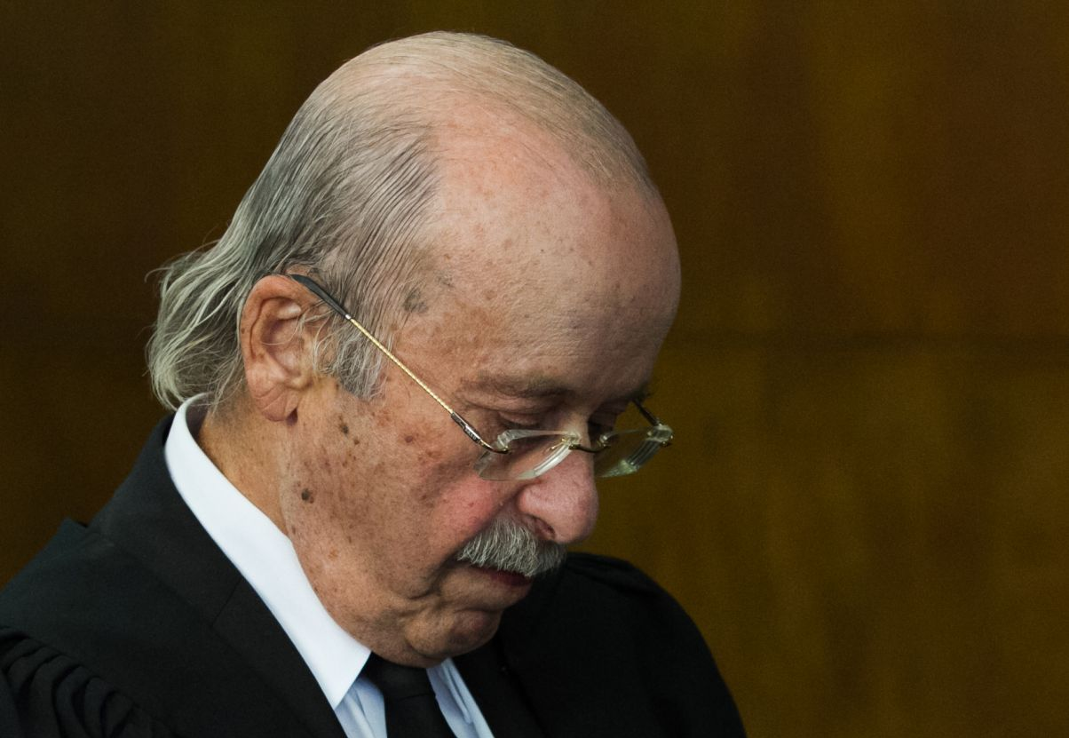
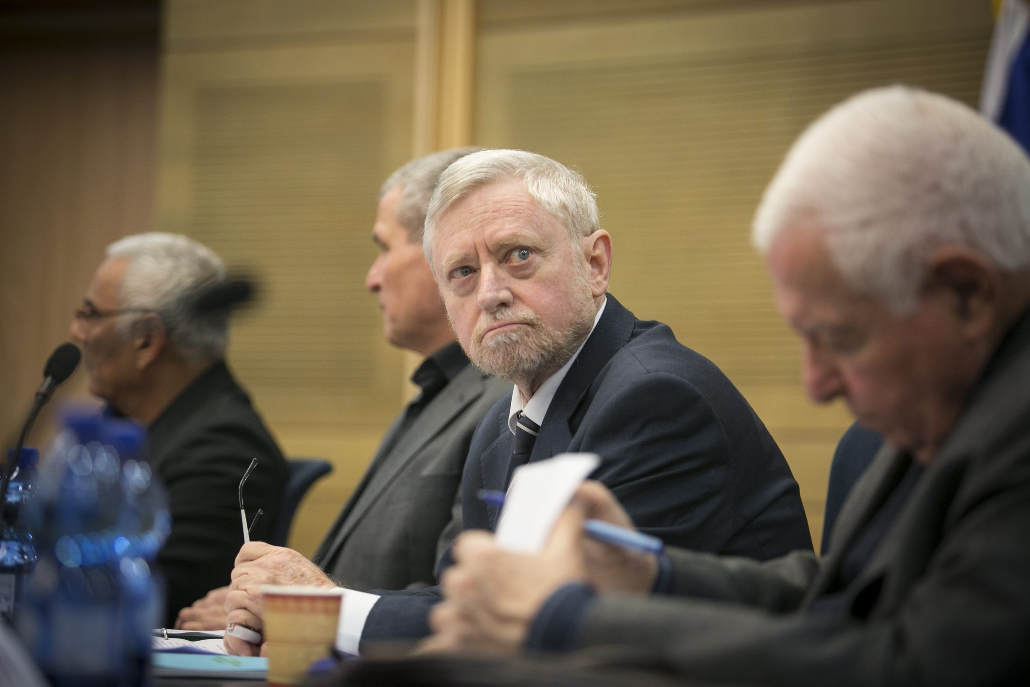
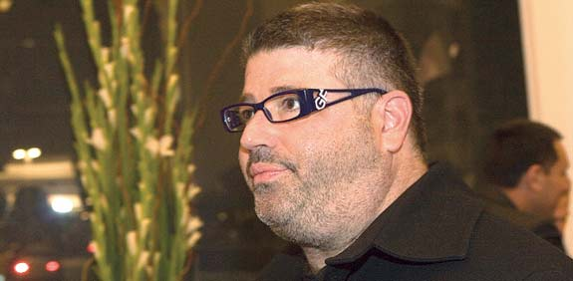
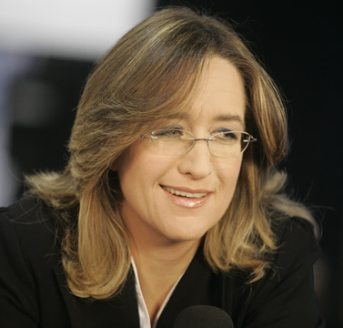
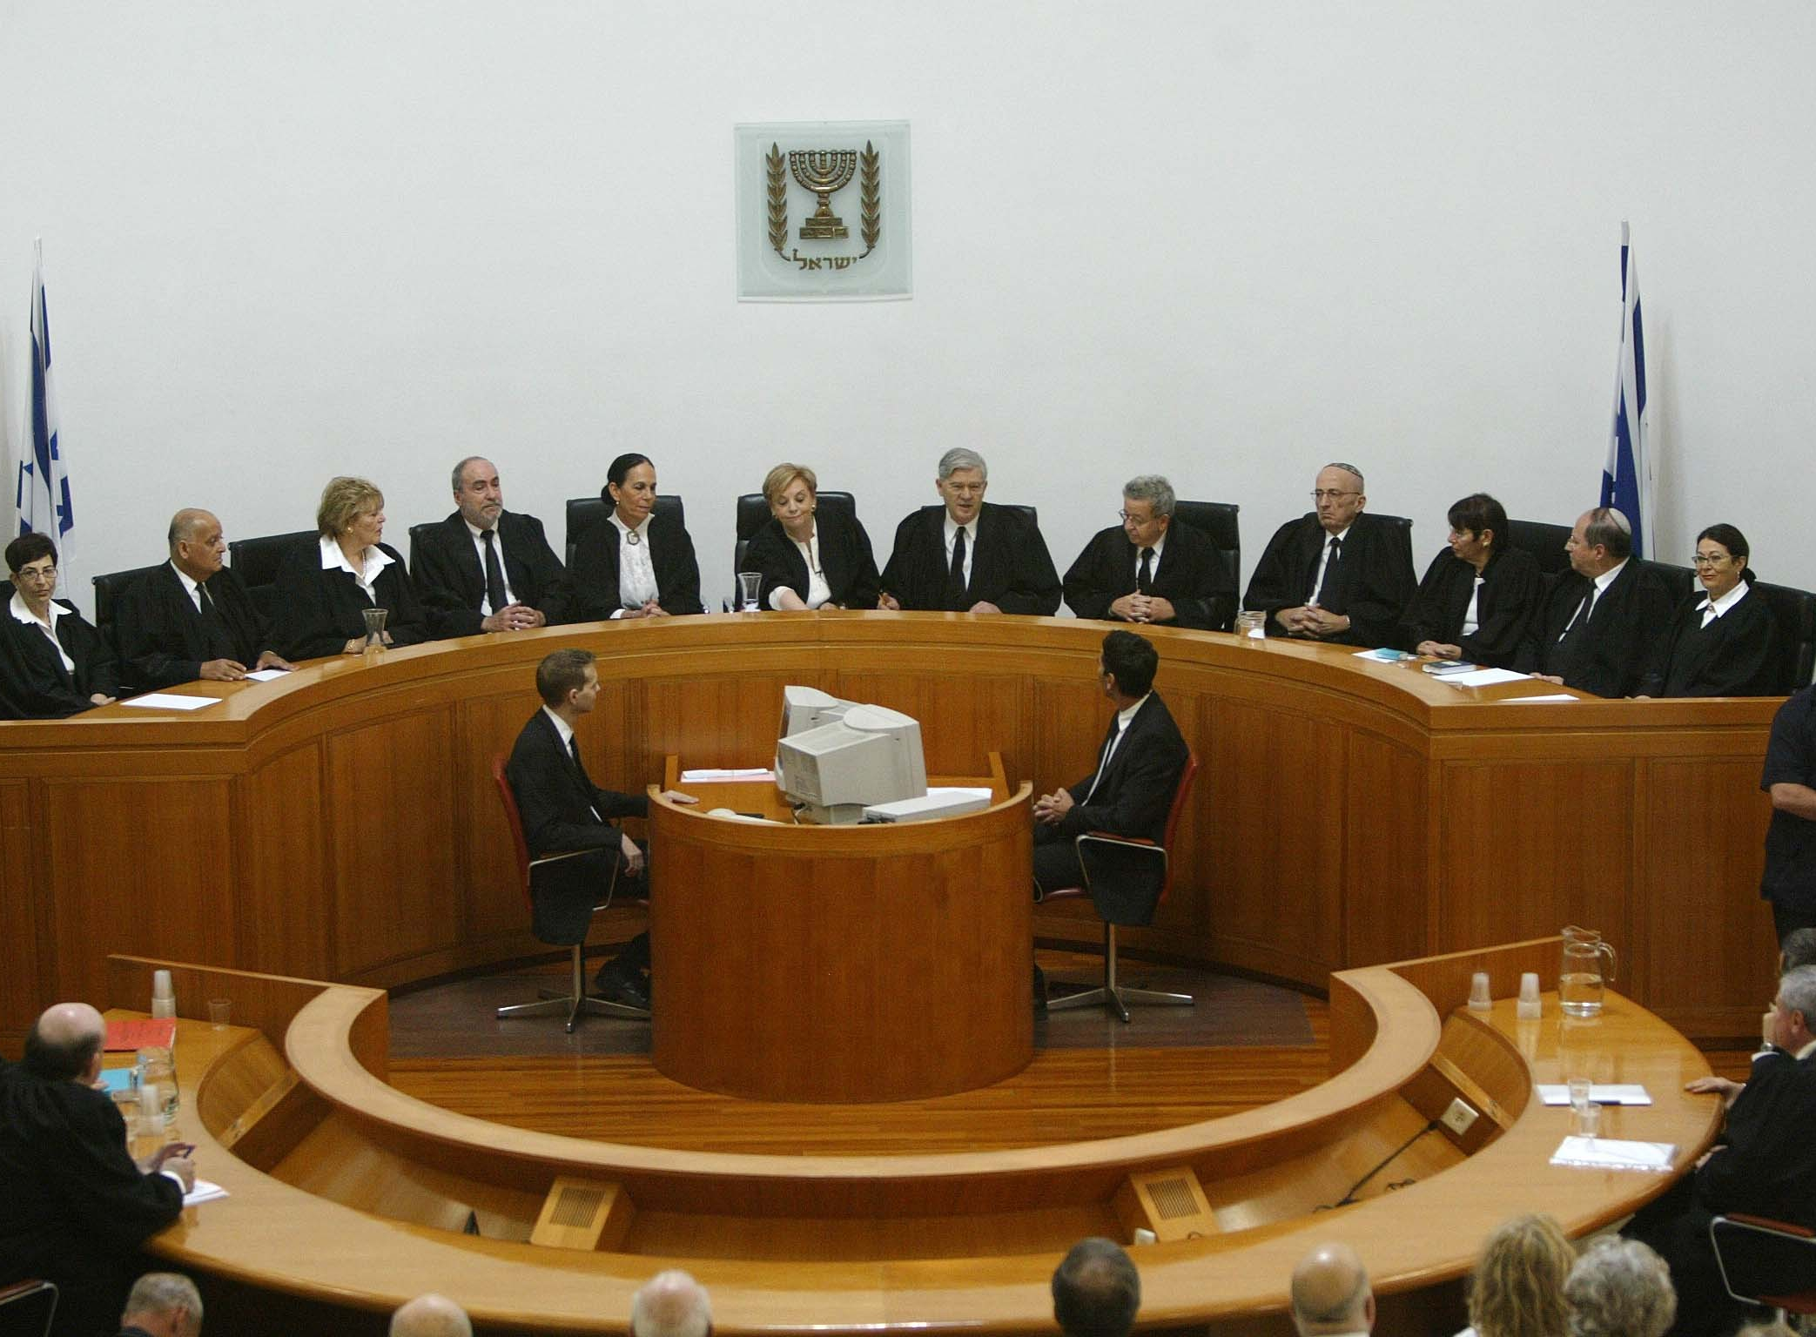
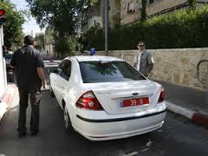
Workspace in Public
Corruption Cases

Slide 3
National Corruption Investigation Unit
Objective
Reveal, Discover and Investigate Fraud and Corruption in the Public Administration

Slide 4
The Functions of the National Corruption Investigation Unit
Exposure and investigation of public corruption cases that violate ethics (Bitan).
Disclosure and investigation of economic offenses in economic bodies in the business sector and the capital market (Check List).
Investigation of unique events and offenses whose investigation requires special expertise (Versailles).
Investigation of bribery and transnational fraud outside the borders of Israel (bribery of a foreign public servant).
Investigation of large-scale money laundering offenses (Task Force).
Offenses that the Inspector General/ Director of VIPs/ Attorney General/ State Attorney instructed the police to investigate because of the sensitivity and/ or complexity of the investigation (Effi Nave).

Slide 5
Topics of Interest
יאח"ה
Central Government Corruption
Local Government Corruption
Sensitive Investigation Files
Public Figures
Money Laundering
Bribery of a Foreign Public Servant
Search for the truth

Slide 6
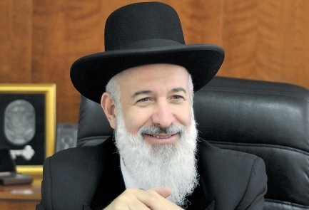
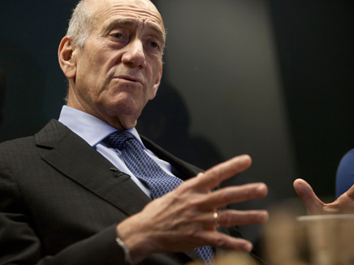
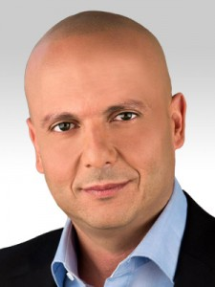
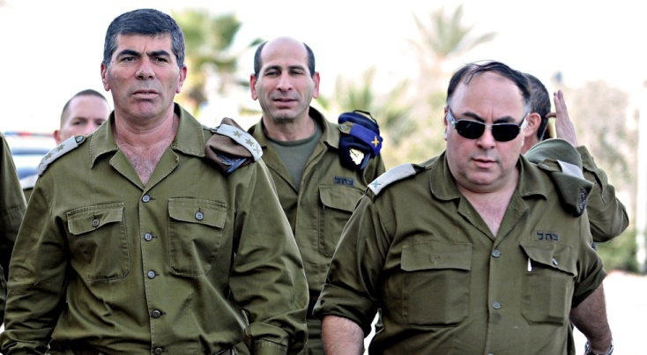
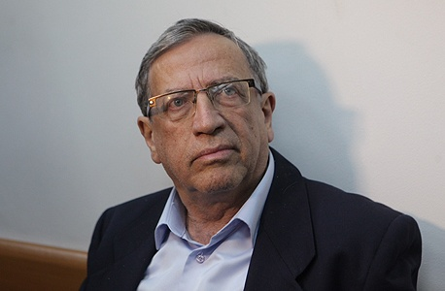
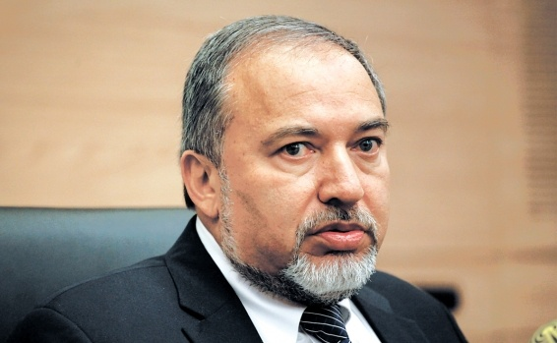
Investigation of Senior Public Figures

Slide 7
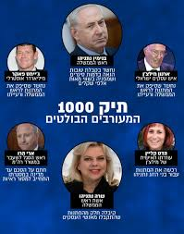
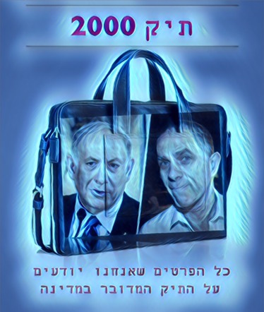
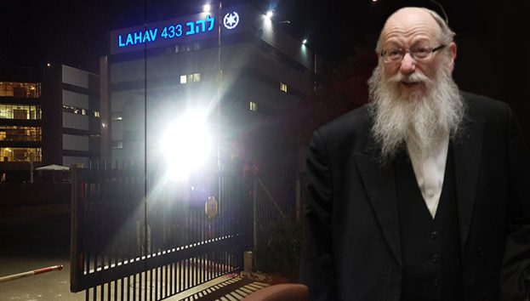
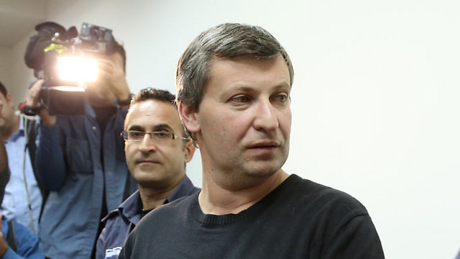
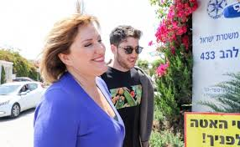
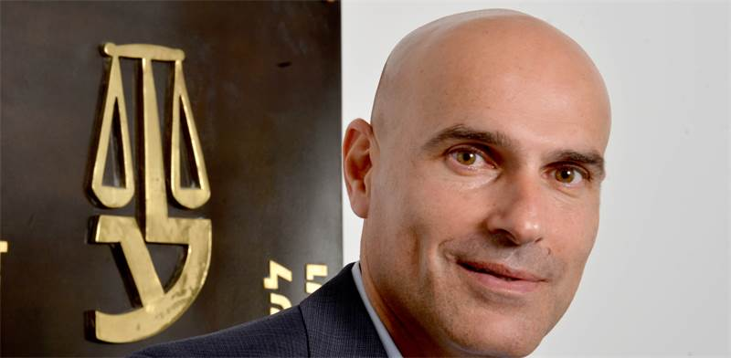
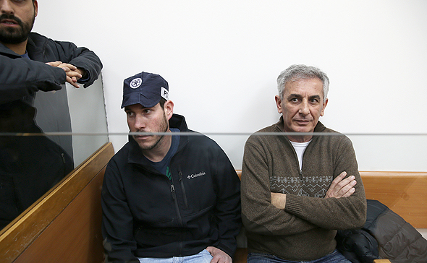
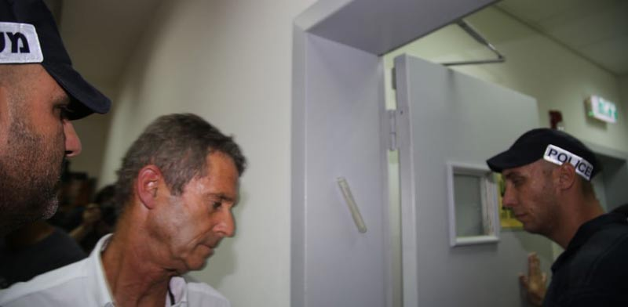
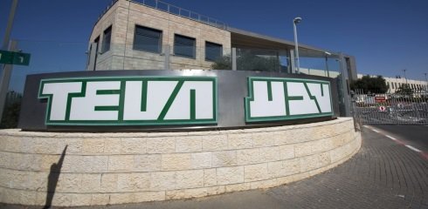

Slide 8
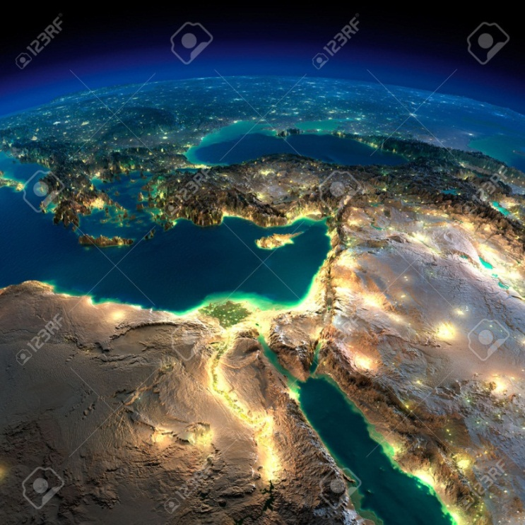
Following Israel's signing of the UN Convention against corruption and in accordance with the OECD Convention on the War on Bribery of Foreign Public Employees in International Transactions, in July 2008, section 291A of the Penal Code, which prohibits bribery of foreign public employees, was added.

Slide 9
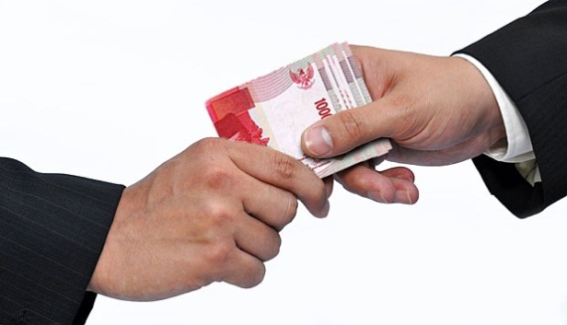
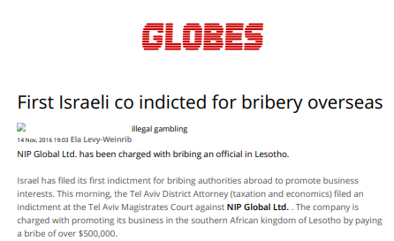
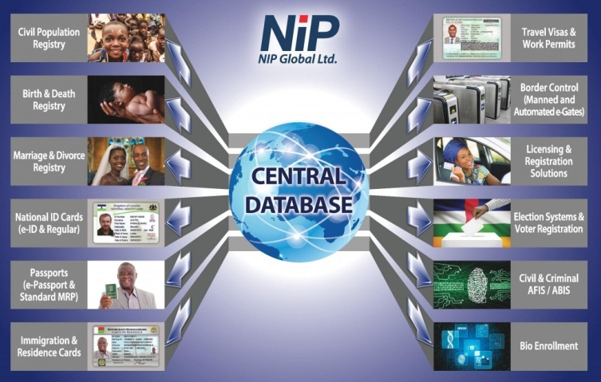
Legal Precedent: An Israeli Company is Indicted for Overseas Bribery

Slide 10
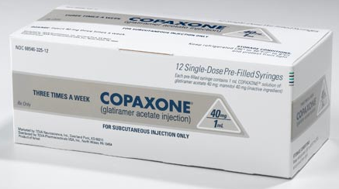
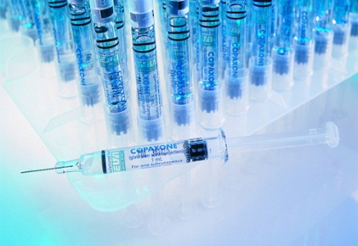
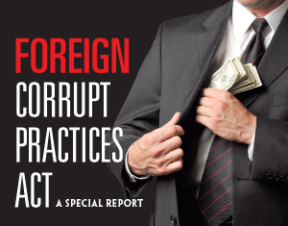
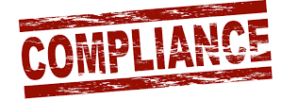
35 Million USD
Beny Steinmetz
BSGR
Guinee's First Lady
TEVA
65 Million
USD
Russia
Ukraine
Mexico
Defense Industries

Slide 11
LAHAV 433 Structure
Lahav Director
Deputy Director
Staff
International Crime Unit
National Corruption Investigation Unit
Economic Crime Unit
ETGAR – Car Thieves
Investigation & Intel Branch
MAOR Unit
Unit 33
Cyber
Investigation Branch
Intel Branch
Investigation Branch
Investigation Branch
Head of Intel Branch
Investigation Division
Evidence Extraction
Exposure Branch
Investigation Branch
Exposure Branch
Intel Branch
Head of Signal Branch
Intel Division
Intel Division
Intel Patrol Team
North and South Divisions
Intel Patrol Team
Operation Branch
Head on Investigations Branch
National Call Center
Detectives Division
National Unit for Prison Guard Investigation
Intel Patrol Team
Investigation Division

Slide 12
National Corruption Investigation Unit Structure
Director
Deputy Director
קפו"ב
Investigation and legislation Assistant
Head of Economic Offensive Team
Human Resource
Indication/ Investigations Coordinator
Intel and Investigation Division
Investigation Division A
Investigation Division B
Investigation
Division C
Corruption Task Force
Money Laundering Professional Task Force
Northern Branch
Southern Branch

Slide 13
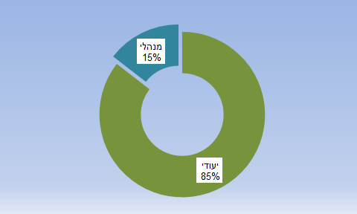
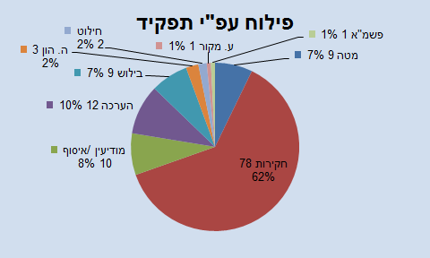
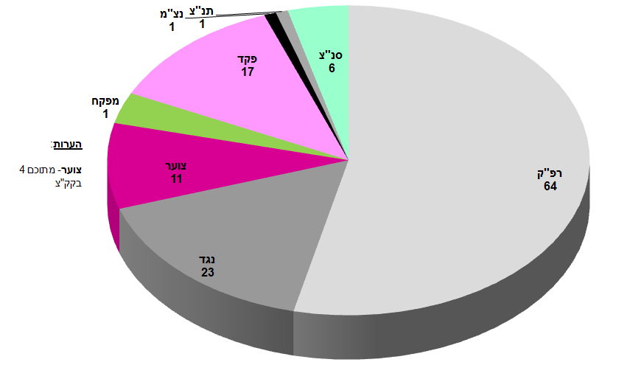
Unit ID
ת"ז יחידתית
Position-Rank-Sector
Asset Forfeiture 2 2%
Segmentation by position
Organized Crime 1 1%
Sources 1 1%
15% Administrative
Capital 3 2%
Staff 9 7%
Detective 9 7%
Evaluation 12 10%
Intelligence / Collection 10 8%
Investigations 78 62%
Dedicated 85%
Brigadier general 1
Commander 1
Commander
17
Chief superintendent
6
Inspector
1
Remarks
Cadet
11
Cadets - of which 4 are doing the Officer’s Course
Superintendent
64
Non-commissioned officer
23

Slide 14
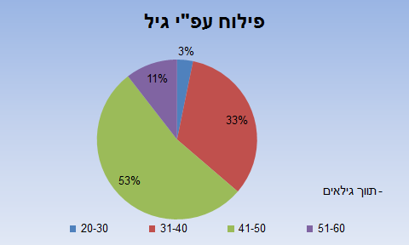
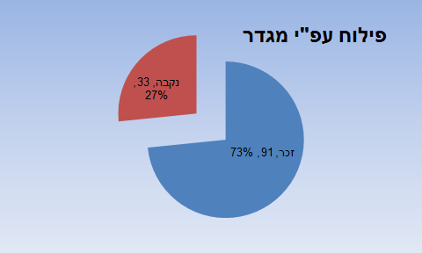
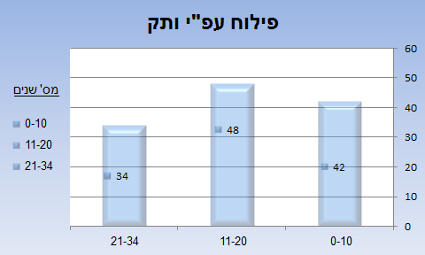
Unit ID
Gender Snapshot
Segmentation by Age
Segmentation by Gender
Female, 33, 27%
Male, 91, 73%
-Range of ages
Segmentation by Seniority
No. of years

Slide 15
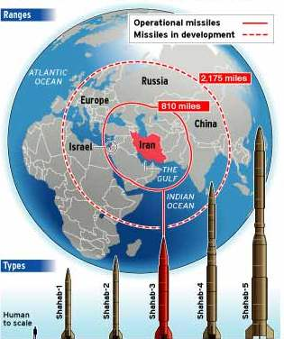
Public Corruption = A Strategic Threat to the Existence of the State of Israel

Slide 16
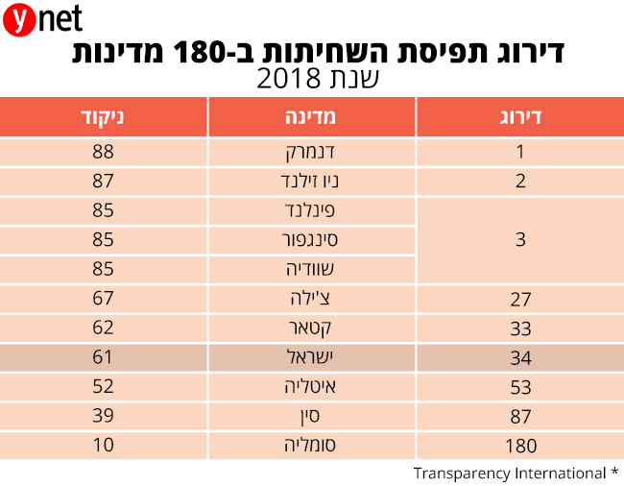
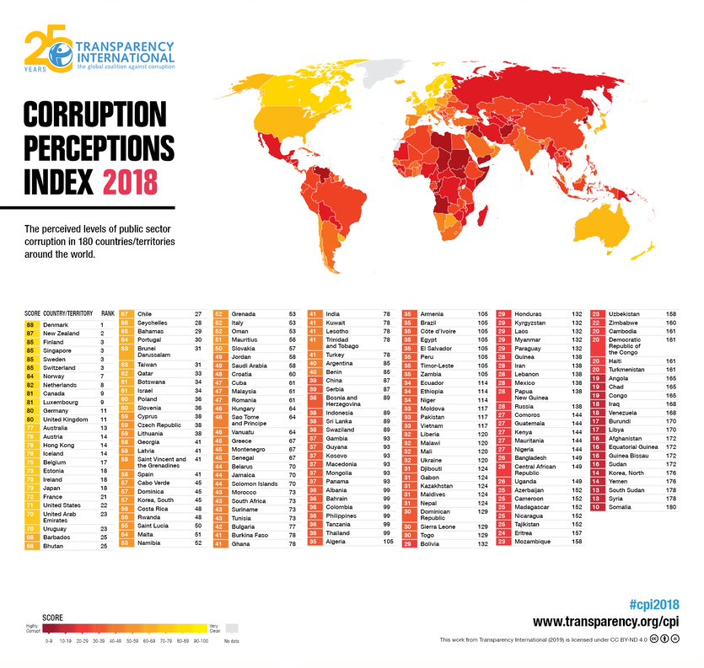
Global Corruption Index 2018
By Transparency International
Corruption Perception Rating in 180 Countries
2018
Scoring
State
Rating
Denmark
New Zealand
Finland
Singapore
Sweden
Chile
Qatar
Israel
Italy
China
Somalia

Slide 17
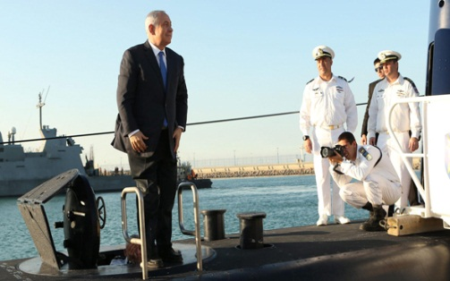
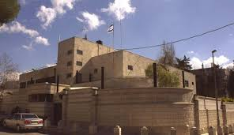

Slide 18
Workspace in Public Corruption Cases:
The Challenges of Time and Period
National
Organizational
Unitary

Slide 19
Decisive / Effective Cases
Index
Cases opened in 2019 and summarized
Cases opened in 2019 for a summary
Old cases handled and summarized in 2019
Test cases summarized in 2019
Data
10 (9 with evidential basis)
6
14 (9 with evidential basis)
13
Excludes ongoing cases and investigations

Slide 20
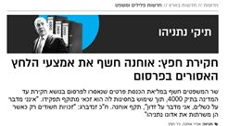
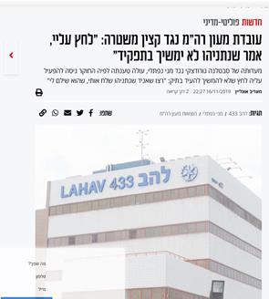
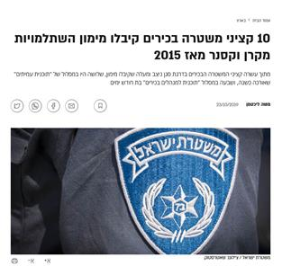
Zero tolerance for mistakes

Slide 21
Current Major Challenges in the Fight Against Corruption
Attempts to produce systemic and personal de-legitimization (argument for foreign considerations and persecution, etc.)
Communication as an active player with interests in the arena
Necessary to become more efficient (shortening investigative and prosecution durations) - a condition for maintaining public confidence in the systems
Pendulum movement between individual rights in investigation and state authority to reach the truth (right to privacy, advice, immunity in face of searches, seizure, questioning)
The fight against government corruption:
A long-distance race

Slide 22
Other Issues on the Professional Agenda

Slide 23
DIGITAL EVIDENCE

Slide 24
Again, Investigation Flaws and Acquittal!
Investigation Flaws –Discretion in the Investigation - Internal Record
INVESTIGATION FLAWS LEAD TO ACQUITTAL

Slide 25
State Witnesses

Slide 26
FINANCIAL ENFORCMENT
(REGURGITATING THE FELLONER)

