Slide 1
Challenges And Trends
In The State Audit Work
- March 2019-

Slide 2
Challenges and trends
Imposition of personal responsibility and criticism of elected officials
Real time review
Policy Review
Access to information

Slide 3
Status of Gatekeepers
Supreme Court / State Comptroller/ Legal Advisor/ Investigators
Governance
Status of Elected Officials
Checks and Balances

Slide 4
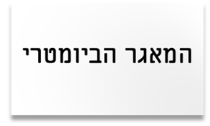
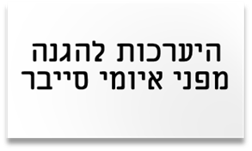
The initiative to limit the auditor's actions to retrospective review and its implications
The controlled administrative action has no definite beginning or end
A combination of dozens of decisions and sub-actions that are intertwined
Continuous and dynamic operation over the years
Reform in the Civil Service
The biometric database
הרפורמה בשירות המדינה
Preparedness to protect against cyber threats

Slide 5
The initiative to limit the auditor's actions to A retrospective review and its implications
The criminal threshold
"Regular" administrative findings
The medium is mostly exposed in real time
Tenders - Foreign Considerations - Conflicts of Interest - Appointments

Slide 6
Imposing personal responsibility on audited persons - criticism of elected officials - mention of names
The change in perception during the period of the State Comptroller Justice (ret.) Lindenstrauss.
Criterion for imposing personal responsibility and mentioning names.
The practical significance of the policy change in the present era.
Main implications for appointments.
Electronic Enforcement in the Israel Police (The Appointment of Major General Edri))
The Carmel Fire
The Reform in the Communications Market (Bezeq)

Slide 7
Criticism of decision-making processes and the interface for policy review
Examination of decision-making processes with regards to a topical issue, with touching elected officials on the public agenda, is ultimately perceived as an illegitimate criticism of policy.
Professional principles that guide the firm in its examination of decision-making processes in general, and in sensitive areas in particular.
Tzuk Eitan Reports
(The tunnel threat)
Reform in the media
market
(The Bezeq affair)

Slide 8
Access To Information - Past Versus Present And Future
- Enterprise computing system
- Personal attitudes
- Data bases
- Emails
- Office Archive
- Working on a document; binder

Slide 9
Dissemination of information in the computerized age
Doc-uments on drive
Doc-uments on other drive
Hard copy doc-uments
Doc-uments on desktops of work-stations
Data-bases and private libraries
Organiza-tional document repository
Deleted Doc-uments
Emails that are not filed
Un-classified emails

Slide 10
Preparedness to protect against cyber threats
Operation Tzuk Eitan
Fixed-line telecommunications market reform (Bezeq Report)
JNF
The Prime Minister's Residence
Senior nominations in the civil service
Foreign ministers' travels abroad
The preparedness of the home front during the Second Lebanon War
Care for the elderly
Development of the natural gas sector
Treatment of police violence
System of debt collection in writ of execution
Treatment of foreigners
The biometric database
Reform in the Civil Service
Management of human resources in the foreign system
Kashrut System
Tax Authority's handling of black capital
The Carmel Fire
Jobs in the Prime Minister's Office

Slide 11
Contradictory trends - the way to where?
The fear of weakening their status as gatekeepers in order to strengthen their ability to govern
Up-to-date review, relevant, contributing and influencing

Slide 12
Implications and responses
Bill –
Real-time auditing
The perception of the role of state audit
Reciprocal relations
Access to information
Challenges and trends
Personal responsibility and elected officials
Real time review
Policy Review

Slide 13
Thank you

