Slide 1



National Defense College
Society Echelon
Leading Instructor, Dr. Anat Stern
47th Class 2019-2020

Slide 2
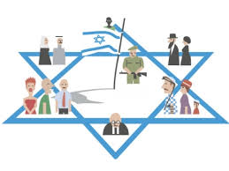
Echelon Rationale
Security isn't just about the tank, the plane and the missile ship. Security is also, and perhaps above all, the human being the Israeli citizen. Security is also a person's education, his home, his school, his street and his neighbor, the society in which he grew up. And security is also a man's hope. Security is the peace of mind and faith of an immigrant from Leningrad, a roof for an Ethiopian immigrant, a factory and employment to the son of this land, to the veteran soldier. It is the integration in our lives and culture. This is also security.
Yitzhak Rabin's Knesset Remarks 13.7.1992

Slide 3

Goals
Study of the roots and characteristics of social phenomena that shape and design the Israeli society.
Learn about the various social groups in Israel.
Focus on selected tensions / challenges and their impact on National Security.

Slide 4
Contents
Visit to the President's Residence
Lipkin-Shahak Conferense
Society Components in National Defense Tours
Israeli Society Course
Society Seminar
National security tours abroad

Slide 5

Content - Global Term
Migration in the Age of Globalization
Prof. Karin Amit
(Foundation of National Security in Global View Course )

Slide 6

Content – Global Term
National Security Content on Europe Tour

Slide 7
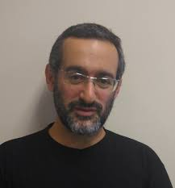
Content - The Israeli Season
Israeli Society Course:
Israeli Society and National Security

Slide 8
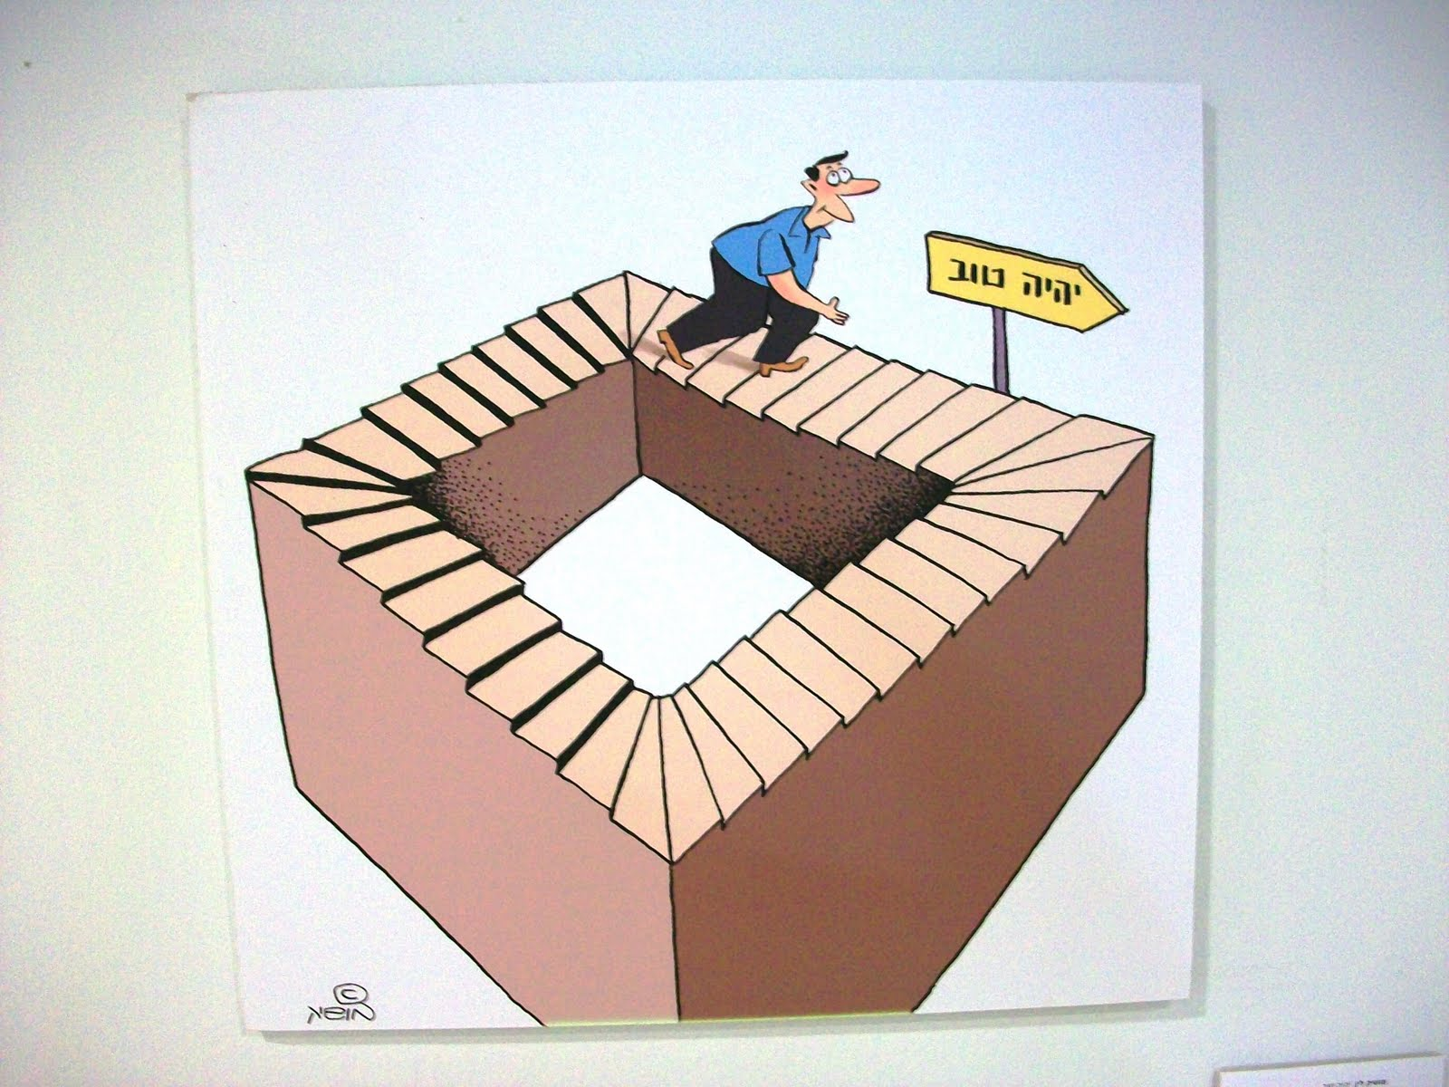
Content - The Israeli Season
Basic concepts in national security:
Definition of national security in Israel (including social aspects)

Slide 9
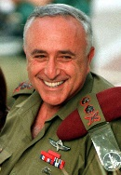
Content - The Israeli Season
Lipkin-Shahak Seminar
IDC Herzliya College

Slide 10
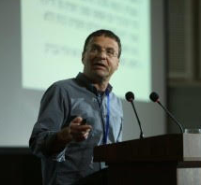
The Specialization Season
Social phenomena
Tensions in society
National Security Relations
Israeli Society Seminar
Dr. Neri Horowitz
Religion in public life
Israeli Arabs in a Jewish and democratic state
Solidarity and social state
Israeli space
Is there a political mamlaktiot for Israeli society?
Civil military relation

Slide 11

Content - The Specialization Season
Content in national defense Tours
East
USA

Slide 12
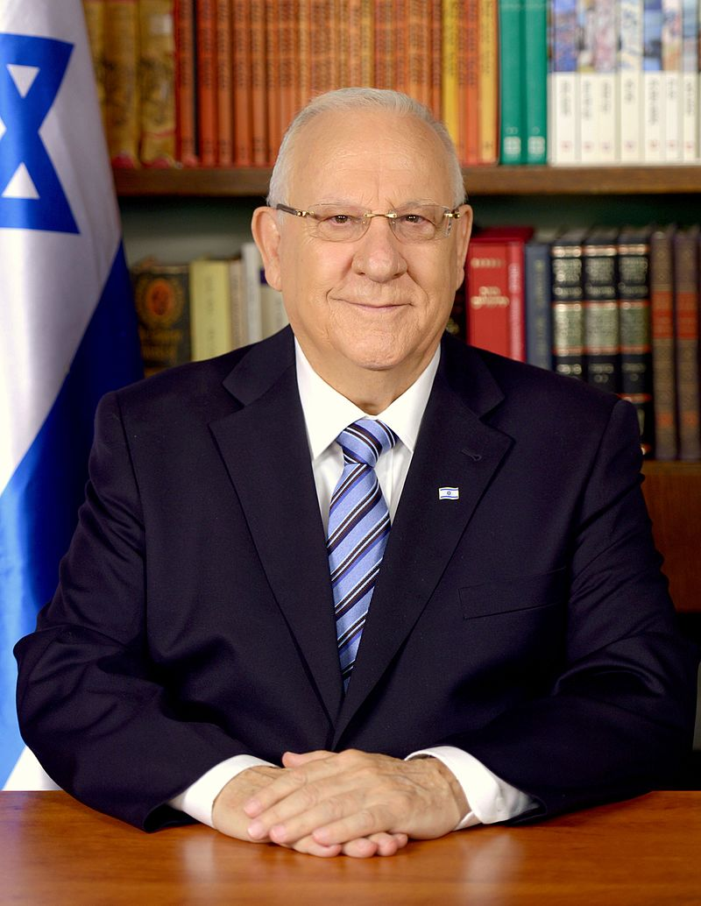
Content - The Integrative Season
Visit to the President's Residence:
President's strategy for Israeli society

Slide 13


