Slide 1


Structure of the National Cyber Directorate

Slide 2

Designation of the National Cyber Directorate:
"To build and strengthen the resilience of the entire economy in cyberspace through preparation, qualification and regulation, including raising the qualifications of sectors and bodies in the economy sector, guiding the economy sector in the field of cyber protection, regulating the market of cyber protection services, licensing, standardization, conducting exercises and training, and providing incentives and further required tools.“
(Government Resolution 2444)
The National Cyber Directorate is in charge of advancing and implementing a national policy on cyberspace. As part of its duties, the directorate will be responsible for the protection of the civilian cyberspace, from the formulation of policy and the construction of technological power to the operational defense of cyber.
The promotion of national capabilities in the field, and the improvement of ways of coping with current and future challenges in cyberspace. It is also responsible for promoting Israel's leadership as a center for developing knowledge and cyber technologies.

Slide 3




The Cyber Directorate -Timeline
2002
NISA
2011
INCB
2016
NCSA
2018
INCD
Notes:
Israel cyber journey began in 2002 and establishing the national CERT in 2016, a bit late from the rest of the world, what gave us the chance to learn from others mistakes and to invent new concepts.

Slide 4


Our Goal
Protection of the Israeli civilian cyberspace
Promoting Israel 's global leadership in cyber (ecosystem)
Management of resources in the Israeli cyberspace
Investment in human capital and infrastructure
We are here so that every person and organization in the State of Israel
will be able to act out of freedom and with maximum protection in the cyberspace of their privacy and business

Slide 5


Areas of Responsibility
Government Offices
Industry and services
Critical Cyber Infrastructure (CCI) bodies
Critical sectors
Public corporations
Government sectors
SMB
Guiding the economy
Are not under our responsibility
Special agencies

Slide 6
Critical Cyber Infrastructure (CCI) Bodies:
Ministry of Finance
Israel Electric Corporation and its
Management Company
Netivei Urban Transport Company - NTA
Population and Immigration Authority
Israel Railways
Oil Refineries Ltd.
The Biometric Database Management Authority
Israel Airports Authority
Paz Oil Refineries Ashdod Ltd.
Government ICT Authority
E-government system
Petroleum and Energy Infrastructures
Eilat Ashkelon Pipeline Company Ltd.
Fuel Products Line
Mekorot Water Company Ltd.
Bank of Israel
HAIFA CHEMICALS LTD
Israel Natural Gas Lines
Magen David Adom (health emergency unit)
Fertilizers and Chemicals Ltd.
Israel Internet Association
Central Bureau of Statistics
The owners of the holdings in the "Ashkelon", "Tamar", "Noa", "Leviathan“ oil companies
Israel Ports Company
the stock exchange
Ministry of Transport and Road Safety
Ashdod Port Company
Israeli Tax Authority
Haifa Port Company

Slide 7
Guidance and Regulation Branch
"To build and strengthen the resilience of the entire economy in cyberspace through preparation, qualification and regulation, including raising the qualifications of sectors and bodies in the economy sector, guiding the economy sector in the field of cyber protection, regulating the market of cyber protection services, licensing, standardization, conducting exercises and training, and providing incentives and further required tools.“
(Government Decision 2444)
Driven by will
Partial
Social Security
Energy
Financial - capital market
The Elections Committee
Internal security
Financial - banks
Economy
Interior
Manufacturers Association
Agriculture
Religious services
Communication
Ministry of Foreign Affairs
Government Offices
    State Comptroller / IT Sector
Environmental protection

Slide 8



Our Strategy
Protection
All the time
During and after the event
Resilience
Before the event
Resistance

Slide 9

Organizational Structure
Prime Minister
Head of the
National Cyber
Directorate
Administration
Spokesperson
Legal Counsel
policy
Accounting
Security Officer
Human Resources
Strategy, Intensification, international
cooperation and foreign relations
Head of Technology Complex
Head of Operational Complex
Head of Durability Complex
Systems
Operational
Critical State
Infrastructures
Information
Systems
Manager
השקעה בהון אנושי ותשתיות
Development and
integration
CERT
Biometric
Durable infrastructure
Intelligence
research
Direction and
regulation
CTO
מבנה ארגוני

Slide 10





CERT – IL 119
Management
Events
SOC
Governmental
Finance
Energy
Protection and Sharing of Information
השקעה בהון אנושי ותשתיות
CERT-IL

Slide 11
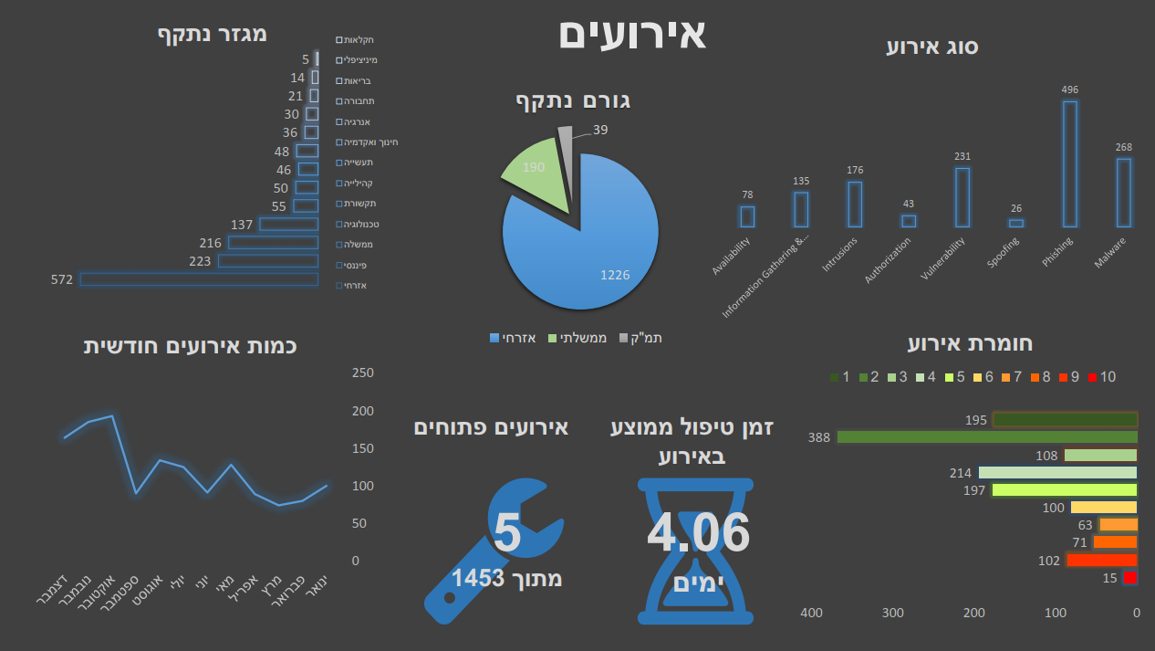
CERT ACTIVITY
The Attacked Sector
Events
Agriculture
Municipal
Health
Transportation
Energy
Education and academia
Manufacturing
Community
Communication
Technology
Government
Financial
Civil
Event Classification
The Attacked Body
Civil
Governmental
CCI
Event severity
Monthly amount of events
December
November
October
September
August
July
June
May
April
March
February
January
Open events
Average event
handling time
השקעה בהון אנושי ותשתיות
Out of
Days

Slide 12
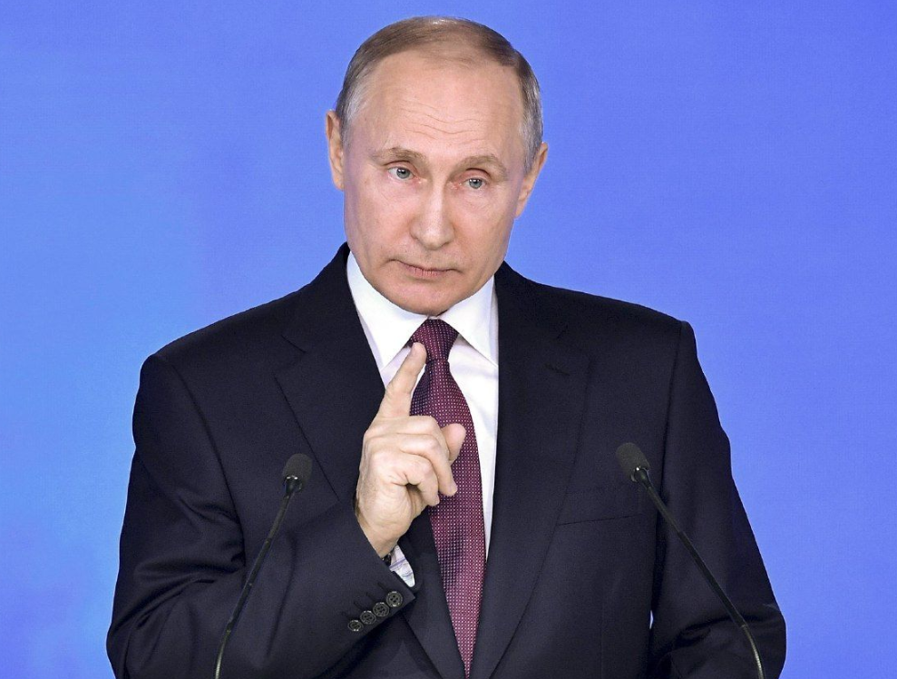
What do I want you to remember?

Slide 13
Our Goal
Everything
is
Hackable!
השקעה בהון אנושי ותשתיות

Slide 14
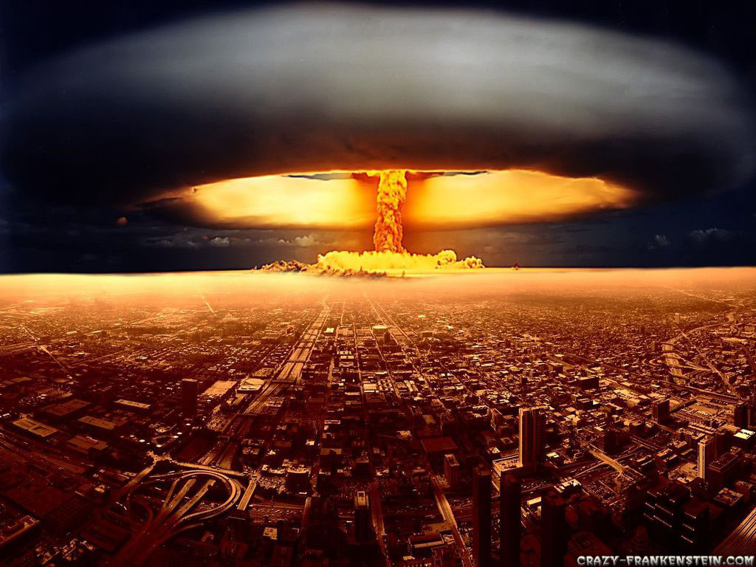
השקעה בהון אנושי ותשתיות

Slide 15
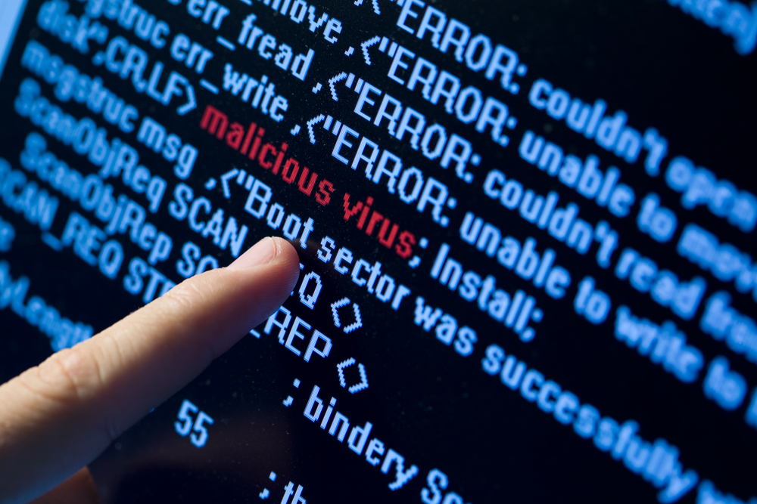
השקעה בהון אנושי ותשתיות

Slide 16


