Slide 1
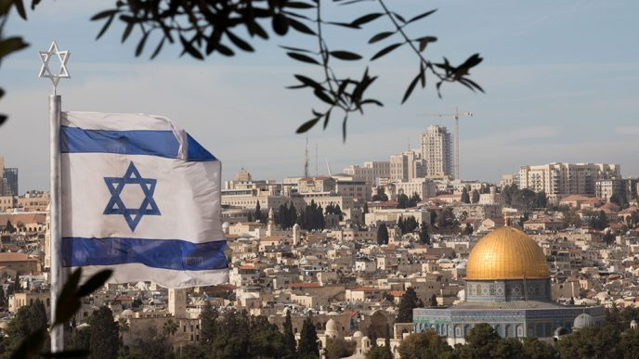
“The value of Jerusalem cannot be measured, weighed or counted, because if the Land of Israel has a soul – it lies in the Jerusalem mountains" David Ben-Gurion
Souvenir from the INDC tour to Jerusalem
Thousands of generations dreamed of Jerusalem, while we, as a link in the chain of generations, are fortunate enough to not only travel to it and enjoy its beauty, but are privileged to serve and protect it!
Wishing us all a fruitful tour!
Team 4, 46th Class
January 16-17, 2019

