Slide 1
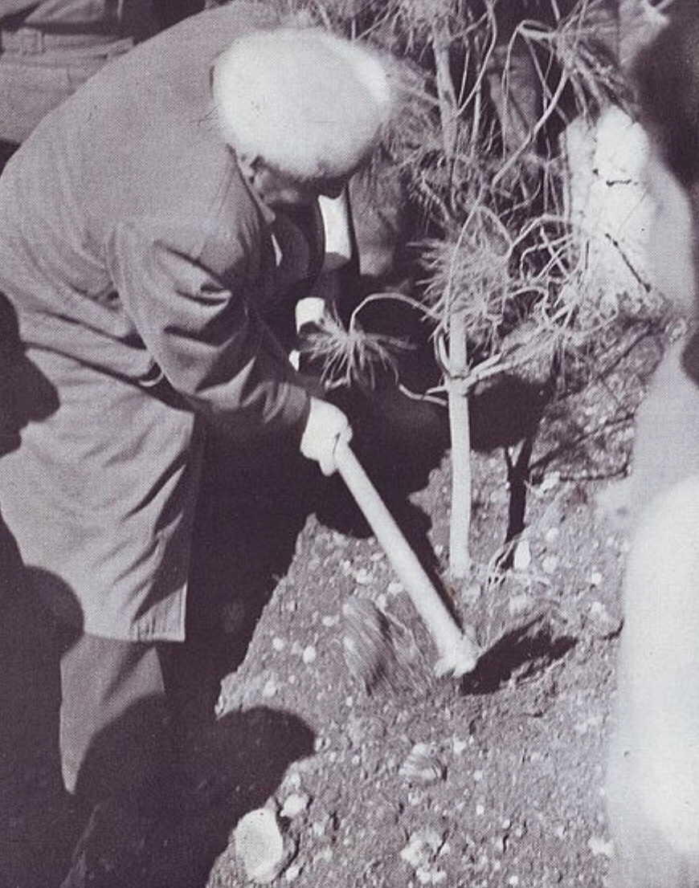
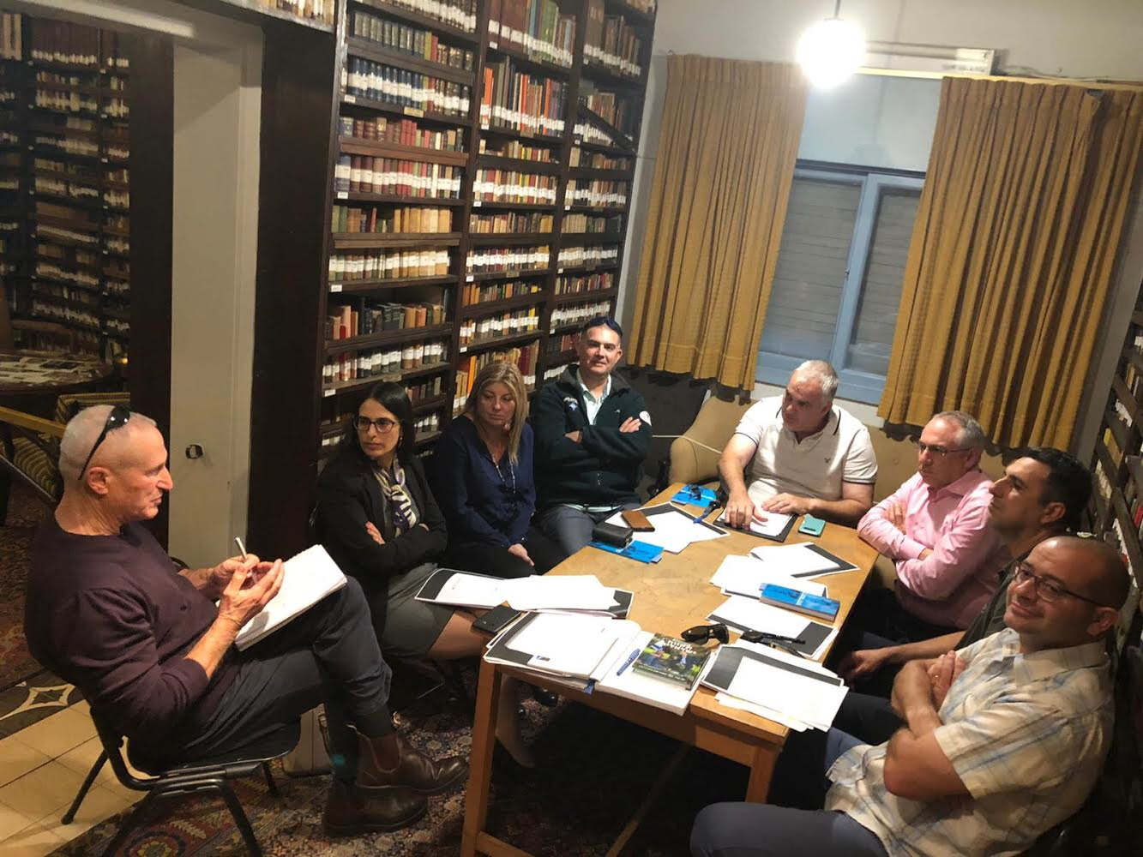
The Value of the State of Israel Through David Ben-Gurion’s Perspective

Slide 2
What We Did- Briefly
Background Materials-
Information booklet
Mass or selective absorption (Picard)
Background materials relating to absorption difficulties and elitist perception
"The Four Tribes" Speech
Movie - Epilogue
Tour of Ben-Gurion’s House
Engaging staff meetings on issues related to Ben-Gurion's vision, with an emphasis on statehood and society

Slide 3
Science and Spirit
Security
Society
Ingathering of the exiles
As a home and shelter
As a historical designation
As an attractive destination
New Society
An exemplary society, a light to the Gentiles
Without deprivation, contrasts and rifts
Fraternity and partnership
Spiritual-existential superiority
A creative, agricultural society
A sense of destiny and connection with the Diaspora
Contribute to the "Treasure of the Occupations of the Human Spirit"
Recognition of the human cultural treasure of all nations, and spiritual independence
National security - in the broad sense
The IDF - a body without any partition
Equal burden
People's Army and crucible
Pioneers and missions - compensation for gap in size and weapons
Conquest of the land through construction
Being good neighbors with the Palestinians - revitalizing the country

Slide 4
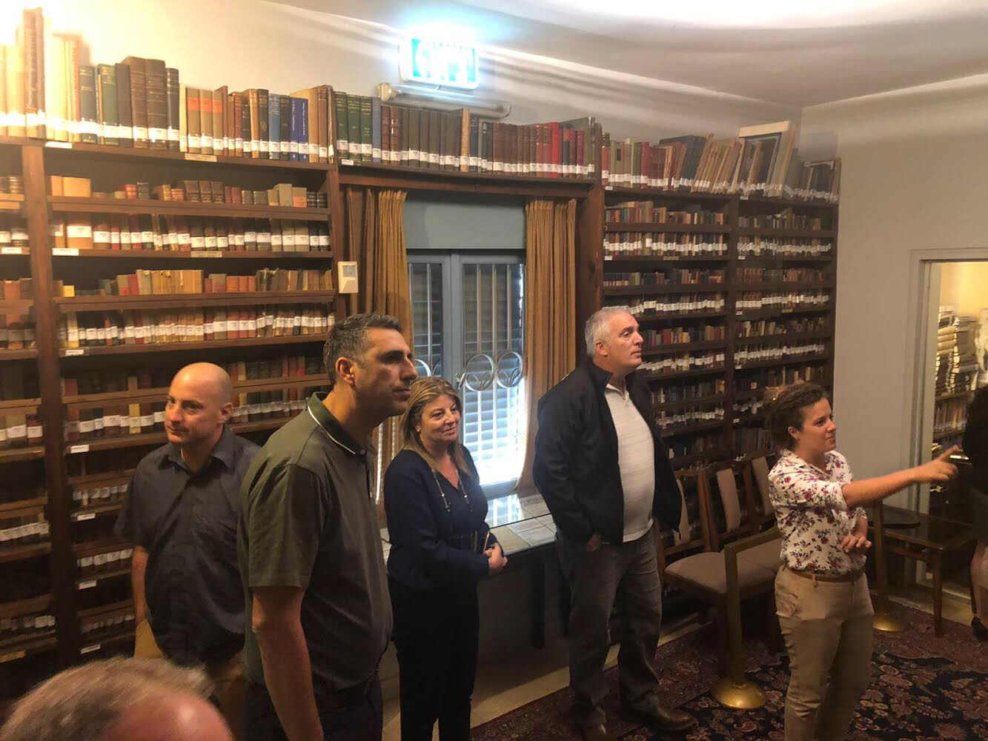
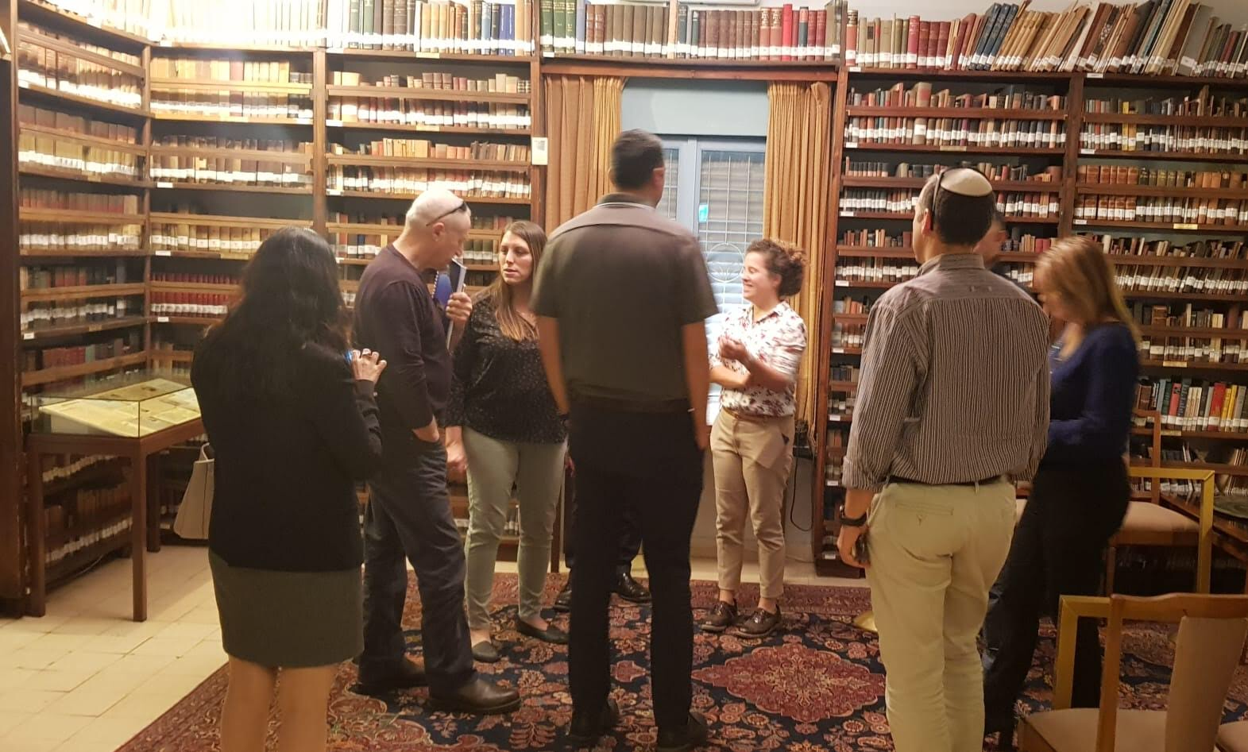
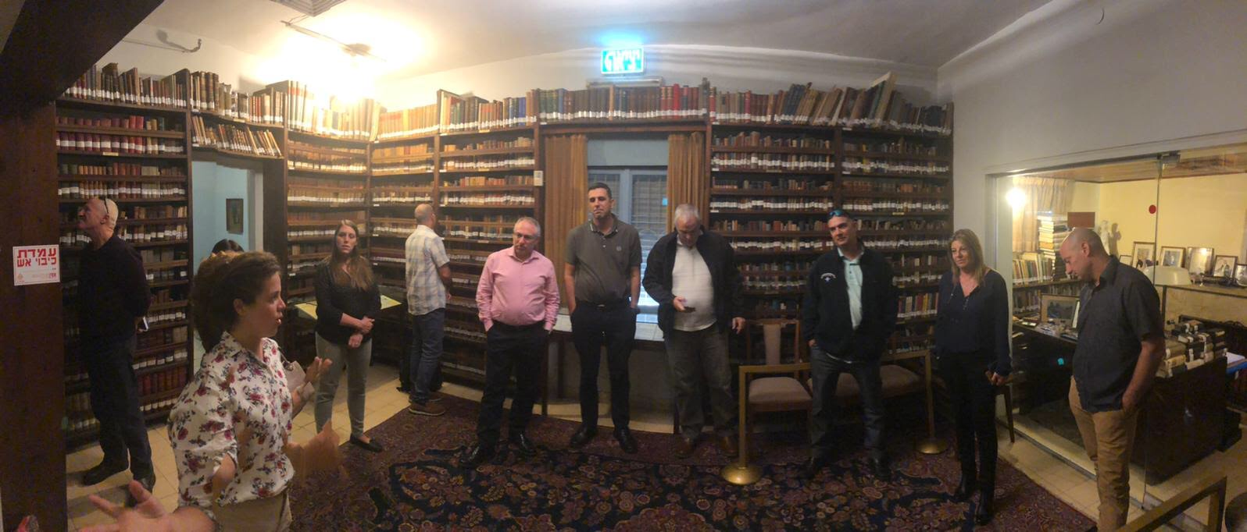

Slide 5
Society
The image of the nation - to be a holy gentile, while arguing about the essence of the holy (social justice and human brotherhood, “Love thy Neighbor”)
In all of our actions there are two basic aspirations - to be as all gentiles and to be different from all gentiles. He is careful when using the term "chosen people" and explains it through our need of survival, given our unique condition and need for spiritual superiority, to conquer hearts and friends.

Slide 6
Science and Spirit
The Jewish Diaspora is also a tremendous factor in our universal connection. Jewish Immigrants from 55 countries fought in the IDF. As we eat Argentinean meat and Russian wheat and plow in an American tractor and forge Belgian steel and use Mexican gasoline and dress in British cloth, and our homes are decorated with Canadian trees - so we shall read all the peoples' literature and seek wisdom.
Does not accept the notion of being Jewish at home and a person when you leave home. Jewish independence is undividable. Rather, redemption allows to reduce the emphasis of being a chosen people and allows greater recognition of human general treasures.

Slide 7
Security
National Security - Aliyah, settlement, industrial development, scientific research, foreign relations.
The military is turning boys who come from slums into new people, but they need to have the tools to continue their progress in civilian life.

