Slide 1

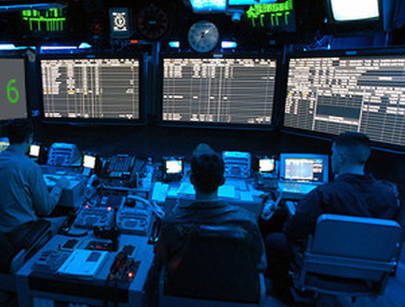
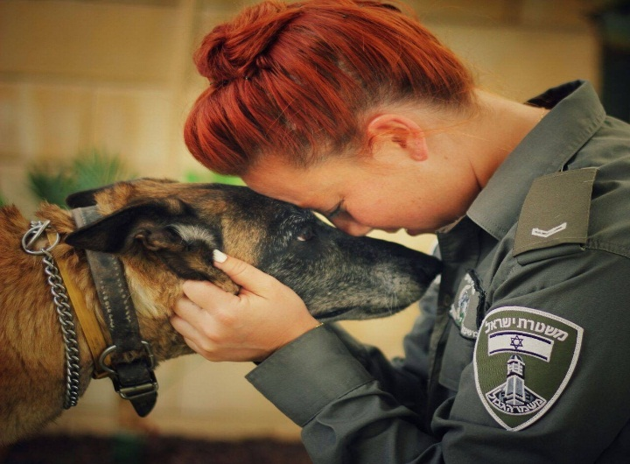
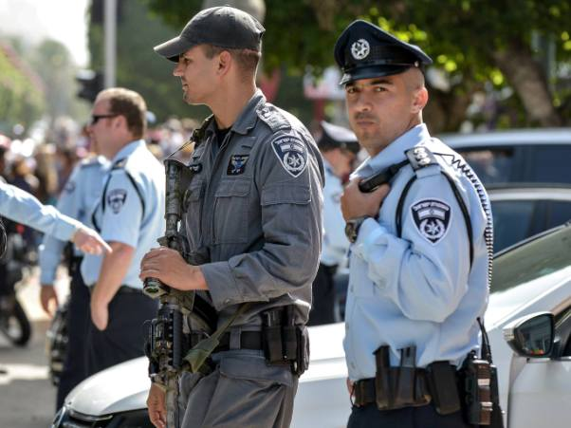
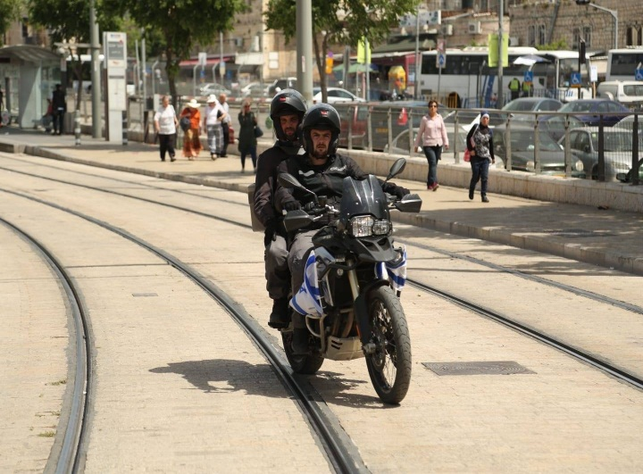
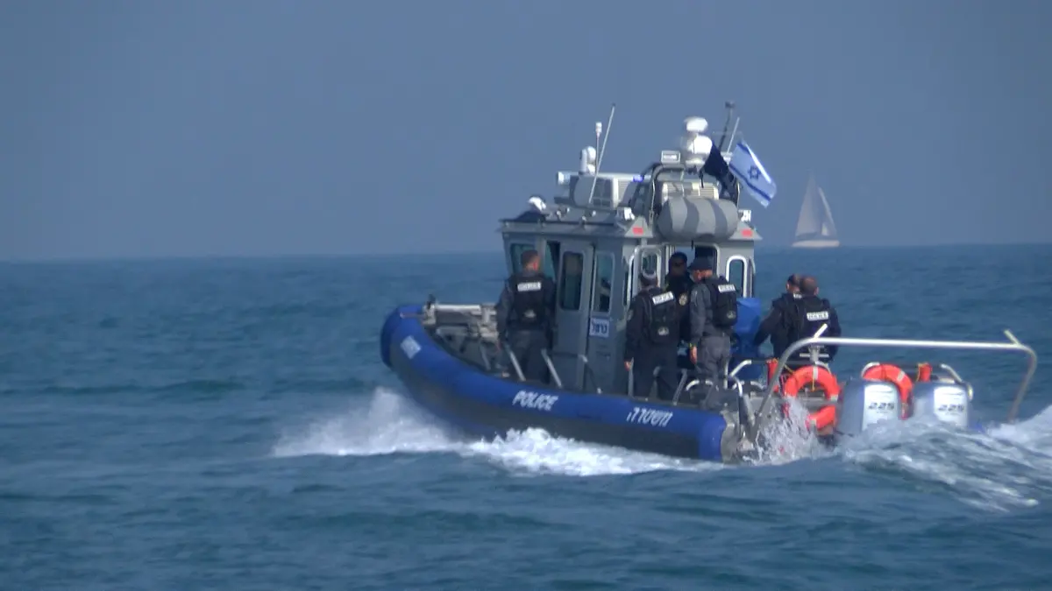
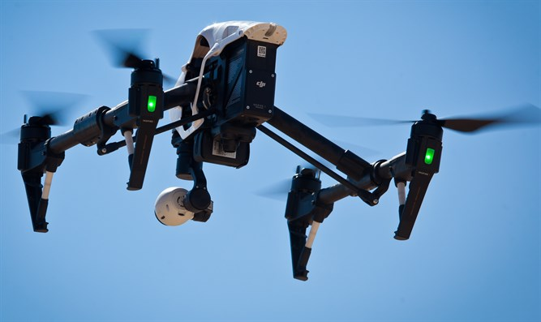
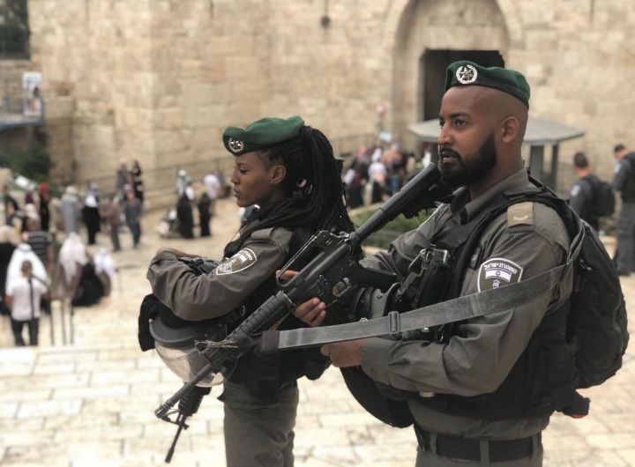
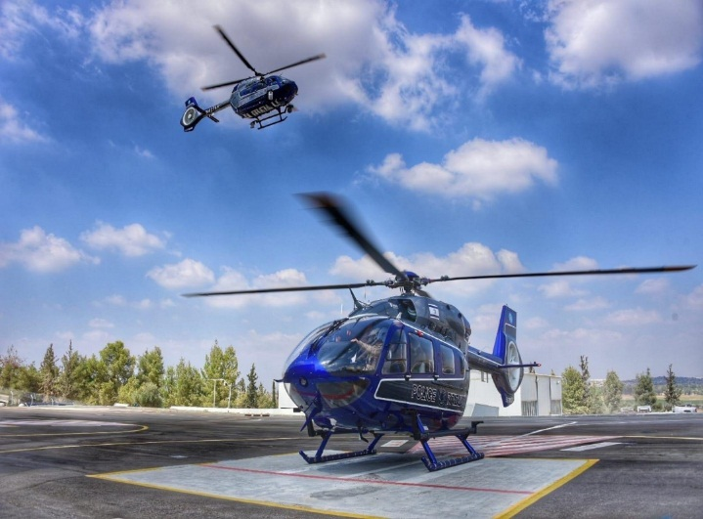
INDC Visit to the Israel Police – March 12th, 2020

Slide 2
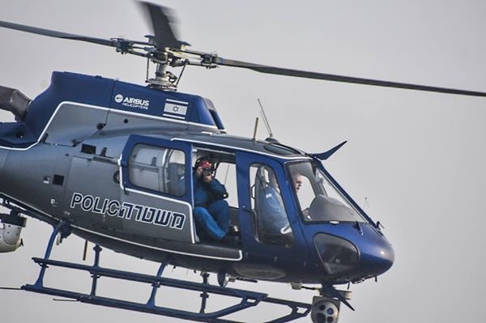
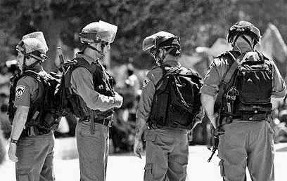
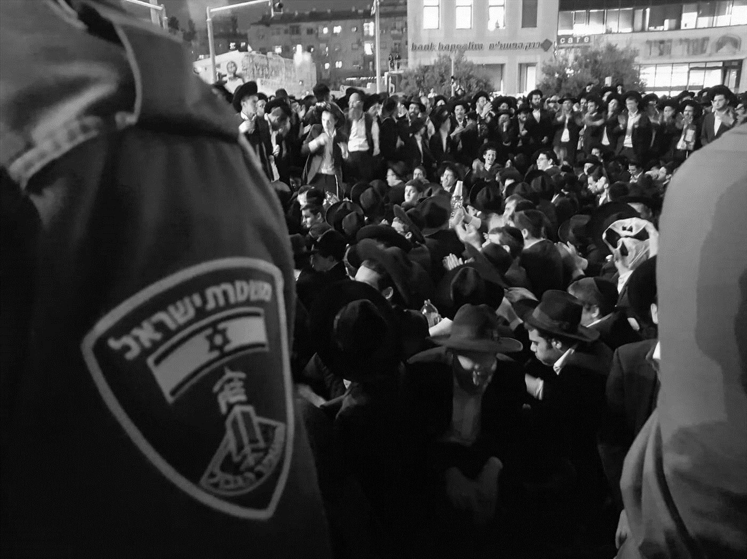
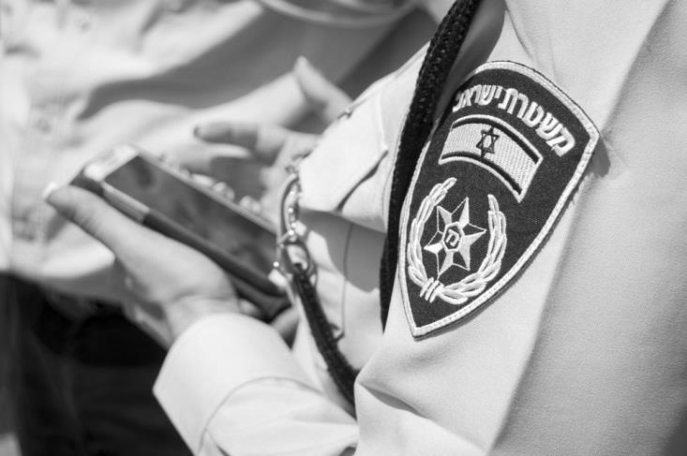
Israeli Police Purpose
Israel Police’s main role to act as the law enforcement branch is set in section 3 of the Police Orders (revised 1971). Section 3 determines that “Israel Police will act to prevent and uncover crimes, catching criminals and putting them on trial, safeguarding prison inmates, and sustaining public order and security.” Israel Police acts according to the authority given to the police officers in Police Orders (revised 1971).
Traffic Patrol
Internal Security
Sustaining Public Order
Fighting Crime

Slide 3
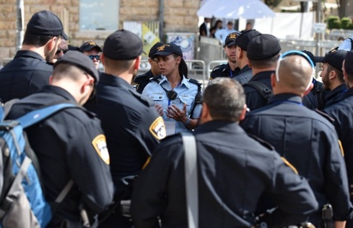
Israel Police | ID
19% Officers
81% NCOs
87%Jew
13% Non Jews
27% Women
73% Men
33,227
22,396
Standing Policemen
1,065 Enlisted
373
Commissioned BP
3,622 Border Patrol (BP)
284 Students
324 National Service
71 Civilians
267 Other
Command
Religion
Gender
+
33,000 Volunteers

Slide 4
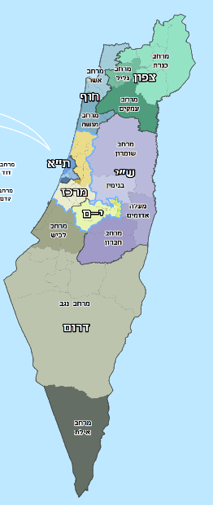
2019 Data
Israel Police | ID
8,000,000
Calls per year
49.5%
Quality of life
events
2,340,000
Events
7,000,000
Calls to 100
1,000,000
TO 110
7 Districts
16 Spaces
79 Stations
Mixture
Events
Calls
Quality of Life Events (noise and transportation incidents)

Slide 5
Israel Police Organizational Chart 2020
Chief Inspector
Deputy
Chief Inspector
Gender Equality and Social Diversity Unit
Arab Society Dept.
Disciplinary Tribunal
Security Dept.
Data Security
International Relations
Internal Critics
Service Improvement Desk
Administrative
Departments
BP
Districts
Planning Dept.
HR
Training
Logistics
Traffic
Policing Operations
Technology
Research and Intel
North
Sea Shore
Center
Tel Aviv
Jerusalem
Judea & Samaria
South
Legal Advisor
Law Suits
Treasury
Population and Media
LAHAV 433

Slide 6




Israel Police on Social Media
Instagram
92,000 Followers
Arabic Instagram Page
Facebook
One Million Visits a Week
Of Which 480 Thousand Are Permanent Followers
Pages In Arabic for the Recruitment Office And Border Police
Twitter
45,000 Followers
Police.gov.il
Internet
Various Online Services
Downloading Forms
News updates

Slide 7
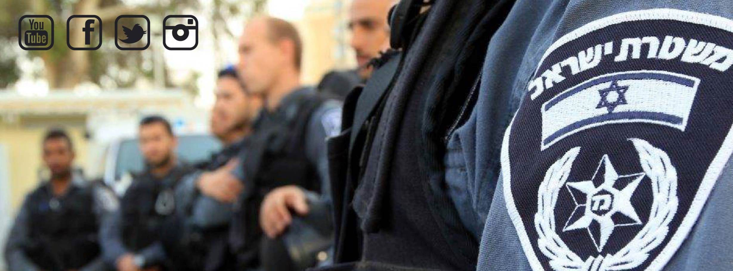
General
On March 12, 2020, INDC's 47th class will visit the Israel Police as part of the learning of the security and social-economic echelons.
The tour will be devoted to understanding Israel Police's central functions and their connection to the elements of national security, and will examine security, social, economic and other aspects.
Naturally, a single tour is not enough to cover the full range of responsibilities and activities of the police and therefore, we will try to touch on key areas that as we understand, and as the participants wish, will reveal new perspectives for most participants.

Slide 8
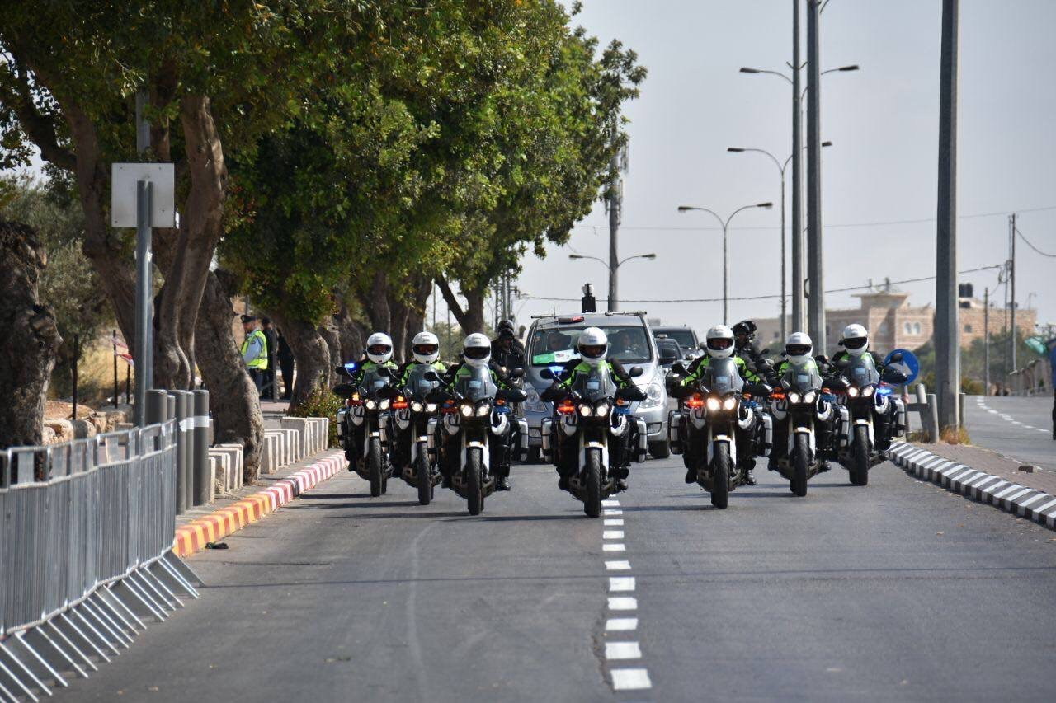
Tour’s Purpose
Deepening the acquaintance of INDC 47th class with the Israeli police, with emphasis on positions and responsibilities relevant to the elements of the national security of Israel.

Slide 9
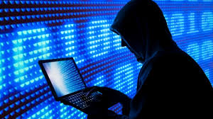

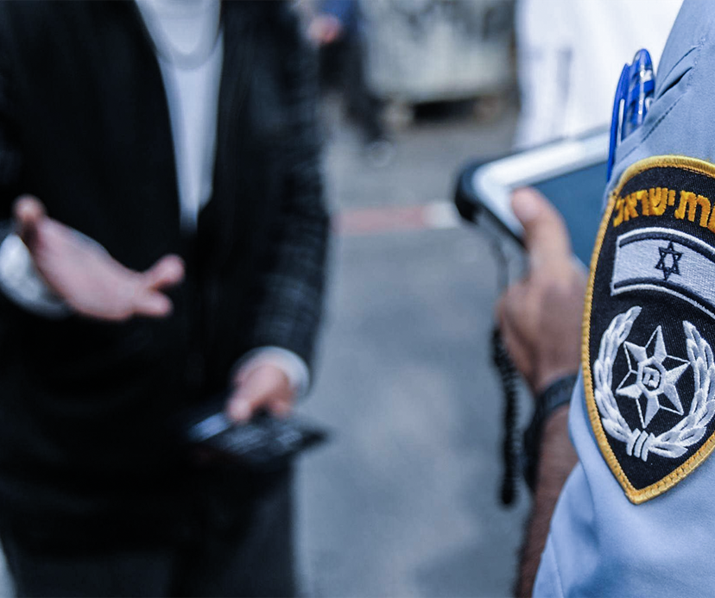
Central Idea
Exposure to the advanced technological abilities as a tool to fight crime
Exposure to police activity in the field of global and national threats - public corruption, economic crime, international crime and cyber crime.
Exposure to the challenges of the police station in the different districts, emphasizing crime fighting, public order, traffic and personal security

Slide 10

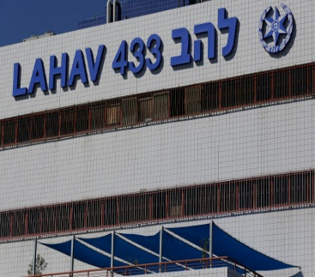

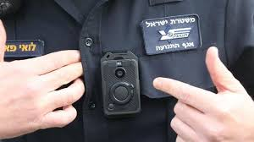

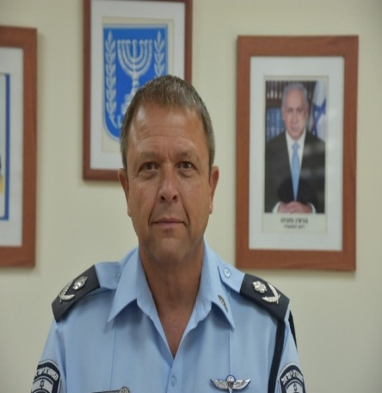
The Method
Visit LAHAV 433
The World of Cyber and Technology
Police Station Visits
Tel Aviv Central
District Briefing
Meet with Acting Chief Inspector
Deputy Commissioner Motti Cohen

Slide 11
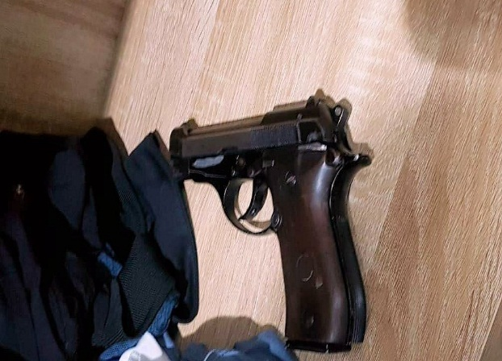
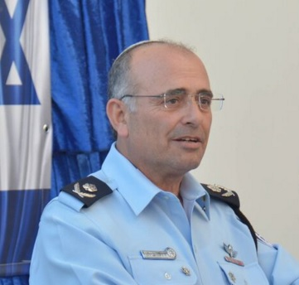
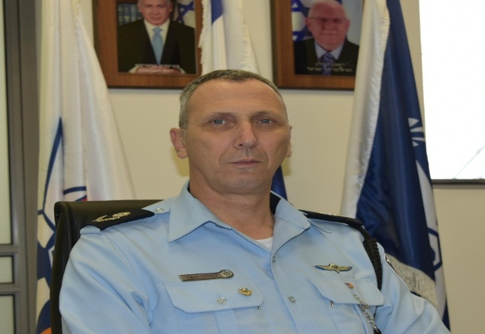
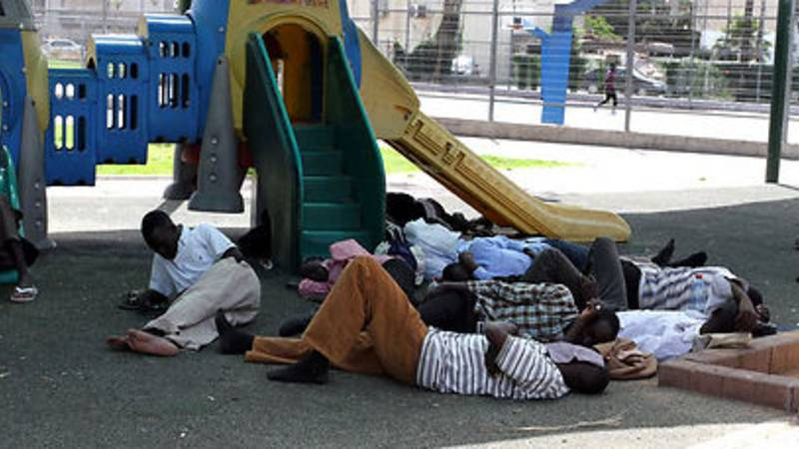
Acquainting with the Classic Police World
Optional
Optional
08:30-10:15
Visit Ramle Gwarish Station
08:30-09:15
Tel Aviv District Commander –
Deputy Commissioner David Bitan
10:45-11:30
Center District Commander –
Deputy Commissioner Ami Ashad
09:45-11:30
Visit South Tel Aviv Sharet Station

Slide 12
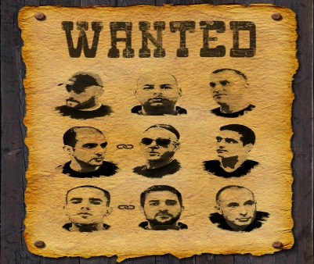


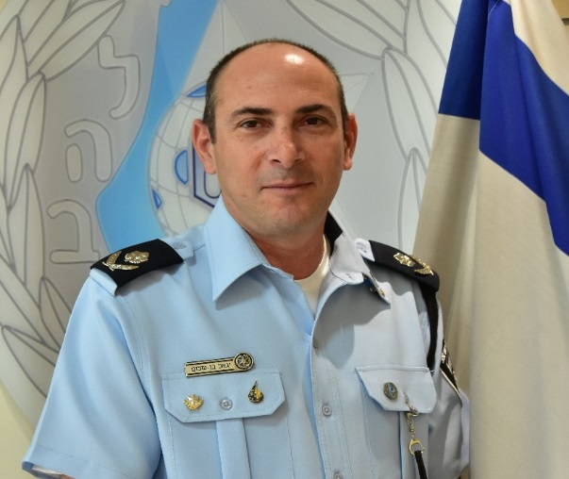

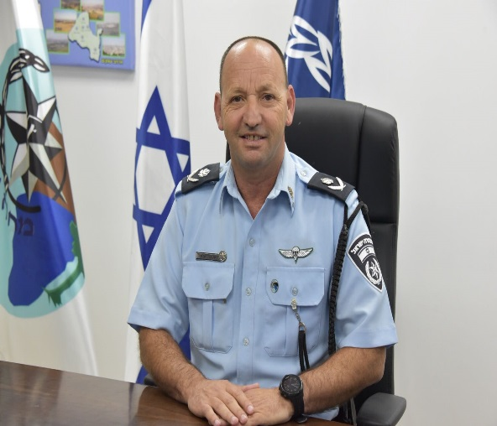
Acquainting with LAHAV 433
Choice
14:45-15:45
Lecture on Cyber Abilities
13:45-14:30
Presenting IT Equipment
at LAHAV 433
16:00-17:00
Criminal Organizations
16:00-17:00
Public Corruption
13:00-13:45
Lecture by LAHAV 433 Commander
Deputy Commissioner Yigal Ben Shalom
12:00-13:00
Lunch at LAHAV 433
17:20-18:00
Tour Conclusion with Deputy Chief Inspector, Deputy Commissioner Alon Assor

Slide 13
Detailed Schedule
Time | Activity |  | Comments
08:30-10:15 | Visit to Ramla Station | Split | Gwarish, Ramla
10:45-11:30 | Lecture from Center District Commander |  | Center District HQ/Ramla Station
08:30-09:15 | Lecture from TA District Commander | Split | TA District HQ
09:45-11:30 | Visit Sharet Station |  | South TA
12:00-13:00 | Lunch |  | LAHAV 433
13:00-13:45 | Lecture from LAHAV 433 Commander | 2 Groups | LAHAV 433
13:45-14:30 | Presenting IT Equipment |  | LAHAV 433
14:45-15:45 | Cyber Lecture |  | LAHAV 433
16:00-17:00 | Lecture on Public Corruption | Split | Split
16:00-17:00 | Lecture on Criminal Organizations |  | Split
17:20-18:00 | Tour Conclusion with Deputy Chief Inspector | Together | Together
Center District
TA District

Slide 14
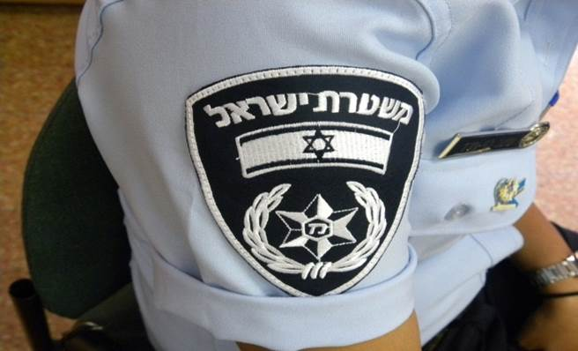
Emphases
Center District – 08:00 Parking at Homefront Command TA District – 07:30 parking at INDC
The Police Station tours will be based on transportation from the INDC
Security – Organized by the relevant districts
Lunch will be held at LAHAV 433
Token Exchanges – Deputy Chief Inspector, TA District Commander, Center District Commander, Sharet Station Commander, Ramla Station Commander, LAHAV 433, IT Representatives
INDC Dress Code
Splitting into groups will be done using a computer
Center District Address
TA District Address

Slide 15

Israel Police Warmly Welcomes the INDC 47th Class

