Slide 1
Labor Market in Israel: Trends, Challenges and Policies
Professor Zvi Eckstein
Head of the Aharon Institute for Economic Policy
Dean of the Tiomkin School of Economics
Hertzliya Interdisciplinary Center
Seminar Day for INDC, June 11, 2019

Slide 2
Topics
Employment trends in Israel
Sources of change in employment and income of households
Poverty - tradeoffs and policies
Recommendations of the Employment Committee 2030

Slide 3
Significant Growth In Employment In Israel
Top 10
Israel
US
OECD
Israel - an increase of 10 percentage points in the employment rate from 2002 to 2017
The US and the OECD - a slow recovery from the 2008 crisis
Ages 25-64. Top 10 - Top ten countries in GDP per capita in 2017 (Luxembourg, Ireland, Norway, Switzerland, United States, Netherlands, Australia, Denmark, Sweden and Austria).
Source: OECD.

Slide 4
Significant Growth In Employment In Israel
Men Women
Top 10
US
Top 10
Israel
OECD
US
Israel
OECD
Men - reversing the trend from a decrease to the increase
Women - acceleration of increasing
The gap between men and women narrowed, one of the lowest in the OECD
Ages 25-64. Top 10 - Top ten countries in GDP per capita in 2017 (Luxembourg, Ireland, Norway, Switzerland, United States, Netherlands, Australia, Denmark, Sweden and Austria).
Source: OECD.

Slide 5
Employment, Unemployment and Participation
Men Women
unemployment (right)
participation
unemployment (right)
participation
unemployment (right)
unemployment (right)
employment
employment
The unemployment rate below "natural unemployment"
Weekly working hours of employed persons - There was no change in women, a very slight decrease among men
We focus on the employment margin and not on the scope of the position
Ages 25-64.
Source: OECD.
Ages 25-64.
Source: OECD.

Slide 6
Description of the Data: Who are the Groups Whose Employment Has Increased?
Changes in employment according to characteristics:
Sector (population group)
Education
Age
Household Size (Fertility)
The main result:
An increase in all sectors, at all levels of education, in all ages and in all households, a higher rate of increase among groups with low earning ability

Slide 7
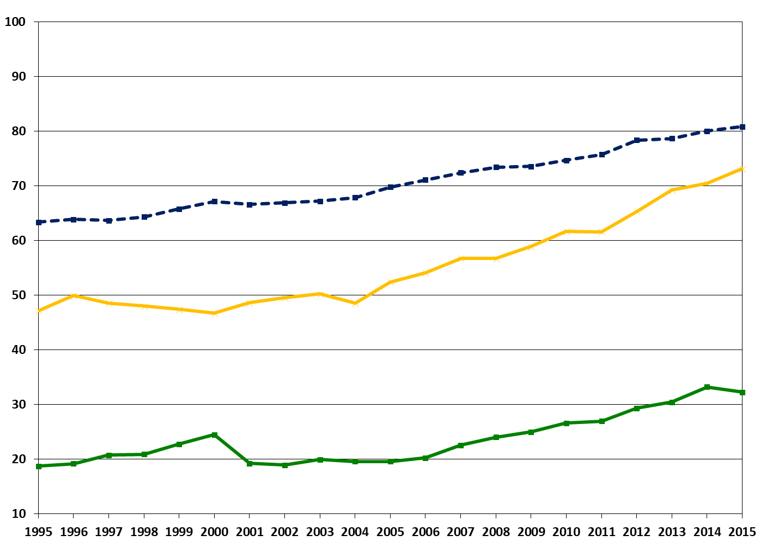
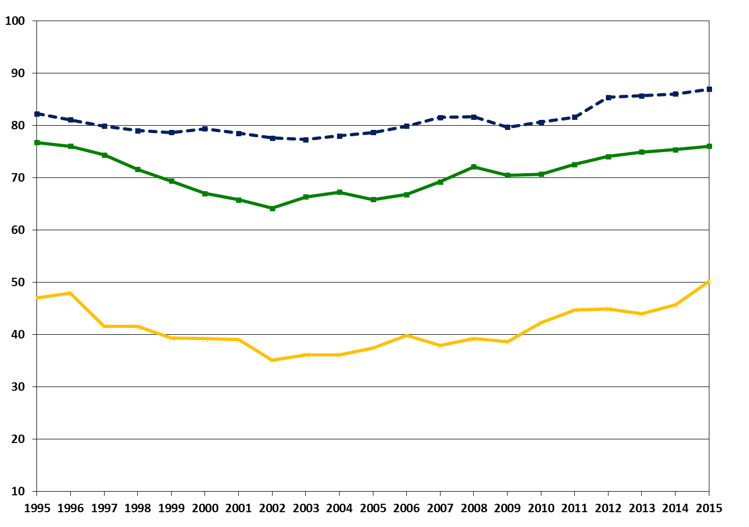
Employment and Sector
Men Women
non-Orthodox Jews
non-Orthodox Jews
Arabs
ultra-Orthodox
ultra-Orthodox
Arabs
An increase in all sectors, more significant for Arabs and ultra-Orthodox Jews
Most of the growth in employment (2002-2015) - non-ultra-Orthodox Jews (68% for men, 73% for women)
Ages 25-64. Up to 2000 Arabs, including non-Jews. Identifying Haredim according to the last school approach. A new sample began in 2012.
SOURCE: Based on labor force surveys.

Slide 8
Employment and Education
Men Women
MA and up
BA
Post-secondary
Matriculation
Up to secondary
An increase in all levels of education is more significant for those with a low level of education
Most of the growth 2002-2015 - up to high school with / without matriculation (51% for men, 55% for women)
Ages 25-64. Up to high school including without a certificate and an unknown certificate;
Post-secondary education includes non-academic technological or professional education.
SOURCE: Based on labor force surveys.

Slide 9
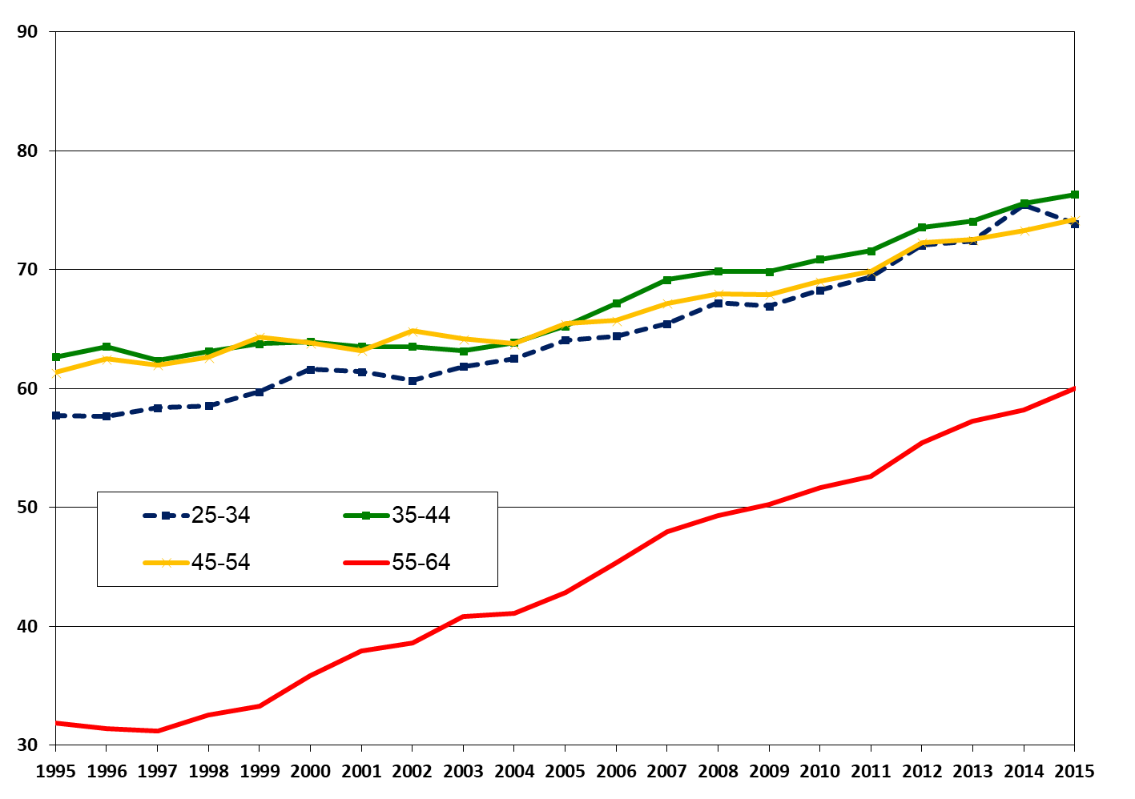
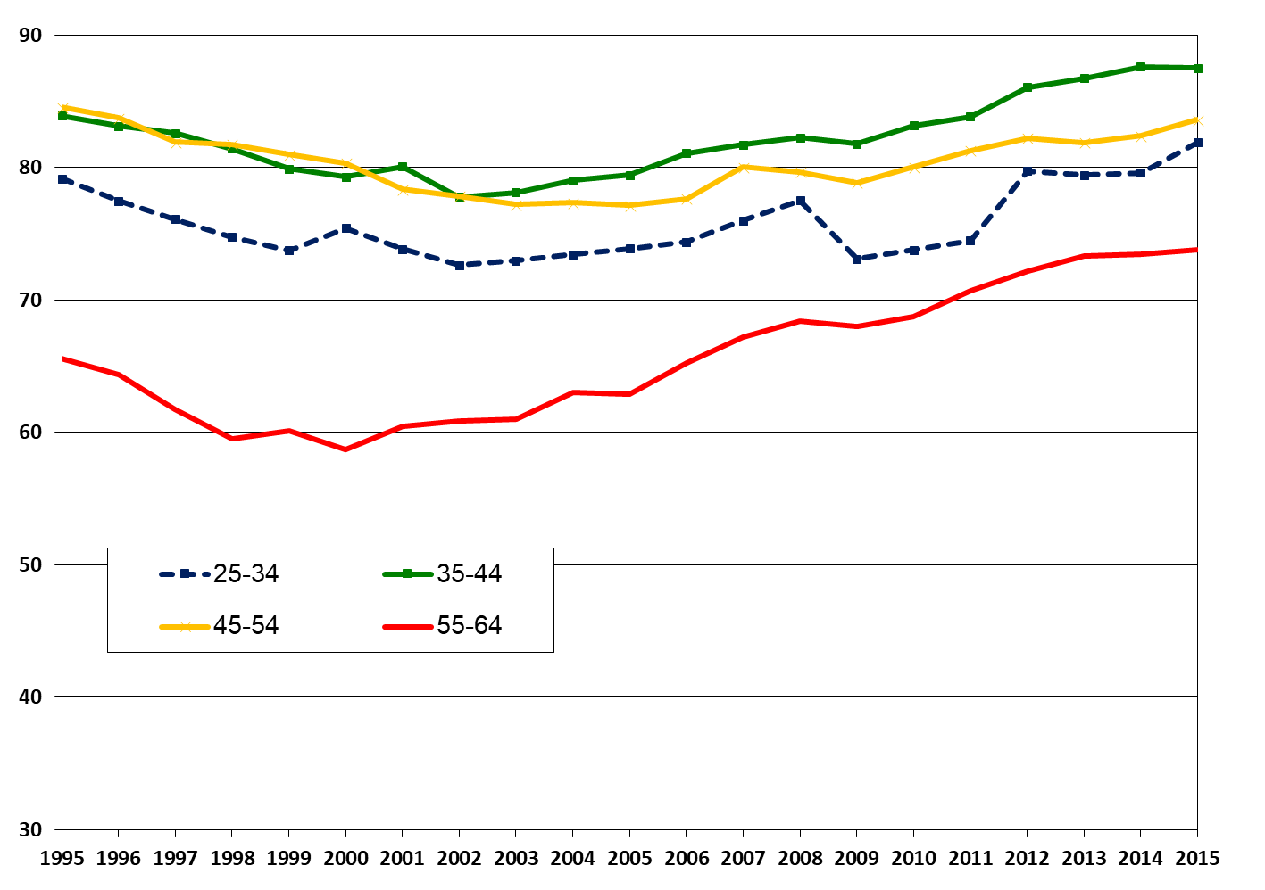
Employment and Age
Men Women
An increase in all age groups, more significant for those aged 55-64
SOURCE: Based on labor force surveys.

Slide 10
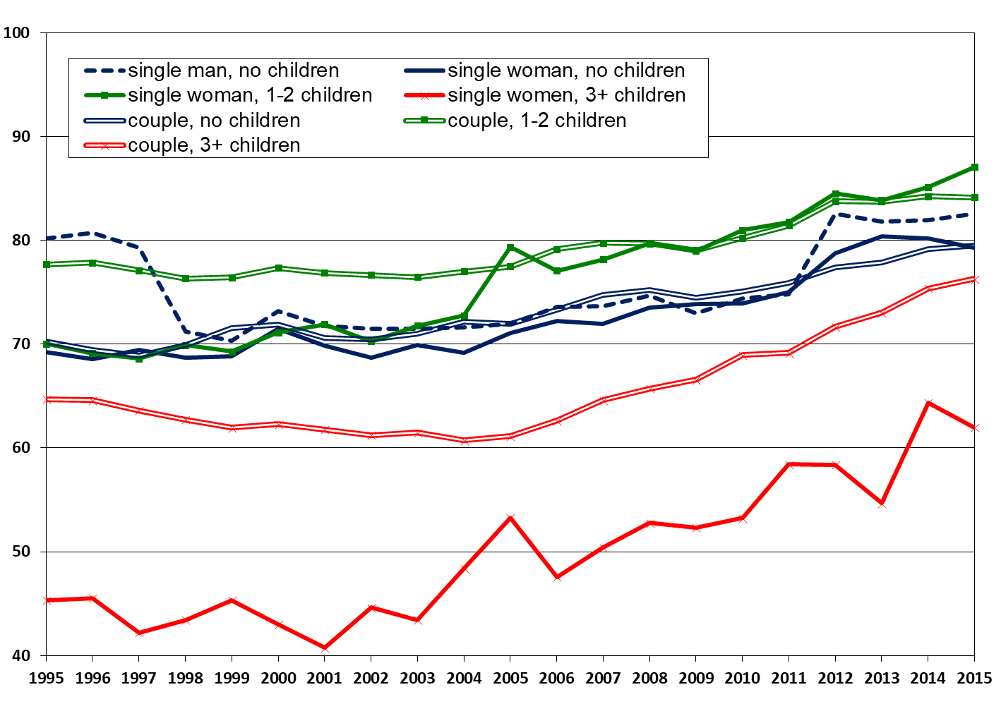
Employment and Size of Household
An increase in all groups, more significant for households with three or more children
Transition from a single provider to two earners
Persons aged 25-64 (head of household). Identifying pairs according to economic context. NUMBER OF CHILDREN AGED 18 IN THE HOUSEHOLD. Refers only to the employment of the head of the household and of the spouse. In the household of an individual, 0 if he does not work and 1 if he works; In a household of a spouse, if both are not working, 0.5 if one of them works and 1 if both work.
SOURCE: Based on labor force surveys.

Slide 11
What are the Sources of Employment Growth?
Demographic changes? Yes to education, not to others
Yields to education? No
Policy? Yes

Slide 12
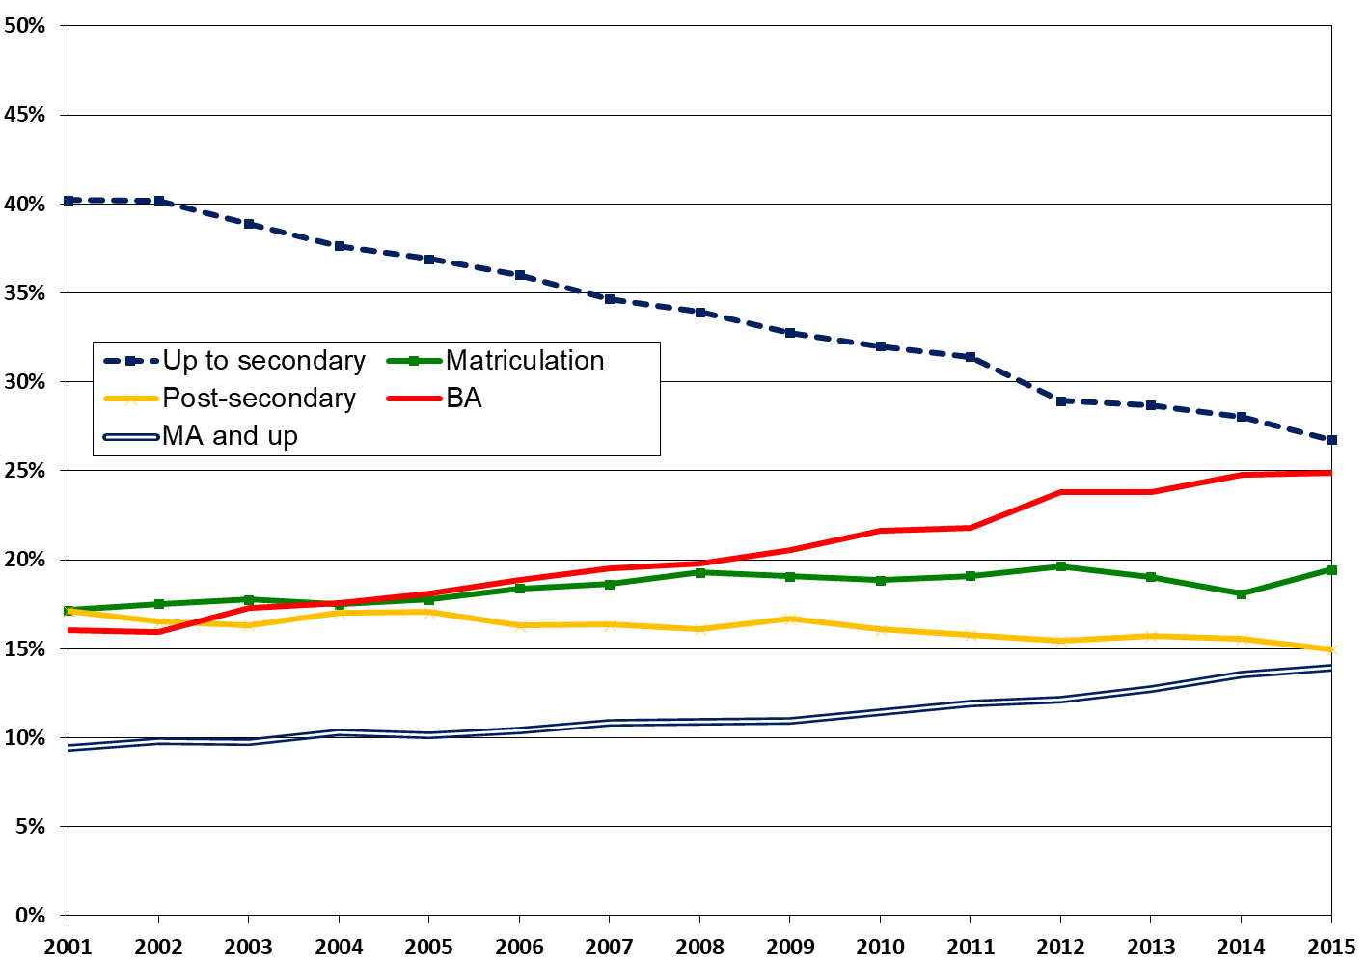
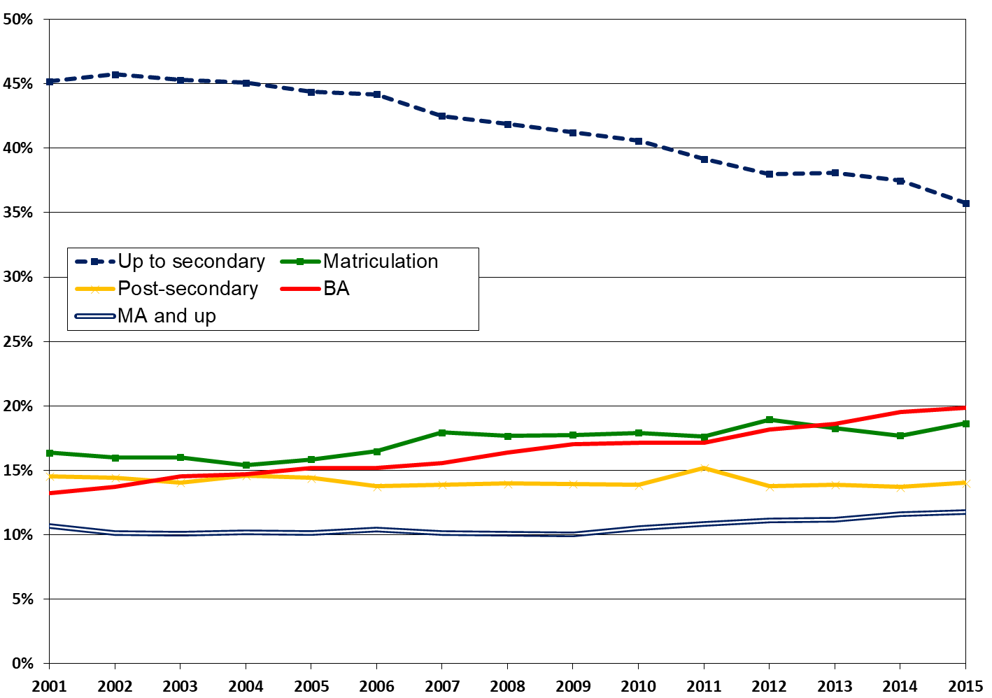
Has the Distribution of Education Lead to an Increase in Employment?
Men Women
Increase in the percentage of those with university education from 2002 to 2015 (women: from 26% to 39%, men: from 24% to 32%) is related to (when employment in each education is maintained at its 2002 level)
40% of the increase in women's employment
20% of the increase in men's employment
Ages 25-64. Up to high school including without a certificate and an unknown certificate; Post-secondary education includes non-academic technological or professional education.
SOURCE: Based on labor force surveys.

Slide 13
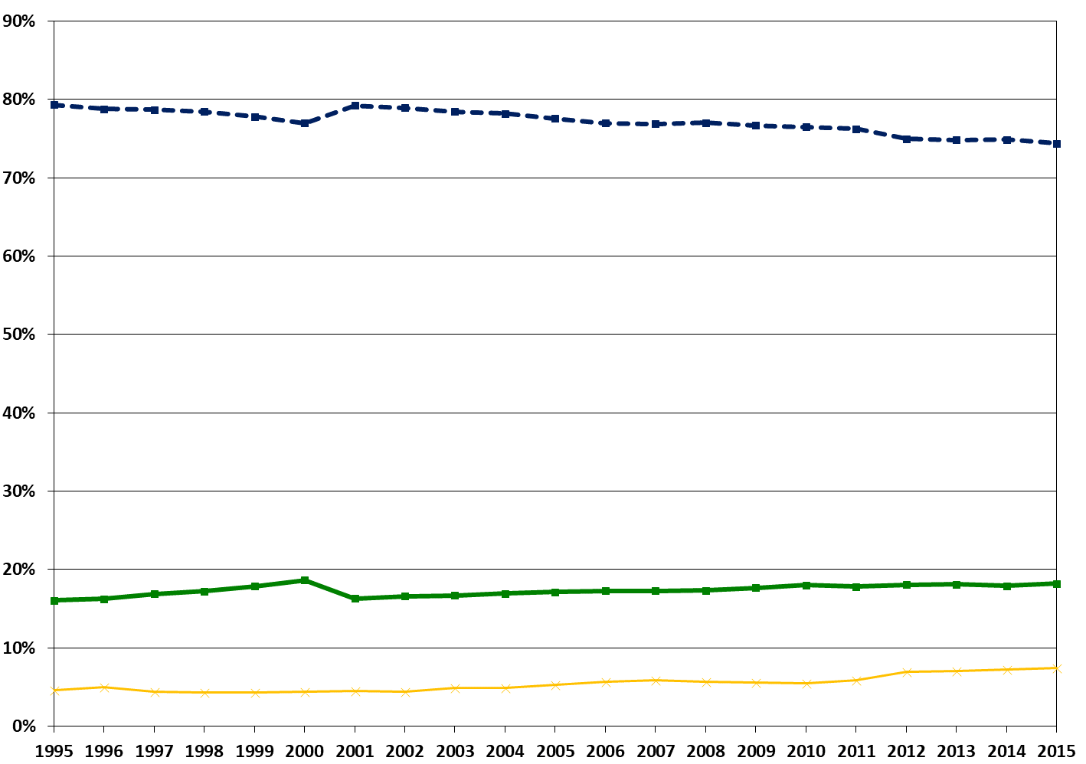
Did the Population Distribution Lead to an Increase In Employment?
non-Orthodox Jews
Arabs
ultra-Orthodox
An increase in the percentage of Arabs (from 17% to 18%) and ultra-Orthodox (from 4% to 7%) leads to a decrease in employment
This is one of the significant long-term challenges
Ages 25-64. Up to 2000 Arabs, including non-Jews. Identifying Haredim according to the last school approach.
SOURCE: Based on labor force surveys.

Slide 14
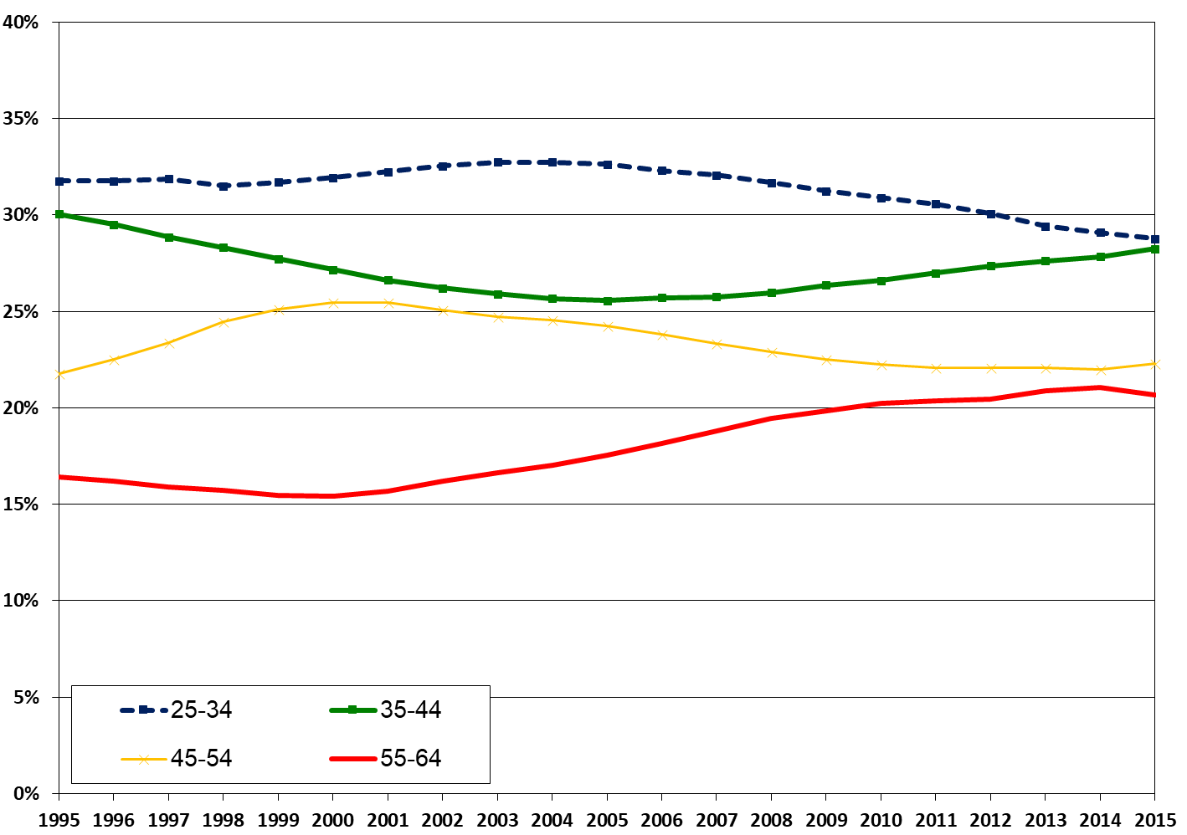
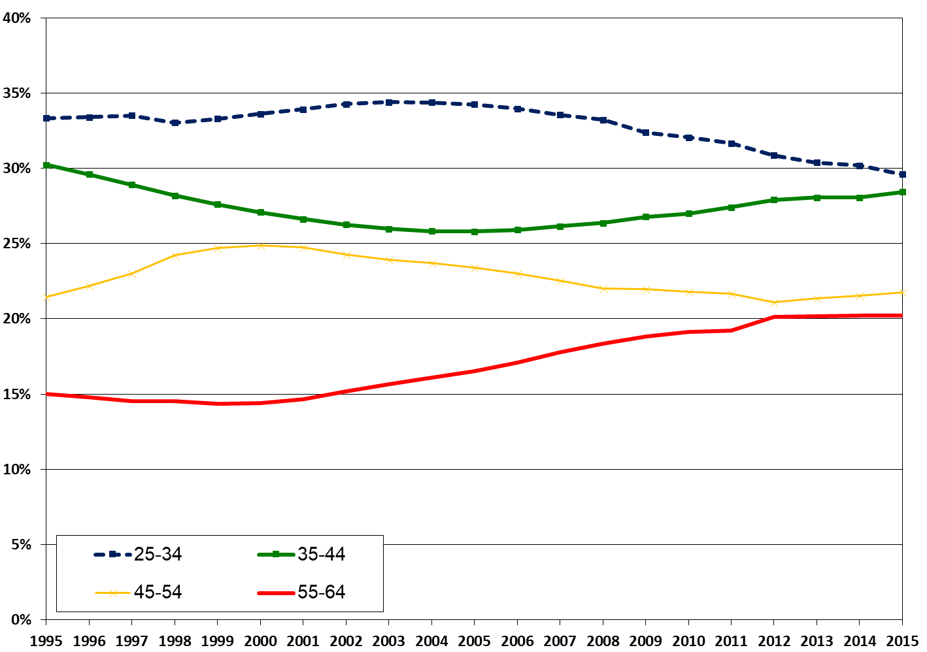
Has the Distribution of Ages Lead to an Increase In Employment?
Men Women
An increase of 55-64 - leads to a decrease in employment
SOURCE: Based on labor force surveys.

Slide 15
Has the Distribution of Productivity Lead to an Increase In Employment?
An increase in the rate of couples with three or more children - leads to a decrease in employment
Arab women - an increase in employment and a decrease in fertility (the rate of couples with three or more children was 45% in 2002, 37% in 2015)
Haredi women - an increase in employment with almost no change in fertility (the proportion of couples with three or more children 57%)
Fertility is endogenous (not in this article)
Persons aged 25-64 (head of household). Identifying pairs according to economic context. NUMBER OF CHILDREN AGED 18 IN THE HOUSEHOLD.
SOURCE: Based on labor force surveys.

Slide 16
Has the Yield to Education Increased from 2006 to 2015? A Wage Equation (With Heckman’s Correction for Selection)
 | Men | Women
 | 2006-2015 | 2006-2015
Matriculation | 0.123 | 0.281
Post-secondary | 0.195 | 0.356
BA | 0.523 | 0.704
MA and up | 0.629 | 0.879
Ages 35-44 | 0.200 | 0.180
Ages 45-54 | 0.257 | 0.207
Ages 55-64 | 0.319 | 0.109
Arabs | -0.225 | -0.391
Ultra-Orthodox | 0.147 | 0.000
Constant | 3.602 | 3.069
The explained variable - the log of hourly wages of salaried employees, at 2015 prices. The omitted group - education up to high school, ages 25-34, non-ultra-Orthodox Jews.
Source: Author processing by income and expenditure surveys.

Slide 17
Has the Yield to Education Increased From 2006 To 2015?
Men Women
MA and up
BA
MA and up
Post-secondary
BA
Post-secondary
Matriculation
Matriculation
The yield to education is almost unchanged; An increase in the yield on second degree and above; A slight increase in the yield on experience (age) - can not account for the increase in employment directed towards groups with low earning potential
Permanent and progressive population groups, with no significant change over the period
The coefficients are derived from salary revisions with the KMN correction, for each year separately.

Slide 18
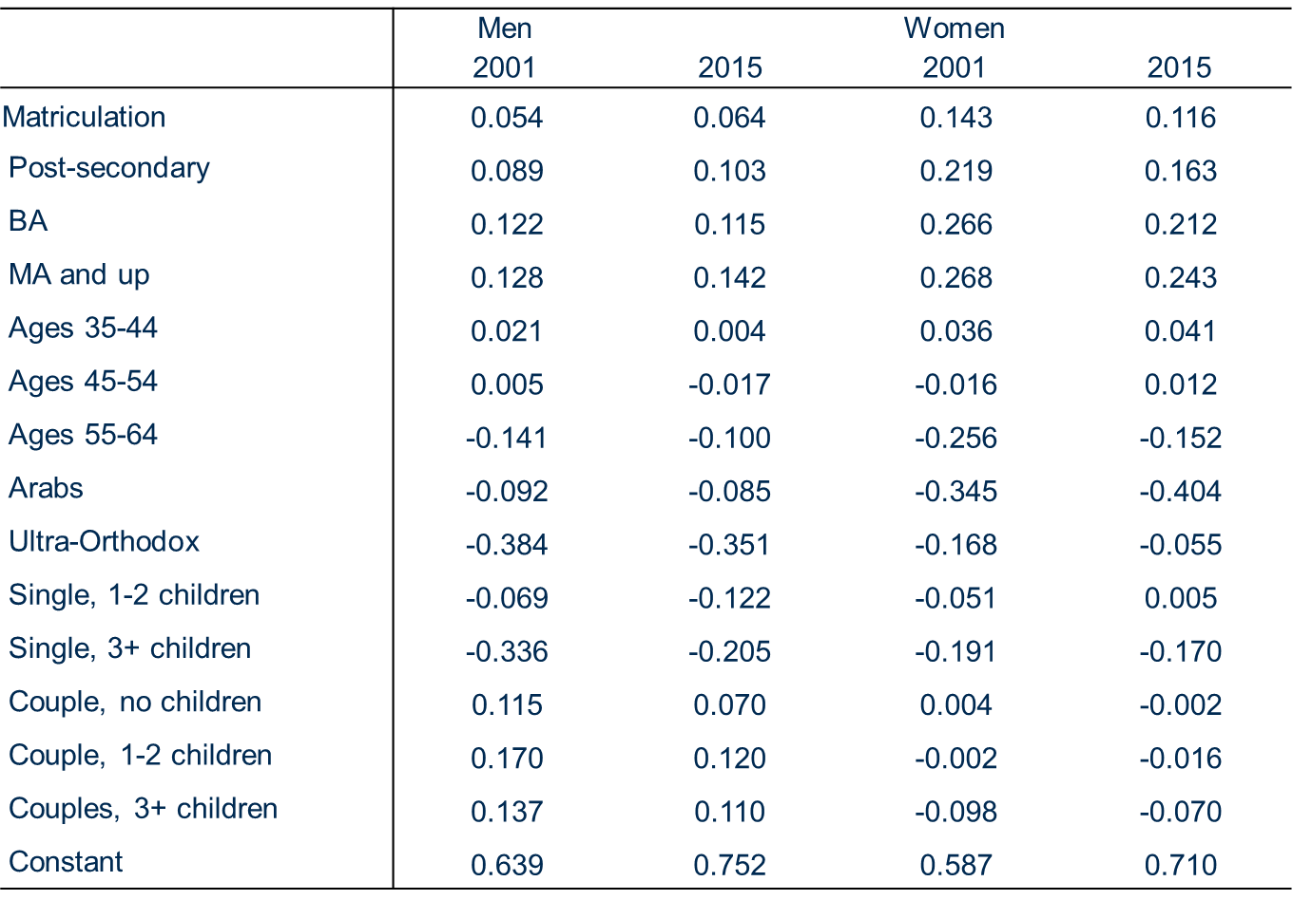
Employment Equation (LPM), 2001-2015
The permanent change in LPM is the change in employment independent of the explanatory variables

Slide 19
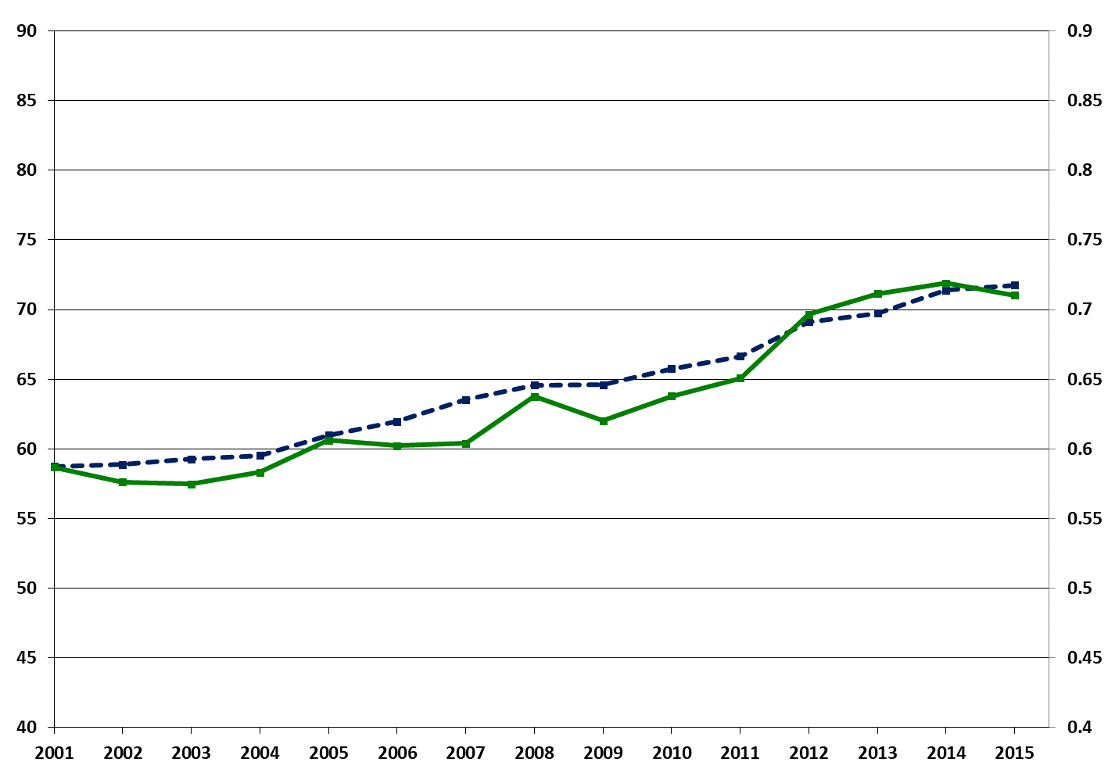
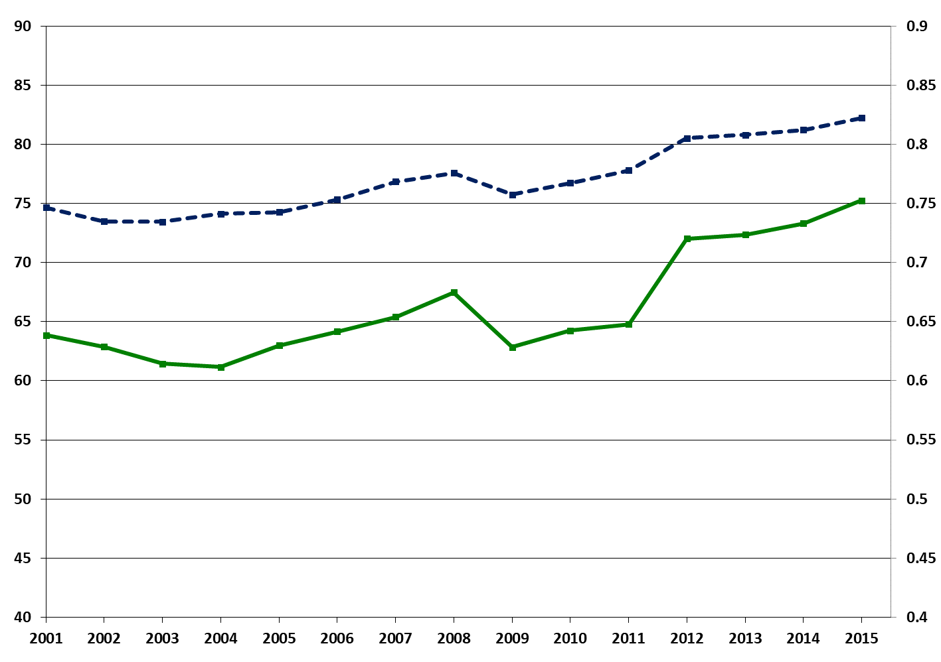
Constant Change ("Policy"), 2001-2015
Men Women
Employment rate
Employment rate
Constant (right)
Constant (right)
Parallel trends, the same change - most of the increase in employment stems from exogenous factors (policy changes)
Which is determined by the LPM regression for employment, each year separately.

Slide 20
Policy for Increasing Incentives for Employment 2003-2015
Policy focused on low income earners and large families:
Reduction of income support benefits and tougher conditions (2003)
Cutbacks in child allowances (from the third child onward) (2003)
Reducing unemployment benefits, toughening conditions and shortening the period of entitlement (2002-3)
Lower income tax rates, mainly for those with low incomes (2002, 2004)
Raising the retirement age for pension (2004)
Welfare-to-Work Programs and Orientation Centers (2005, 2007, 2014)
Work grant ("negative income tax") (2008, 2012)

Slide 21
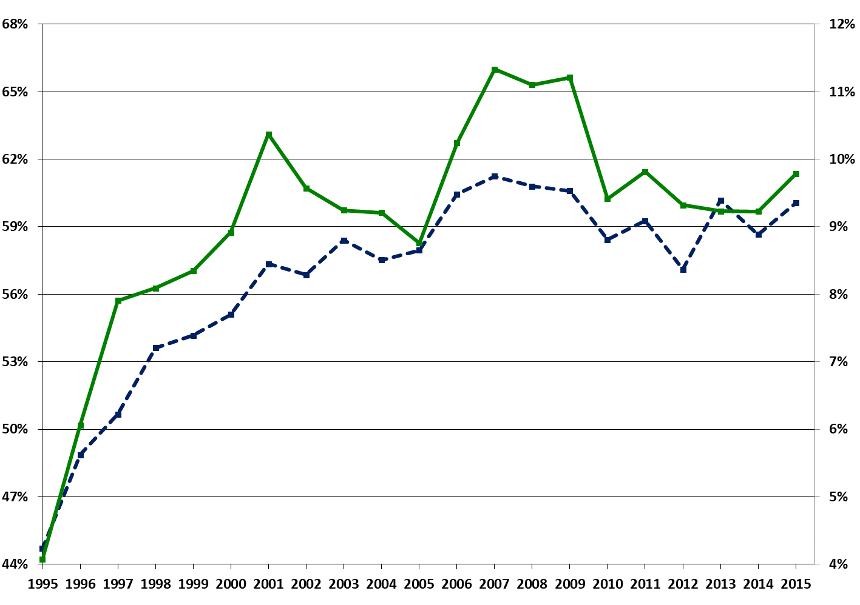
Increase in Minimum Wage, but there is No Full Enforcement
Share of employees under hourly minimum wage (right)
Minimum/median wage ratio
The hourly minimum wage, the median hourly wage for all salaried employees. Who earn below the minimum wage for salaried employees aged 25-64.
Source: National Insurance Institute.

Slide 22
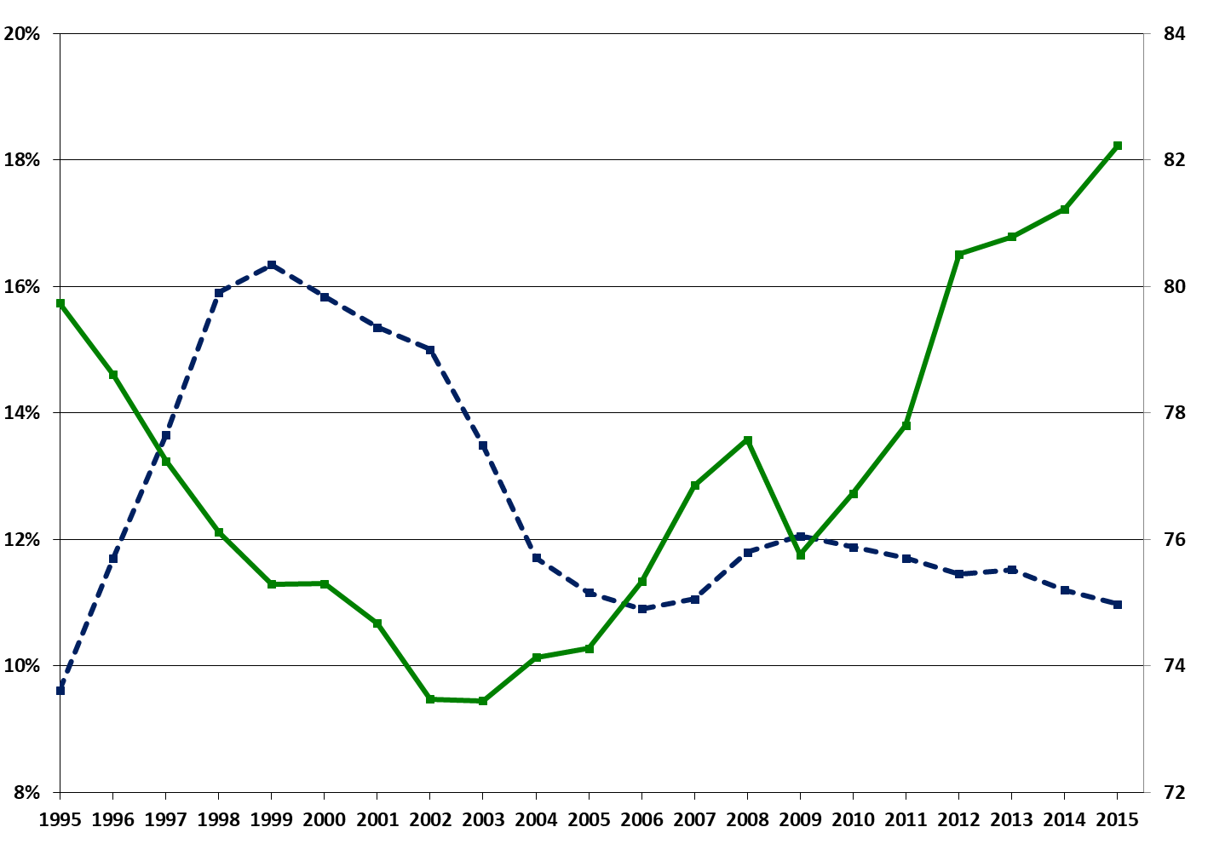
Decrease in the Rate of Foreign Workers (Legal And Illegal)
Share of non-Israeli workers in the business sector
Employment rate, men (right)
SOURCE: Bank of Israel and calculations of the authors from Labor Force Surveys.

Slide 23
Income Support Benefits and Children - Actual Payment
Welfare payment per households (NIS)
% households under welfare support (right)
Child allowance per household (NIS)
A decline in the percentage of households receiving income support and in the actual amount - a cause and effect of the increase in employment
A positive correlation between the rates of decline in allowances and the increase in employment (across population groups and households)
גילאי 25-64 (ראש משק הבית). סכום ממוצע למשק בית רק למשקי בית המקבלים את הקצבה, במחירי 2015.
מקור: עיבודי המחברים מתוך סקרי הכנסות והוצאות.

Slide 24
What is the Effect of the Policy on:
Wage
Household income
Poverty and inequality

Slide 25
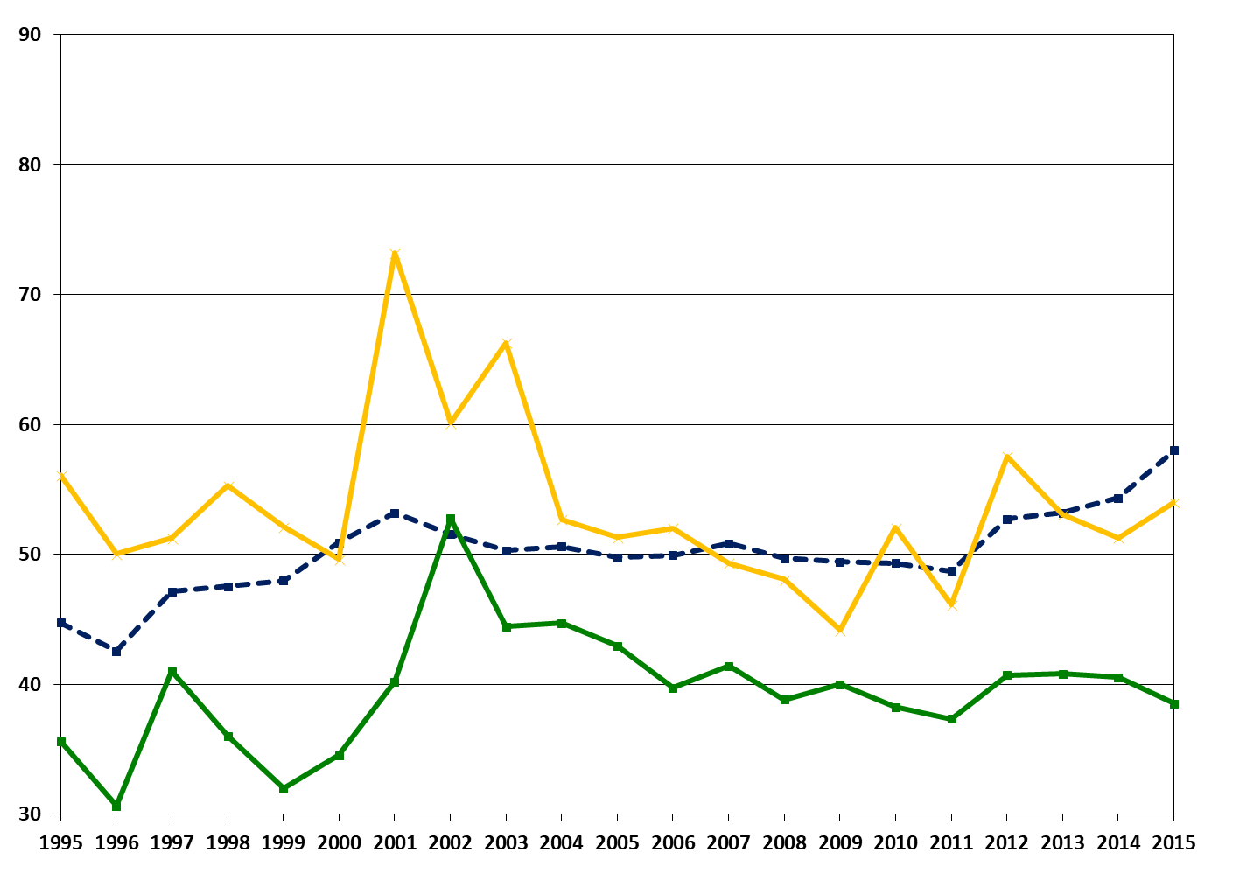
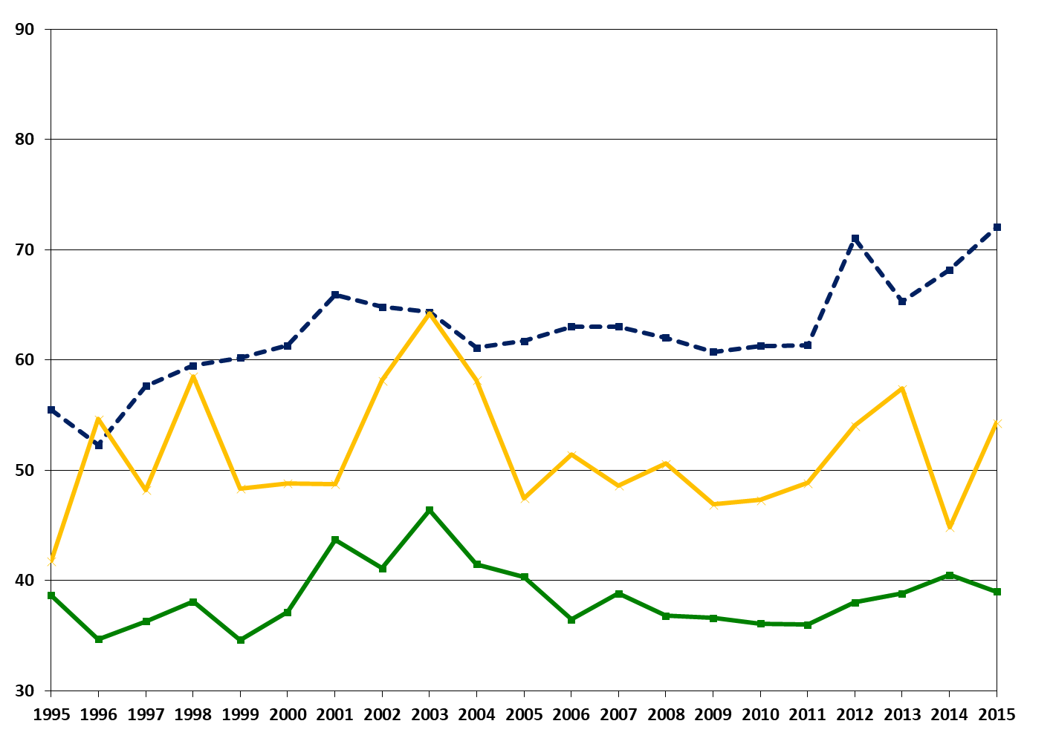
Hourly wages by population group
Women Men
non-Orthodox Jews
non-Orthodox Jews
ultra-Orthodox
ultra-Orthodox
Arabs
Arabs
Wage has not declined, despite the entry of those with low earning potential
Only a slight rise for non-ultra-Orthodox Jews, especially those with an academic education
The hourly wage gaps have hardly changed, not even by deciles
Hourly wages per employee, at 2015 prices. Source: Author processing by income and expenditure surveys.

Slide 26
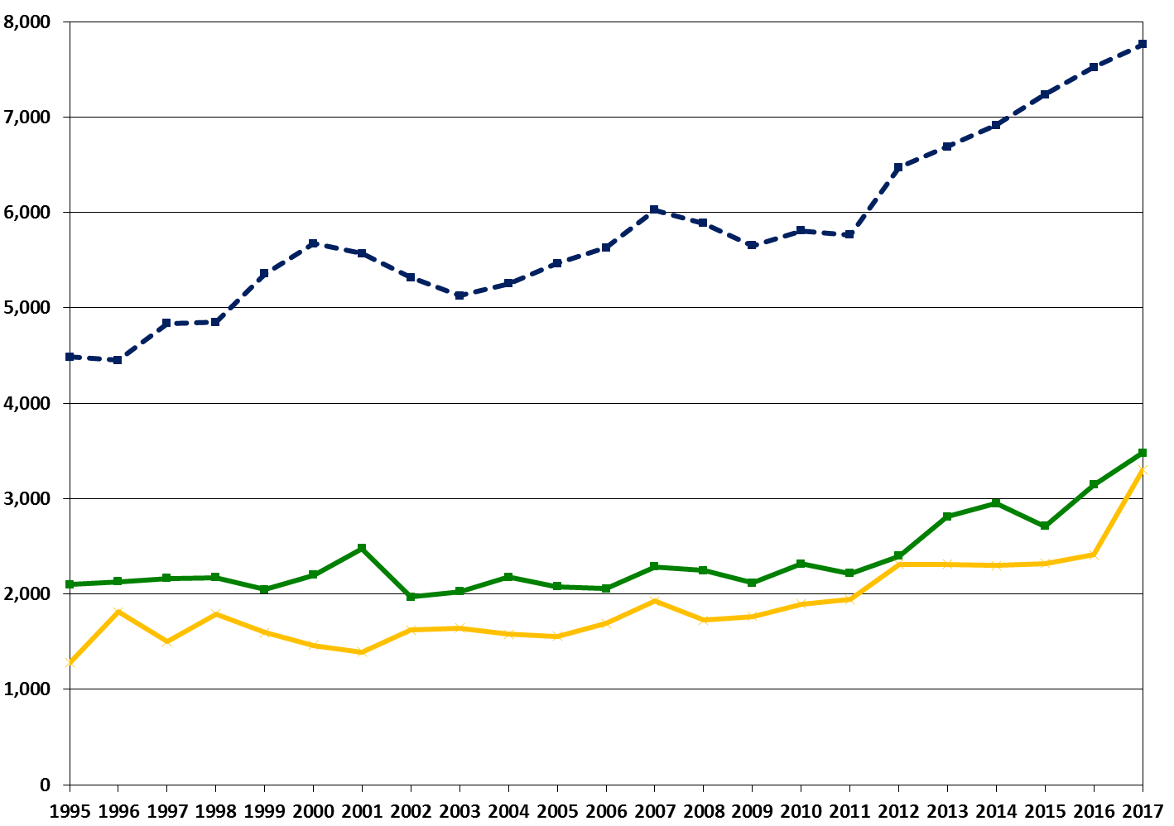
(Gross) Income of Households
non-Orthodox Jews
Δ2002-2017: 46%
Arabs
Δ2002-2017: 77%
ultra-Orthodox
Δ2002-2017: 104%
An increase in all population groups, in all types of households and in all deciles
A greater increase in income from work for households with a greater increase in employment
Persons aged 25-64 (head of household). Income from work per standard person in all households, at 2017 prices.
Source: Author processing by income and expenditure surveys.

Slide 27
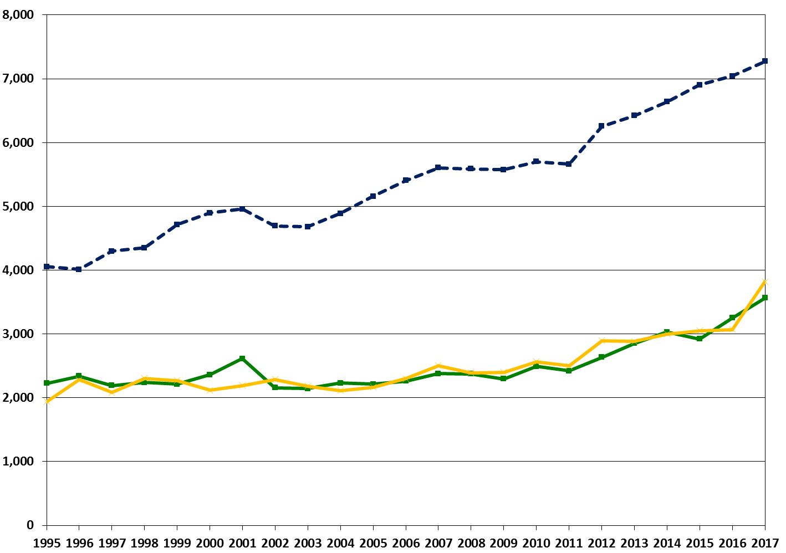
Net Disposable Income of Households
non-Orthodox Jews
Δ2002-2017: 55%
Arabs
Δ2002-2017: 65%
ultra-Orthodox
Δ2002-2017: 67%
An increase in all population groups and in all deciles - despite the substitution between income from work and welfare payments
The gaps have been narrowing in recent years, but still large
Persons aged 25-64 (head of household). Income from work per standard person in all households, at 2017 prices.
Source: Author processing by income and expenditure surveys.

Slide 28
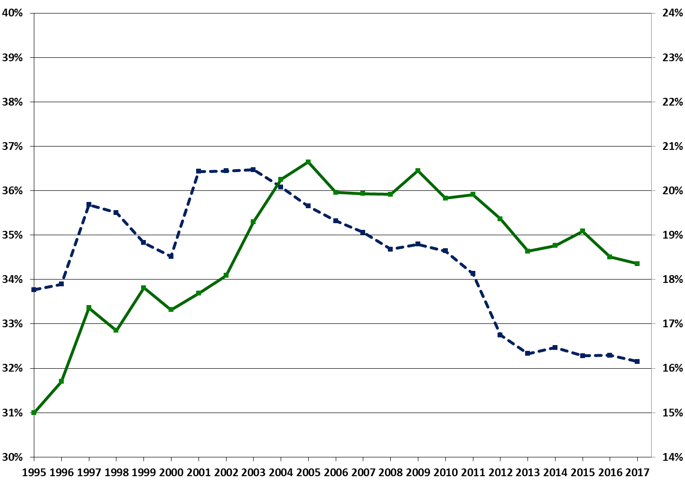
The Incidence of Poverty Among Households: Income from Work and Disposable Income
Share of households under the gross income “poverty line”
Share of households under the disposable (net) income poverty line
A continuing decline in poverty and inequality by income from work
In the first years, an increase in poverty and inequality by disposable income; The decline comes in delay
All ages. Source: Author processing by income and expenditure surveys..

Slide 29
Summary
Increase in employment as a result of a policy focused on work incentives
An increase in household income and a decline in poverty, but it is still high
Wages and fertility are constant, and low for individuals without an academic education
The main challenges:
Increasing the employment of Arab women and Haredi men
Raising the wages and fertility of individuals without academic education, Arabs and ultra-Orthodox

Slide 30
An Increase in the Employment Rate is not Enough
GDP growth over the last decade - 3.5% per year:
Employment (total hours worked) - an increase of 2.6% per annum, 74% of growth
Productivity per hour worked - an increase of 0.9% per year, 26% of growth
Aaron Institute forecast:
The employment growth rate will slow significantly to 1.6% (with optimistic assumptions about employment targets 2030)
Without an accelerated improvement in productivity, GDP growth will slow to 2.3 percent a year - zero growth in GDP per capita
Resources for improving productivity: human capital, private capital, infrastructure

Slide 31
Committee for the Advancement of Employment Towards 2030
Ministry of Labor, Welfare and Social Services
The vision: To encourage growth while reducing poverty by increasing employment, exploiting and upgrading the employees' human capital
Recommendations on goals for the rate and quality of employment, and on means and practical plans for achieving the goals
The adoption of quantitative targets by the government has been proven to be an effective work tool
Criteria for determining the new objectives: Macroeconomic impact, simplicity and availability of data, operative at the core of the work force, broad consensus

Slide 32
Employment Committee 2030: Employment rate targets
 | 2018 | 2020’s Destination | 2030’s Destination, Ages 25-66
Ultra-orthodox men* | 50.2 | 63.0 | 65/70
Arab women | 38.2 | 41.0 | 53
Persons with disabilities (over 20%) | 41.9 | - | 51
Ultra-orthodox women* | 76.1 | 63.0 | 81
Arab men | 76.3 | 78.0 | 83
Non-ultra-orthodox Jews (men and women) | 85.0 | 83.0 | 86
Focusing on groups with low employment rates
Total employment in 2030 aged 25-66 - 80.4%, fifth place in the OECD today
Many ultra-Orthodox and ultra-Orthodox are employed in small and part-time jobs. To 2018 and the 2020 target for ages
25-64, the target for 2030 for ages 25-66. For people with disabilities, the last figure for 2016.Ultra-Orthodox according to the definition of the National Economic Council.
Persons with disabilities according to the definition of the National Insurance Institute.

Slide 33
Employment Committee 2030: Quality of Employment Objectives
 | Target 2030, ages 25-39
Ultra-orthodox women | An increase of 3.3% per annum in the nominal monthly wage A higher-than-expected rate for non-ultra-Orthodox Jewish women
Arab men | An increase of 3% per annum in the nominal monthly wage A higher-than-expected rate for non-ultra-Orthodox Jewish men
Women | An increase of 2.6% per annum in the nominal monthly wage
Ultra-orthodox men | An increase in the same rate for non-ultra-Orthodox Jewish men
Arab women | An increase in the same percentage of non-ultra-Orthodox Jewish women
Raising the productivity and income from household labor
Focusing on groups with a high employment rate but low wages and skills
Reducing the rate of employees below the minimum wage per hour from 10% to 5%
The set of goals will lead to a reduction in poverty
Ultra - Orthodox according to the definition of the National Insurance Institute.
Average annual rate of growth in nominal monthly wages (at current prices).

Slide 34
Employment Committee 2030: Reform in vocational and technological training
Vision: Improving the system so that it will provide quality vocational training and high-tech technologies as a central mechanism for improving the productivity and wages of employed persons, especially those in the lower half
The return on wages for a professional quality training year is no less than the return on academic education
Target Audiences of the Reform:
Young people who enter the labor market and do not apply for academic education
Unemployed or job seekers who have not yet entered the labor market
Employees who are afraid that their profession is gone and are on the brink of dismissal

Slide 35
Employment Committee 2030: Reform in vocational and technological training
Holistic vision of vocational training
Each training will meet a quality-yield criterion of at least 6%, in terms of wages (compared with the expected salary for graduates if they did not undergo the training)
Strengthening and expanding studies in areas where there is high demand and rising wages
Updating the programs according to market demand and with the participation of employers
Integration of actual work with employers (specializations) as part of the study programs
A combination of general human capital studies and soft skills for work - Hebrew, English, mathematics and digital literacy
Sequence of Accreditations and Chain Building Courses

Slide 36
Employment Committee 2030: Reform in vocational and technological training
The system monitors on the basis of quality criteria, with flexibility to the instrument institutions
Advantages of scale - a learning continuum and incentives for integration with the technological and academic colleges
Improving the image of the system
Competition between the instruments
This refers to learners according to their qualifications and market demands
Cost-based budgeting is dependent on yield, qualification and employment integration

Slide 37
Employment Committee 2030: Adjustments to the changing labor market
There is uncertainty as to the rate and extent of the changes
Establishing a platform for information accessibility, direction and diagnosis that will be available to employed persons, employers and training bodies, including information on trends in demand and supply by profession
Adapting the skills of the employees to the skills required in the labor market, with emphasis on soft (non-cognitive) skills and basic skills
Examining and adapting the labor laws in a manner that will enable diverse and mobility employment arrangements between employers
An examination of the implementation of retraining, training and upgrading programs for workers employed in professions with evidence of decline and therefore on the verge of unemployment or in cases where training is not implemented due to market failure

Slide 38
Employment Committee 2030: Employment programs for target populations
Increasing the effectiveness of the centers for the Arab population, focusing on Hebrew studies for Arab women
Improving the human capital of the Haredi population, focusing on English and digital literacy, and expanding the scope of the position for ultra-Orthodox women
Adapting programs to people with disabilities, including support for employers and tailored training

Slide 39
Thank You

