Slide 1
Housing Prices – Where to?
Prof. Zvi Eckstein
Dean of the Tiomkin School of Economics and Head of the Aaron Institute for Economic Policy, IDC Herzliya
Aaron Institute for Economic Policy
11 June 2019
Notes:
1

Slide 2
Real Price index of apartments: A cycle and a high trend that causes damage to the economy
Are prices in Israel high? Is turnover in Israel exceptional? Yes
Reasons for price increase: Ongoing reduction in the planning inventory of housing land relative to the addition of households
The government's not handling the problem
Six reforms that are not implemented – this crisis is an opportunity
2000-2015: An increase of 44%
2007-2017:
An increase o 90%
Rising wave
The stabilization program
1997-2007: a decrease of 22%
Annual change on the trend line: 1.93%
Notes:
לא מצאתי את האקסל

Slide 3
Real Housing Prices Over Time
The trend of real housing prices in Israel is higher than the OECD countries
The rise of housing prices increases inequality and harms the urban development of economy and welfare
.
Real-growth average
Israel- 2.9%
OECD – 1.5%
Prices of OECD dwellings
Price index of dwellings in Israel
מקור: עיבוד נתוני הOECD והלמ"ס.
Notes:
מצאתי נתונים עד 1983 עבור ישראל בלמ"ס

Slide 4
Square Meter Prices of Real Estate for 2014
Sharp increase in housing prices rather than office prices and construction costs
The conclusion of the increase in housing prices is not due to the construction costs, so what is it?
.
The rise of land prices for housing is also due to financing limitations to the municipalities.
Price sqm real estate 2006-2016
Growth ratew2006-2016
Residence 64%
Offices 28%
Construction inputs 4%
Residence
Offices
Inputs
Source: Aaron Institute for Tax Authority data.
Notes:
תמחק את השקף המיותר

Slide 5
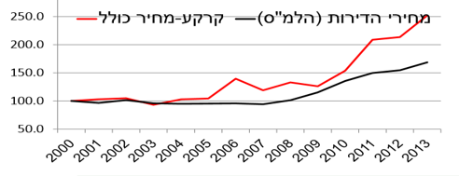
Land prices
Why are housing prices rising?
Due to a shortage of land for housing, especially in the Tel Aviv and Central Districts.
Prices of apartments - land -Total price
Source: Bank of Israel

Slide 6
Israel: One Central City (& Jerusalem)
Lack of land for housing in central Israel affects housing prices throughout the country: Israel is a single metropolis
So what should be done and not done?
Percent change by city
Average change in real estate 71%
Kiryat Motzkin
Pardes Hanna-Karkur
Kiryat Ata
Akko
Source: Aharon Institute for Tax Authority data.

Slide 7
Government activities in the field of housing
Although the housing crisis stems from problems in land supply most of the government's actions are on the side of demand
Increasing purchase tax for investors and tax on a third apartment
Taxes on housing of all kinds raises prices.
Apartment investors do not reduce the supply of apartments from the market, apartment for rent is available inventory for housing just as much as an owned apartment.
2. Subsidized housing prices
Subsidies through lotteries on a new apartment for a young couple - why not give a fixed subsidy on buying any apartment?
Government actions on the side of demand will not address the serious problems of the housing and real estate market and cause damage

Slide 8
Government actions on the demand side will not address the serious problems of the housing and real estate market and cause damage
Roof agreements. Financing one-time investments to local authorities in order to increase building permits. A temporary solution that does not deal with the constant negative incentive of the authorities to add households.
Inventory of land available for construction, step in the right direction - but...
Establishment of an authority for urban renewal, with an annual budget of NIS 80 million, compared to the required budget? (~ Billion shekels).
There is an increase in planning but not in land available for construction and land prices do not show a decline - a necessary condition for the decline in housing prices

Slide 9
Government actions encourage uncertainty in the housing market
Government actions and proposals affect the housing market both on the demand side and on the supply side, and in practice increase the uncertainty for purchasers of the first apartment, for the investors and for the contractors.
Will the taxation on owners of apartments increase investment?
The risk of buying an apartment increases
Will more land and apartments be offered?
Better to wait before you buy an apartment first (prices have fallen?)
It is better to wait before starting a large construction project
(Land prices dropped - less construction starts)
If the uncertainty in the housing market falls later on, the demand for apartments will increase both from investors and buyers of the first apartment and in the short term there will be less available supply

Slide 10
Inventory of housing units per household - descending; Housing prices relative to GDP per capita - are rising
h
The decline in the inventory of housing units across all cities

Slide 11
Increase in housing units
In 2018 the inventory increase the apartments reached a peak of 50,000 apartments for the first time since 1997
Will the trend continue?
Tel Aviv

Slide 12
Increase in housing units
The main development on the side of supply in 2016-2018 was an increase in construction beginnings, which peaked in 2016, while construction starts fell by 5% in 2017 and 10% in 2018.

Slide 13


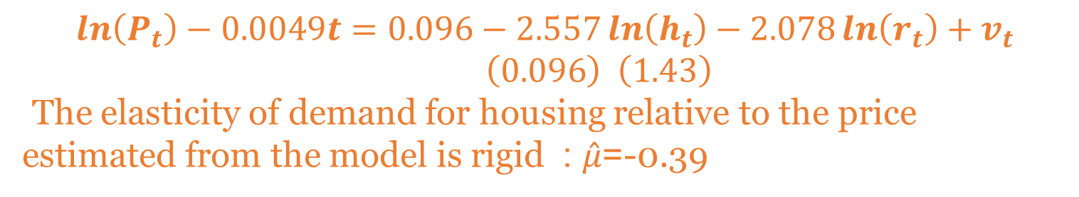
The estimated model
$\ln\left(P_{t}\right)−0.0049t=0.096−2.557\ln\left(h_{t}\right)−2.078\ln\left(r_{t}\right)+v_{t}$ $\left(0.096\right) \left(1.43\right)$
The elasticity of demand for housing relative to the price estimated from the model is rigid : $\hat{μ}$=-0.39
$\left(0. 589\right)$
v1=1.246, v2=-0.25 Serial adapter coefficients in $v_{t}$
$R^{2}=0.955,$ RMSE=0.129=12.9%

Slide 14
The model from 2000
The behavior of housing prices given constant housing stock since 2000:
The cumulative difference in the average apartment price is 30%
estimation
Actual price
Fixed 2000 r
Constant 2000 h

Slide 15
2017.Q2-2019.Q1 Actual forecast
$\ln\left(P_{t}\right)−0.0049t=0.096−2.557\ln\left(h_{t}\right)−2.078\ln\left(r_{t}\right)+v_{t}$ $\left(0.096\right) \left(1.43\right)$
Forecast
From 1975 to the second quarter of 2017
Actual price versus one quarter forecast ahead
v1=1.246, v2=-0.25

Slide 16
Forecast by completing construction
2019-2024
Construction of 80 thousand housing units per year over the next few years will stabilize the housing prices at the current interest rates construction up to 2021 according to construction starts in the last two years
forecast
forecast 2019 Q1
Notes:
אמידה עד 2017\Q2
תחזית מq1\2018

Slide 17
The Reforms that are Recommended in order to Increase the Inventory of Land Available for Housing
Planning reform
Increasing the inventory of housing permits at a level that will meet the natural demand for the next 10 years
Especially in the Tel Aviv and Gush Dan districts in order to lower land prices in the center.
Reform of the Israel Lands Administration
The sale of land is not programmed in city centers in general, and especially in the Gush Dan region. Marketing planned and unplanned land while waiving the determination of minimum price and taxation of land value as long as the land is not built.
Reforming the financing of local authorities
In order for local authorities to increase building permits, the form of financing of local authorities should be changed.
The financing of the authorities will be determined in a manner that encourages the development of residential real estate and real estate for businesses according to the levels of demand in the various regions.
An example of this reform is a new article by Roi Shalem and Tal Mukkady

Slide 18
The Reforms that are Recommended In order to Increase the Inventory of Land Available For Housing
Reform in urban renewal
Increasing the budget for urban renewal so that the level of urban renewal will reach 20,000 housing units per year.
Reform in industrialization of construction
Promoting productivity and efficiency in the residential construction sector by investing in equipment (accelerated depreciation), standard construction components and entry of foreign companies from developed countries
Reforming the urbanization of the Arab sector
Turning the centers of Arab communities into urban centers, high-rise construction with industrial and commercial centers, creating accessibility through efficient public transport, and focusing on communities along Route 6, Wadi Ara and the Bedouin settlements in the Negev.

Slide 19
Thank You!

Slide 20
Price Per Occupant
By the end of 2018 there were 136 thousand entitled to the price of occupant and the price target of which 57 thousand participated in the lottery price occupant.
Lotteries are held at the planning stage even before the appropriate entrances have been established, so there is a large time gap between winning the apartment.
While a couple without an apartment is required to rent an apartment and pay mortgage so increased their financial risk.
The tenders tend to be in the periphery and not in Tel Aviv and the center where 50% of the households differ from actual demand (excluding Jerusalem)
The Bank of Israel claims that it is possible that the first apartments in the neighborhood will serve the winnings in communities far from their homes in order to rent the apartment.
Since the risk of falling housing prices outside the center is greater, they are raising their financial risk.

Slide 21
Price to be transported by provinces
 | Tel Aviv | Center | Jerusalem | Haifa | Everything Else | Total
Tenders by the end of 2018 | 6132 | 27995 | 22821 | 19369 | 35710 | 112027
Percentage of total tenders to contractors by the end of 2018 | 5% | 25% | 20% | 17% | 32% | 100%
Percent of total winners by April 2019 | 20% | 26% | 13% | 8% | 34% | 59964
Percentage of the apartments that were divided in lottery to eligible until April 2019 | 7% | 31% | 11% | 13% | 38% | 60050
Percentage of payables recorded until April 2019 | 22% | 24% | 13% | 8% | 33% | 145000
Source: Israel Lands Authority

Slide 22
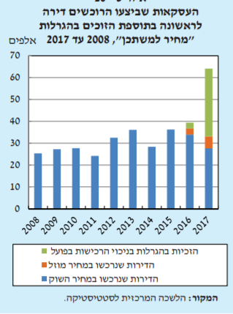
First apartment buyers prefer to buy apartments at market prices probably from incompatibility between the residential area and the winning
Transactions carried out by purchasers first apartment plus winners of the lottery "occupant price", 2008 to 2017
Lottery winnings in the actual purchases
The apartments purchased at a discounted price
The apartments purchased at the market price
Source: Bank of Israel

Slide 23
Inventory of housing units for households by city, 1990-2016
A steady decline in every city for three decades

Slide 24
The gap between the stock of dwellings and the total number of households, 26 selected cities, 1990 - 2016
Kfar Saba
Rishon Letsoin

Slide 25
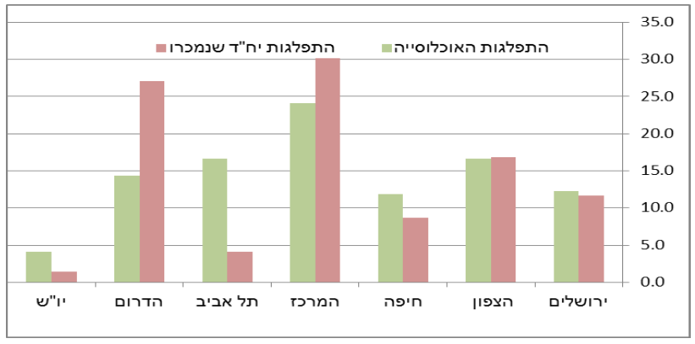
Sale of land by Israel Land Administration 1998-2013
Residential units Distribution Sold
Population distribution
West Bank
South
Tel Aviv
Center
Haifa
North
Jerusalem
Source: Weitzman Nagar Bank of Israel
Marketing lands 2014-2015
The population in Tel Aviv and the center constitutes 45 households only 25 of its marketing in Tel Aviv and the centerIn contrast, 23 of the households in Haifa and Jerusalem comprise 39 of the markets
Source: Israel Land Administration

Slide 26
Real Change 2007-2016
Average real change 71%
Nesher
Kiryat Ata
Haifa
Kiryat Yam
Askelon
Pardes Hanna-Karkur

Slide 27
Increase in building permits
Number and permits for private construction between 2007 and 2015 and the target for 2016
The source of the logging and the Aharon Institute

Slide 28
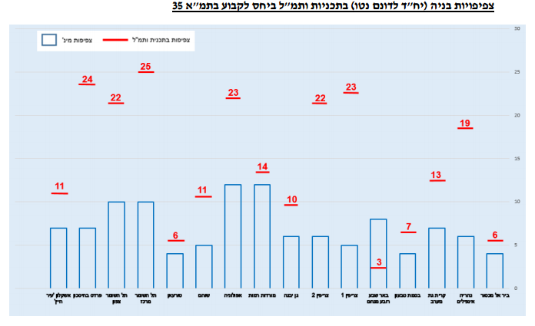
Activities of the National Committee for Planning and Construction of Preferred Housing Areas
The National Committee for Planning and Construction of Preferred Housing Areas was established as a governmental tool aimed at increasing the stock of housing units in Israel.
In the first year in which the National Committee for Planning and Construction of Preferred Housing Areas was active, 53 complexes were declared, including 172,000 housing units, and eight plans were approved, including 32,000 housing units, of which 4 were approved, comprising 25,000 units, Of housing units that were validated in that year.

Slide 29
Demand For Housing
Household Necessary housing quantity $h_{t}$ dependent on the price of housing services $S_{t}^{}$in the permanent income of the household $y _{t}$
Assuming that the demand elasticity of household income is unitary and permanent, households' demand for housing is given by the following equation:
$h_{t}={aS}_{t}^{−μ}y _{t}$
Where μ is the elasticity of housing demand relative to price and 𝑎 constant

Slide 30
The Price Of Housing Services Equals Profit From Ownership
The price of housing services $S_{t}$ is equal to interest payments $r_{t}$ on apartment value + house maintenance expenses ${(P}_{t}δ$) Less capital gains ${(P}_{t}p_{t}^{e}$), where $P_{t}$ is the apartment price and $p_{t}^{e}$ is the expected profit on capital
The equation for the price of housing services is obtained:
$$S_{t}=\left(δ+r_{t}\right)P_{t}−P_{t}p_{t}^{e}$$
The higher the expectation of rising housing prices and the lower the interest rate, the lower the price of housing services

Slide 31
The Model Equation For Housing Prices
By placing the price equation in the demand equation obtained
$$\ln\left(P_{t}\right)+\ln\left(δ+r_{t}−p_{t}^{e}\right)=a_{0}−\frac{1}{μ}\ln\left(h_{t}\right)+\frac{1}{μ}ln⁡(y_{t})$$
Let us use approximation, $\ln\left(δ+r_{t}−p_{t}^{e}\right)≈φln⁡(r_{t})+a+ε_{t}$, assume a permanent increase in income, and approximate the housing price log equation:
$$\ln\left(P_{t}\right)−gt=a_{0}−\frac{1}{μ}\ln\left(h_{t}\right)−φ\ln\left(r_{t}\right)+v_{t}$$
Where $v_{t}$ is a random disorder that results from shocks to price and revenue expectations

Slide 32
Planning reform
Increasing the inventory of housing permits at a level that will meet the demand for the next 10 years.
district | Distribution of population | Growing from the home outlet | A planning inventory target is 10 times more recommended than population growth | Planning inventory at different stages | Planning gap 10 years | 40 year planning goals of the government | Gap 40 years
National | 100% | 52000 | 520000 | 436744 | 83256 | 2612000 | 2,175,256.00
Tel Aviv | 16% | 8320 | 83200 | 38163 | 45037 | 436000 | 397,837.00
Center | 25% | 13000 | 130000 | 62592 | 67408 | 637000 | 574,408.00
Jerusalem | 13% | 6760 | 67600 | 17991 | 49609 | 300000 | 282,009.00
Haifa | 12% | 6240 | 62400 | 42951 | 19449 | 310000 | 267,049.00
Everything Else | 34.00% | 17680 | 176800 | 275047 | -98247 | 929000 | 653,953.00

Slide 33
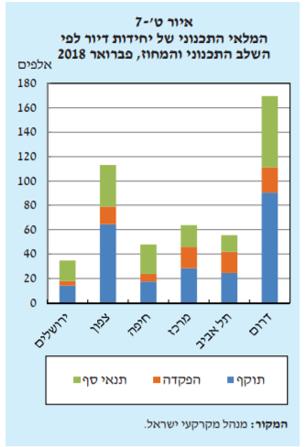
Inventory planning February 2018
The inventory is planned in the periphery, as opposed to the distribution of households
Tel Aviv
North
Haifa
Center
South
Jerusalem
Threshold conditions
Deposut
Validity
Source: Bank of Israel

Slide 34
Where is the demand?
Half of the households live in Tel Aviv and the Central District, and 23% of the planning stocks

Slide 35
Public building starts
“Construction in public initiative includes construction on land marketed by the Ministry of Construction and Housing, separately or jointly with the Israel Land Administration, but built by private developers.
Source: Ministry of Housing
Source: Aharon Institute for Central Bureau of Statistics Publications that are no longer available
Notes:
בנייה ביוזמה פרטית כוללת שני מרכיבים: בנייה על קרקע בבעלות פרטית (כ-59%) ובנייה על קרקע בבעלות המדינה המשווקת ע"י מינהל מקרקעי ישראל."

Slide 36
Housing starts fell from the peak of 2016
Building starts2007-2018

