Slide 1
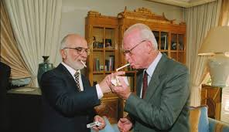
What Influenced Yigal Amir's Decision to Assassinate Prime Minister Yitzhak Rabin?

Slide 2
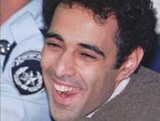
Yigal Amir During His Trial

Slide 3
One of Us...
Born in 1970 , Herzliya
Normative Family National Haredi tendency
National
High school "New Yishuv" in Tel Aviv
Yeshivat “Seder”
“Divnah Vineyard"
Fighter in the Golani Brigade
An emissary in Riga
Law student at Bar-Ilan University
Legitimate protest activity
Transition to planning violent and terrorist activities

Slide 4
"Without faith in my name, I had no power to do that - that is, faith in the afterlife. For the past three years, I have realized that Yitzhak Rabin is not a leader who can lead the people ... He has abandoned Jews, he lied, he had the lust for government. He brainwashed people and the media. He came up with ideas like a Palestinian state. He received a Nobel Peace Prize with Arafat but he didn't pay attention to his people. He split the people. He left the settlers aside and didn't consider them. I had to save the people because the people didn't understand. He used the term "peace victims“, soldiers were killed in Lebanon and Israel did not respond because there was a political process ... " From the report of the Inquiry Committee on the assassination of the late Prime Minister Rabin

Slide 5
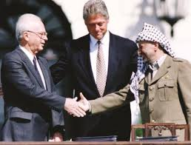
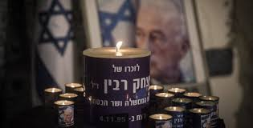
"What do you mean why did I shoot Rabin? Someone had to stop the Oslo Accords."
Amir testified at the Shamgar Committee
Signing of the Oslo Accords
13 September, 1993

Slide 6
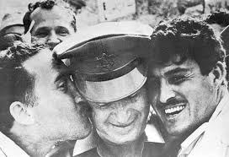
"The problem is that Rabin held the image of security in the people’s minds. Rabin closed people's eyes. People said that when he was there he could be trusted. And that mistake was a serious problem." "This prize is Haman, and Rabin is Achshverosh " Amir to the Shamgar Committee

Slide 7
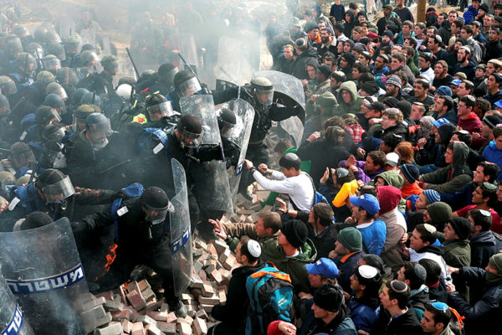
Rabin, the Man
"... I just need a nation, that's what I need. And our nation is torn, and I wasn’t the one who tore it down."
Yigal Amir’s investigation
"There is a persecuting law and it is permanent and a law does not apply to those who remove parts of the Land of Israel as well." Testimony of Amir to the Shamgar Committee

Slide 8
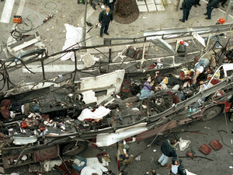
The Assassination's Influence on National Security
"...there is a more important imperative than “do not murder” and it is life-saving ..."
"A whole nation doesn't notice at all that a Palestinian state with an army of terrorists is here, and we will have to fight with them." Amir in Detention Extension 5.11

Slide 9
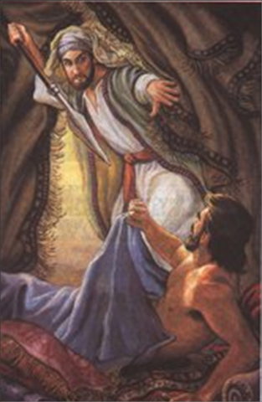
"Therefore I am to give him my covenant of peace, and he and his seed would have a covenant of world service, under which he envied his God and made atonement for the children of Israel." (Bamidbar 26, 12-13)
Jealousy of God - Pinchas Cohen's Act

Slide 10
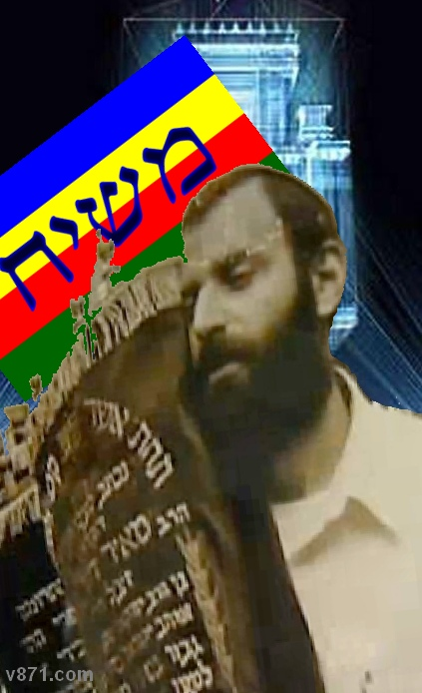
Revenge and Jealousy for the Land of Israel
"I went to the funeral. First of all, I wanted to know ... If a person gets up and sacrifices his or her life, it seems that this public is bothering him ... I saw the love they had for him ..." Amir, in testimony to the Shamgar Committee

Slide 11
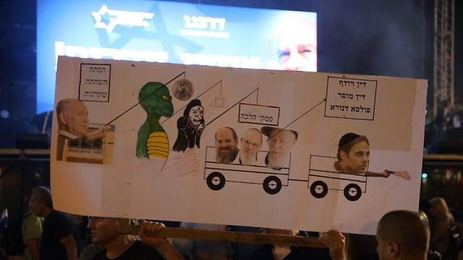
"Without a ruling or a haunting verdict that applied to Rabin by a number of rabbis I know about, I would have had a hard time murdering. Such a murder must be backed up. If I had no backing and many other people would not stand, I would not have acted." (Investigation Committee p. 89)
"I'm sure the victim wouldn't have been in vain otherwise I would not have succeeded.” Amir before the Shamgar Commission

Slide 12
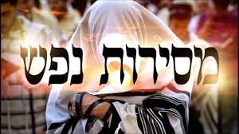
The Proximity-Adherence Attack on the Target
"Even when you kill in war, it's a negative act, but the goal is lofty and so you can do it ..." Amir in court
“Yigal was willing to risk his life" (Haggai Amir Diary 2.1.96)

Slide 13
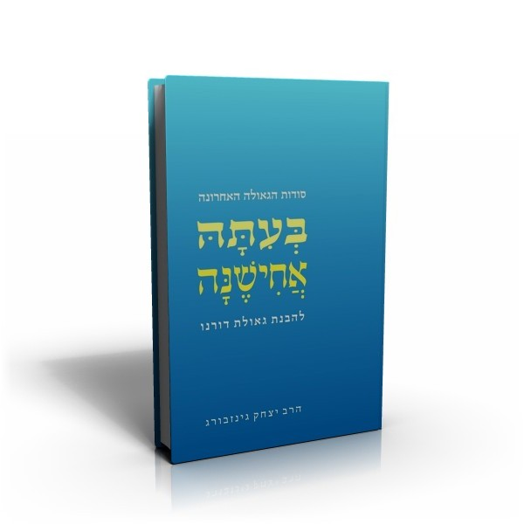
Days of Past..
Later on or immediately? The individual’s duty or the public’s duty?

Slide 14
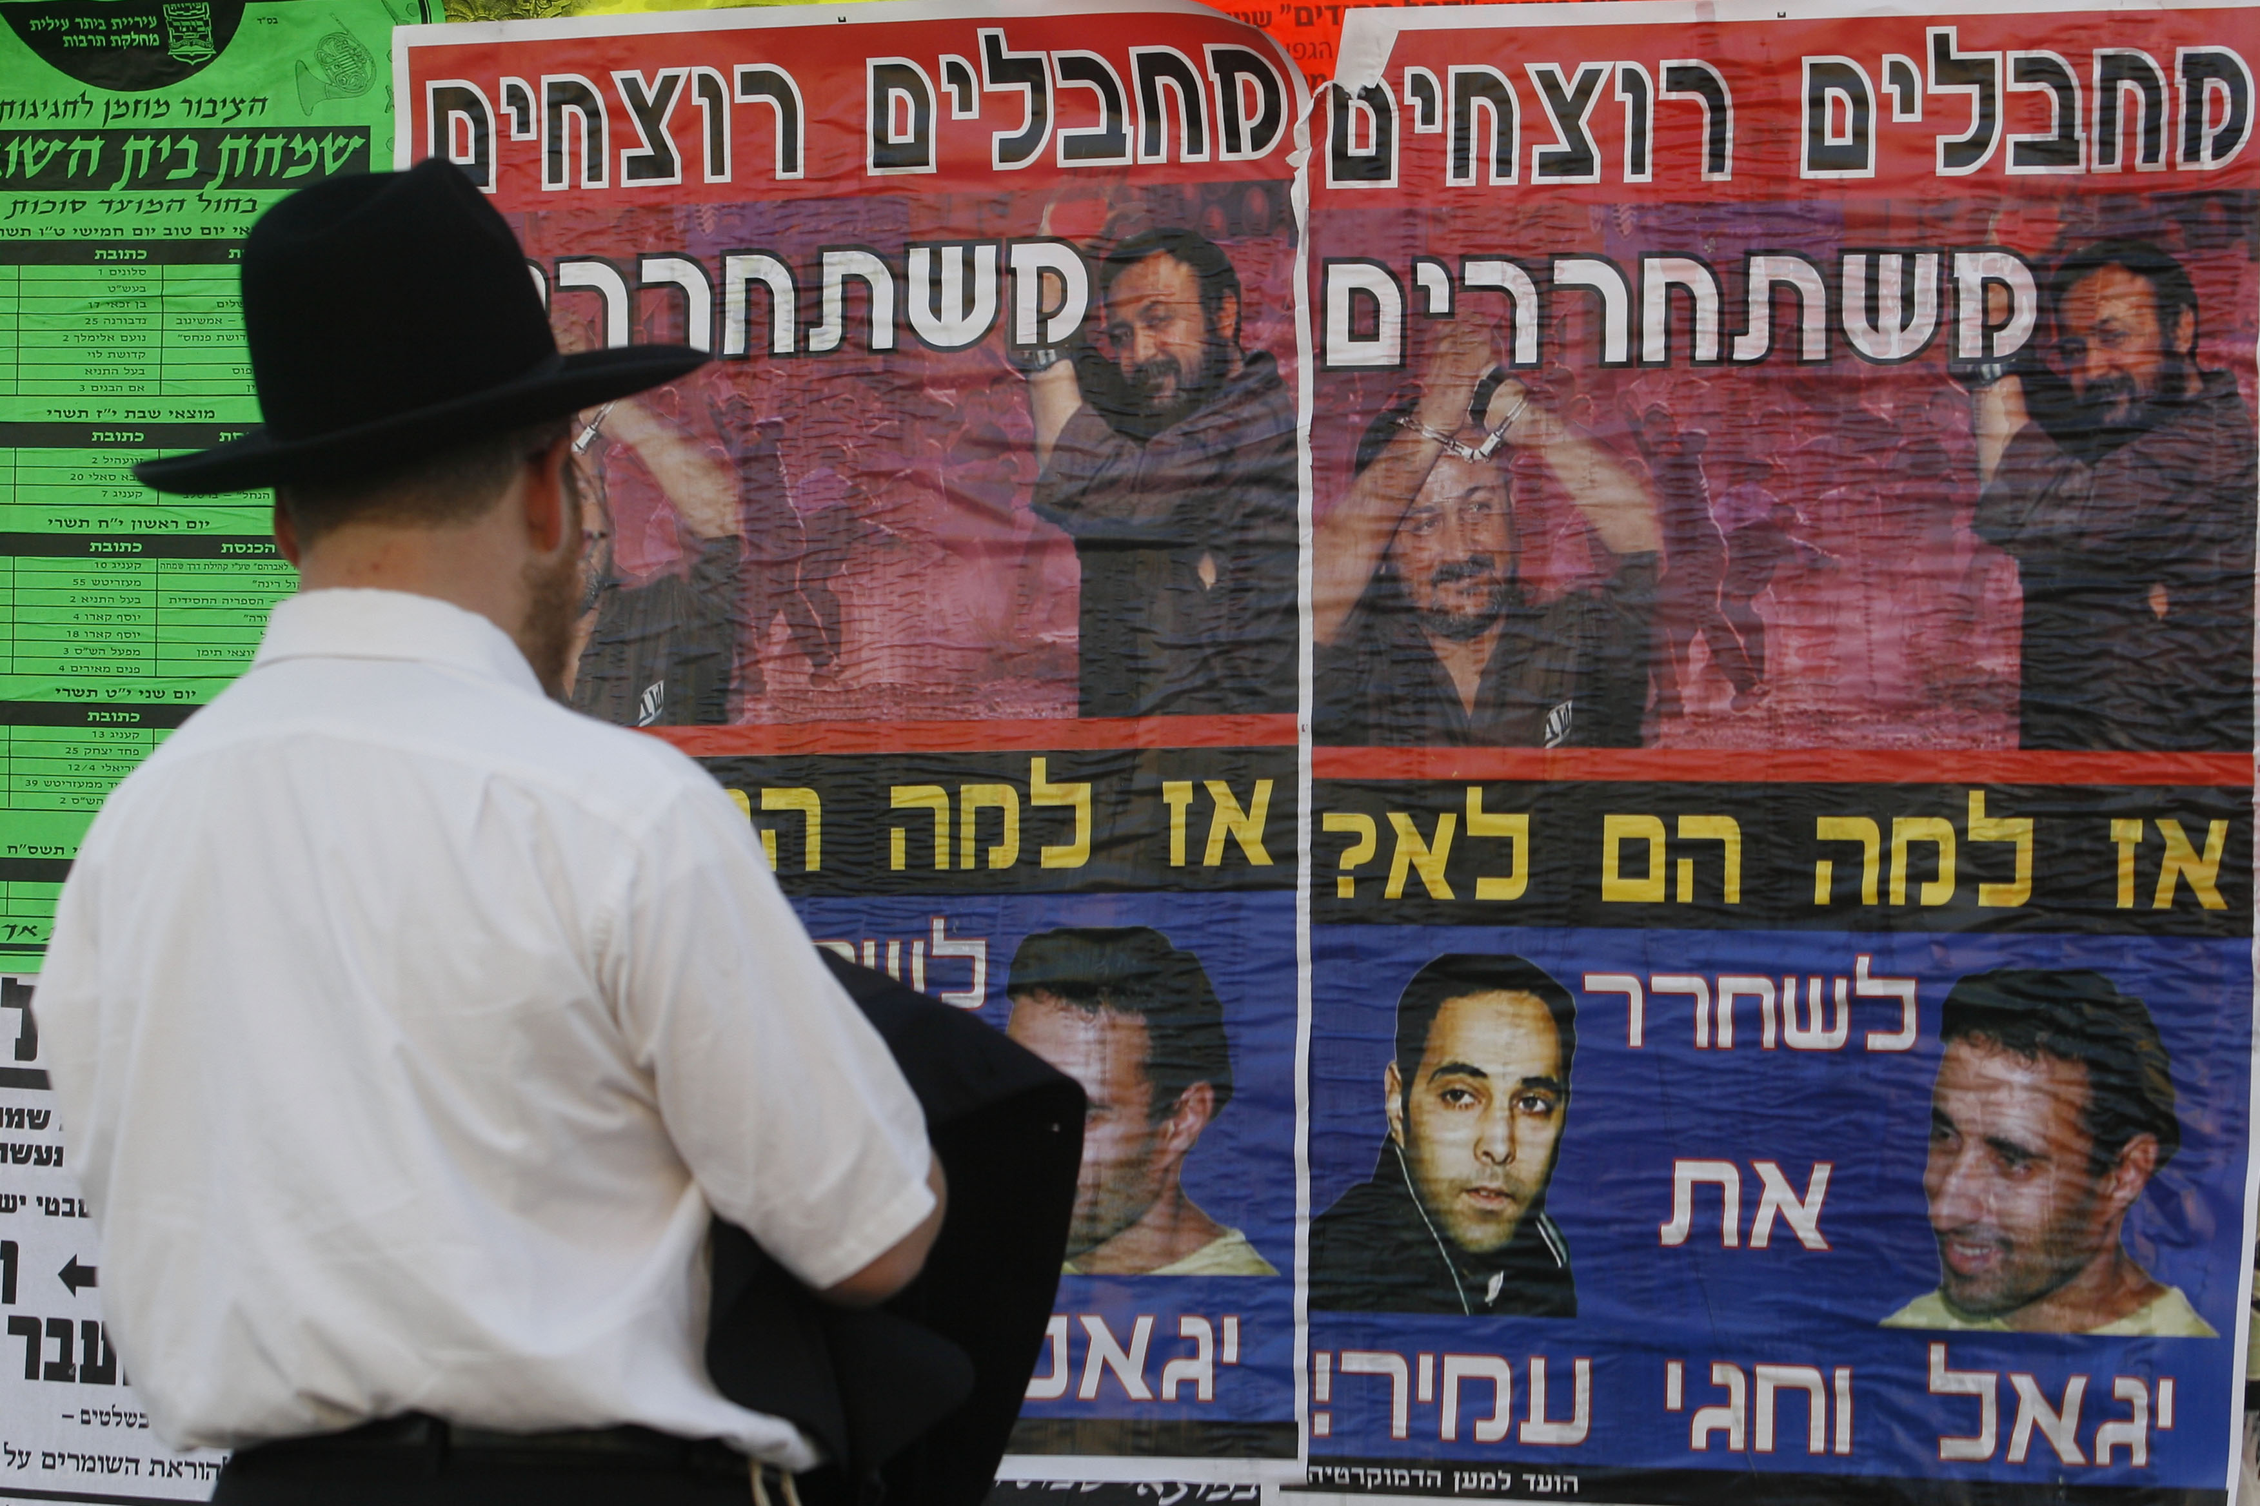
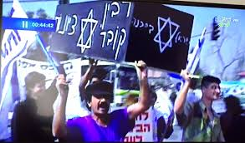
Leadership
"As soon as the nation stops working - the individual ones start working. There is no choice...I had to do what the individual does ..." Testimony of Amir in the Inquiry Committee

Slide 15
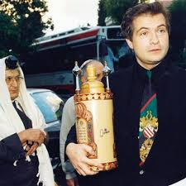
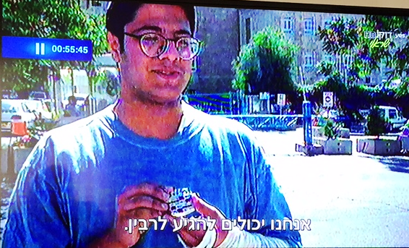
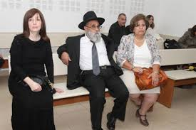
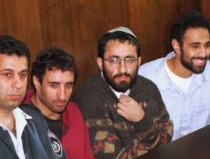
"I would say 'Rabin should be killed', and I would smile. Go and try to understand that from what Yigal means (...) People didn't take me seriously. People argued conceptually, as you argue (...) I assure you that many were happy with the ending"
From Yigal Amir’s Interrogation
"He is one of the righteous of the generation. Tomorrow will be a celebration of victory because Oslo's betrayal process is dead" Avigador Askin. Right wing.

Slide 16
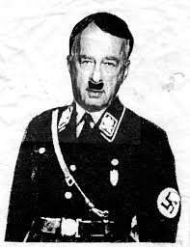
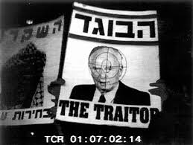
Personal Incitement and Extent

Slide 17
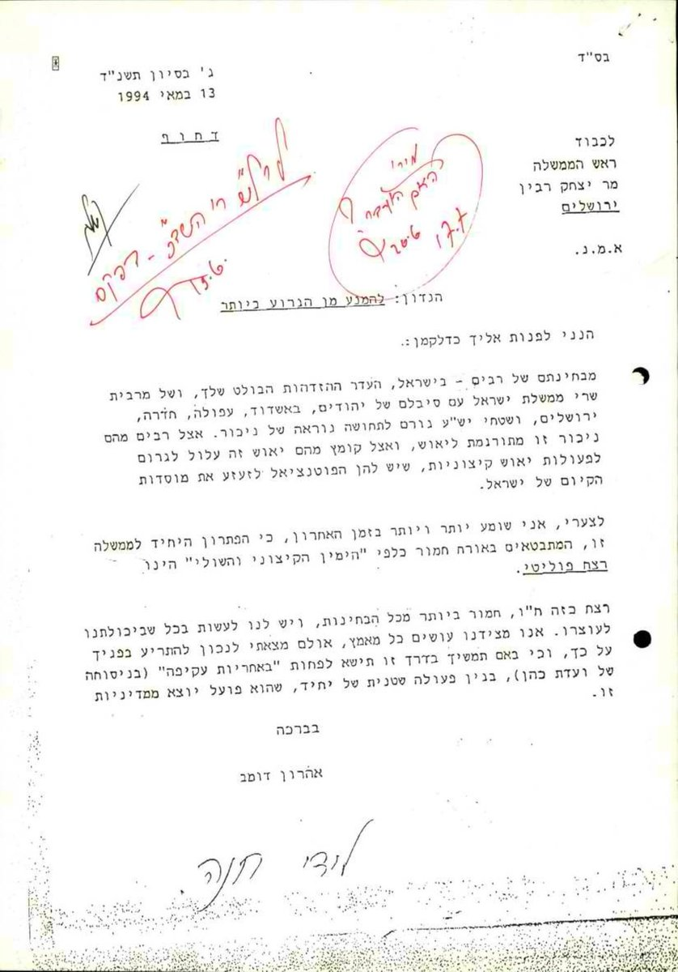
Leadership in front of the Incitement Wave

Slide 18
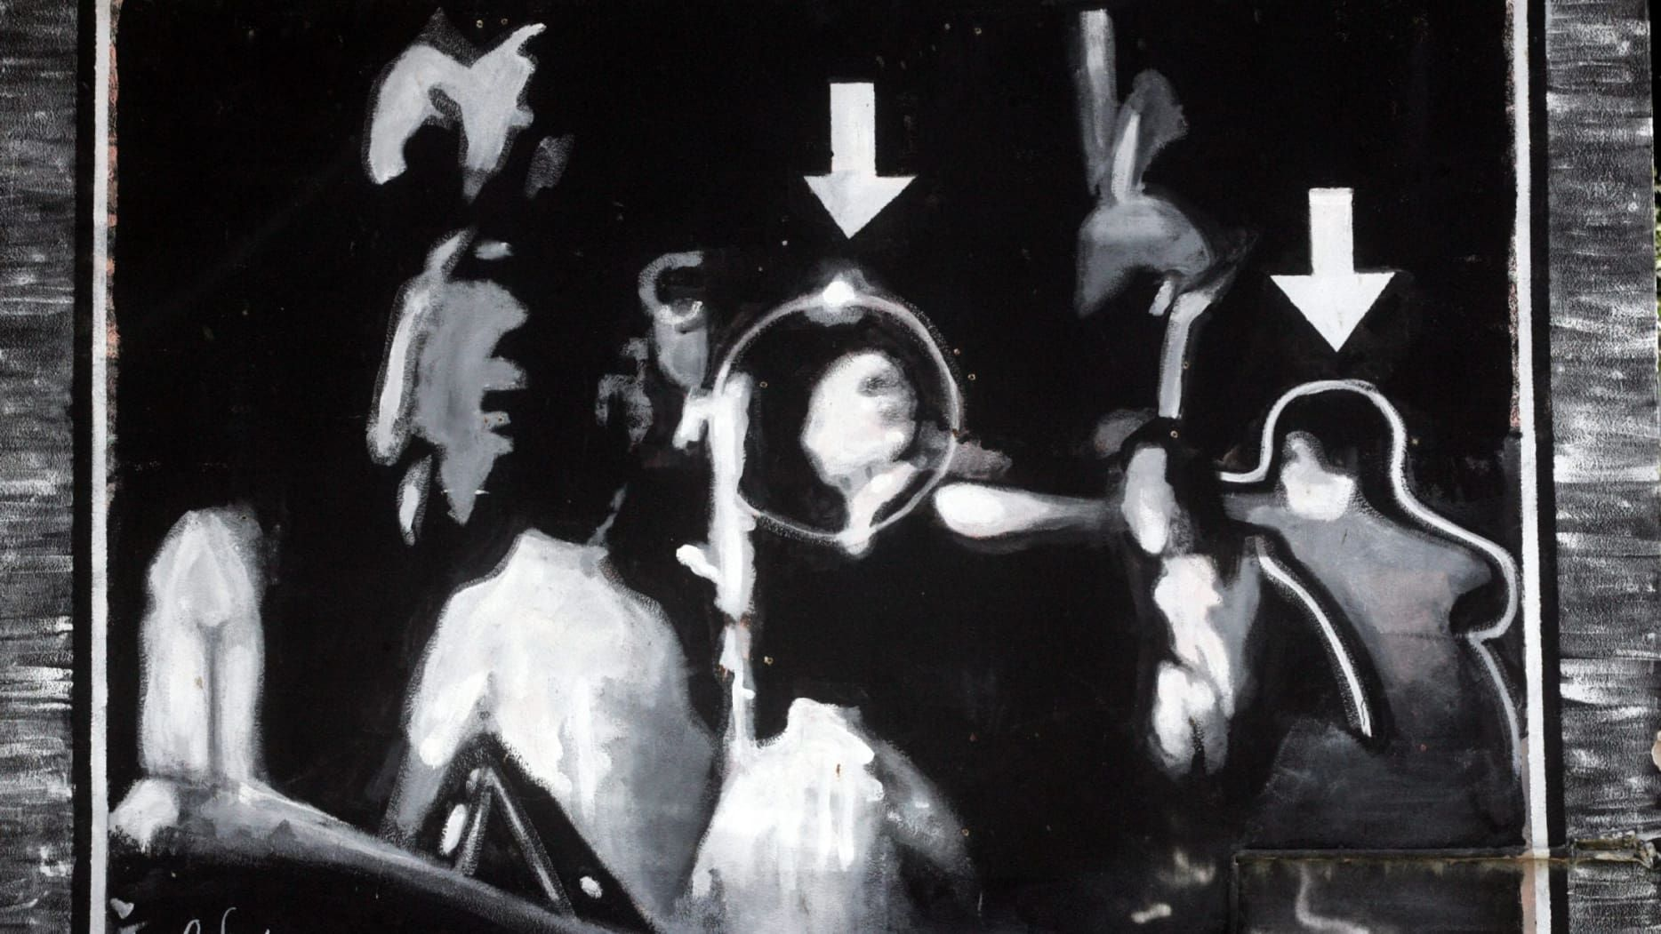
Operational Programming

Slide 19
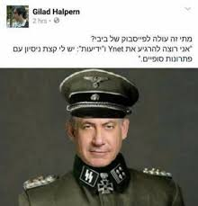
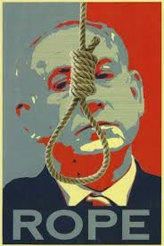
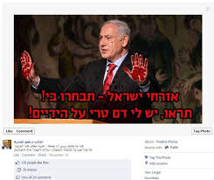
What Has Changed?

