Slide 1
Israel National Defense College
Strategy
Leading Instructor: Yehuda Yochananoff
47th Class 2019 -2020

Slide 2
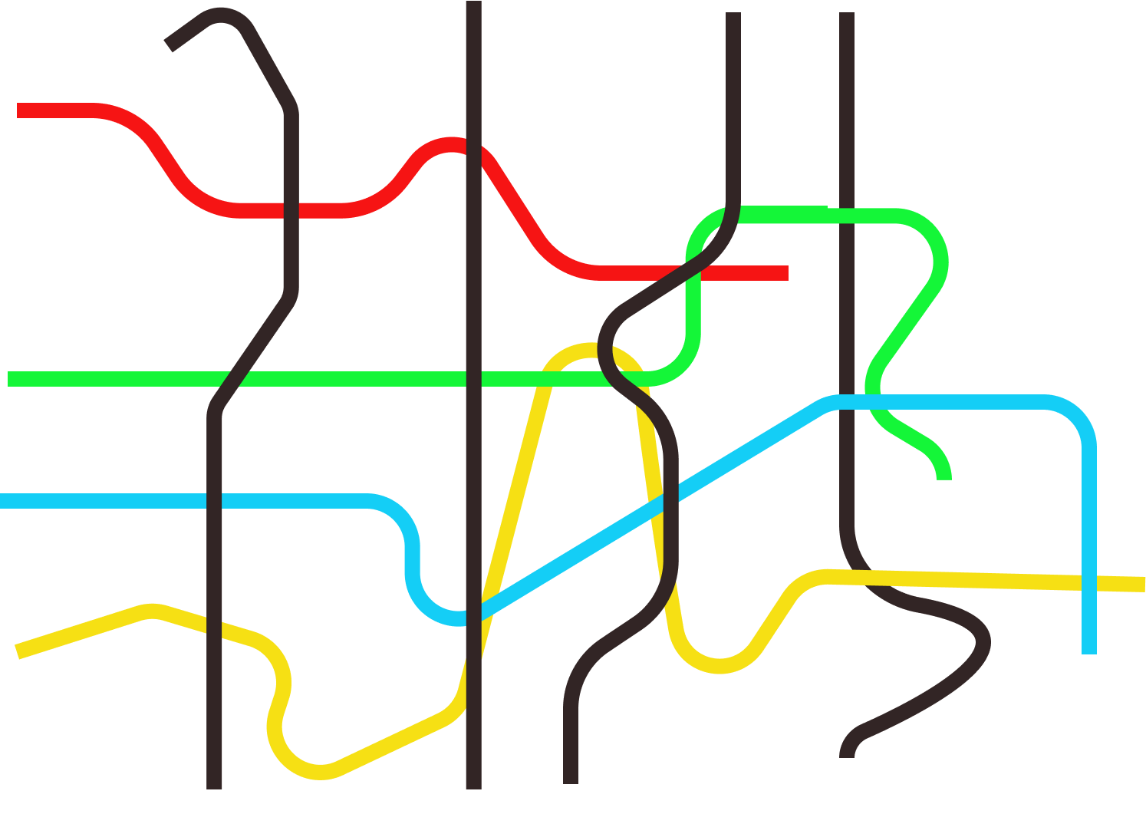
The Purple Line- Strategy
T1Global Season
T2Israeli Season
T3Internship
T 4The Integrative Season
National Defense
Economy
Society
Statesmanship

Slide 3
The Priory's idea
National Security Strategy
Strategic Thinking
The Development of strategic thinking
Experiment 1 Simulation Experiment 3
Design Approach to Dado Center
Senior Lecture
Tours in Israel and the world

Slide 4
Goals
Historical discovery and familiarity, theoretical knowledge and practical analytical tools that enable research, development and management of military security strategies in the context of national security policy.
Creation of intellectual experience with theoretical and practical history. Theory and practice of military strategic thinking in the context of national security.
Extension and acquaintance with public business strategy.
Develop an area of leadership and systemic thinking Develop an area of leadership and systemic thinking(unclear, variable(unclear, variable unclear, friction-free environment variable ,) to better link tactical-operational actions to the wisdom of strategic actions.
Encourage the challenge of a closed doctrine and defining knowledge.
Provide system participants with systematic understanding and tools to conduct strategic thinking processes in line with public service requirements.
Introduce participants to the strategic complexity and various aspects of strategy in both the public service and the business world.

Slide 5
The Method of Study in the Field of Strategy
Third Experience East Tour
Second Experience
The conflict
Israeli-Palestinian
First Experience
Northern arena
The Design Approach
Dado Center
Strategic thinking
Commandant Itai Veruv
Strategic thought
Professor Dima Adamski
Background Points for Reference
Background points for Reference
Background Points for Reference
Systematic Inquiry as a Strategy Design Strategy
Conceptual Strategic Thinking and Action Levels
The Development of Military Strategic Thinking
East tour
Experiment with the Design Approach
Experiment with the Design Approach
The History of Strategic Thought and the Development of Conventional Warfare
Summary
"Screen Lift" Summary
Summary
Systemic Research as a Methodology for Strategy Design
Challenges in Strategic Thinking and Competing Approaches in Strategy
The History of Strategic Thought in the Age of Hybrid Warfare
Experience in Exploring the Relevance Gap
Strategic Exercise
"Systems":systemic thinking , complex system and systemic level
The History of Strategic Thought in the Nuclear Age
Processing
Intelligence diagnosis and Strategic Planning
Strategy as design, planning and realization (institutional learning and fulfillment)
The Russian Strategy

Slide 6
Military Strategic Thought Professor Dima Adamski
The Development of Modern Strategic Thinking
The Birth of Strategy Studies in the Academic World
The Development of Strategic Thought in the Conventional War Era
The Development of Strategic Thinking in the Era of Hybrid Fighting
The Development of Strategic Thought in the Nuclear War Era
Intelligence Diagnosis, Net Assessment, Planning the Strategic Place of the International Relations War

Slide 7
The Course of Military Strategic Thought Development - Prof. Dima Adamski
Date | No. of Days
15.09.19 | 3
16.09.19 | 3
18.09.19 | 4
19.09.19 | 4
Total | 14

Slide 8
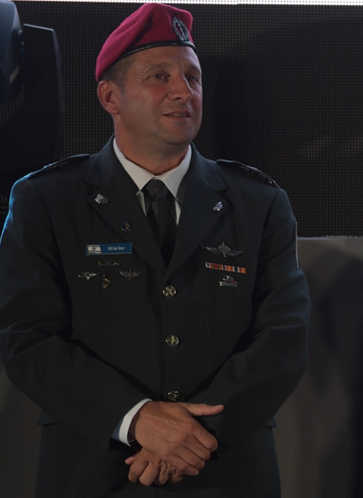
Strategic Thinking Approach – MG Itai Veruv
The essence, complexity and paradoxes of strategic thinking.
A strategy between a static-rational approach and a dynamic-holistic approach.
Systemic thinking, systemic approach and systemic level-conceptual clarification.
Strategy as an Essential Learning System and a System of Inquiry Process.
Strategic planning as a systematic process of systemic knowledge development.
The Design Approach (Dadu Center).

Slide 9
Strategic Thinking Approach – MG Itai Veruv
Dates | No. of Days | Comments
30.10.19 | 1 | Connecting Dima to Europe - Intro
04.12.19 | 2
11.12.19 | 4 | Mini Strategy towards complex systems – before the South Tour
25.12.19 | 1
01.01.20 | 4 | Strategy exercise
Total | 12

Slide 10
Dado’s Center Design Approach – BG Eran Ortal
Date | No. of Days | Comments
08.01.20 | 2 | Design Approach – Dado Center
08.01.20 | 1 | Team Processing – Dado Center
Total | 3

Slide 11
First Strategic Experience – The Northern Arena

Slide 12
First Strategic Experience – The Northern Arena
Date | No. of Periods | Comments
08.01.20 | 1 | Prep
09.01.20 | 2 | Prep
15-16.01.20 | 8-10 | Experience
Total | 14

Slide 13
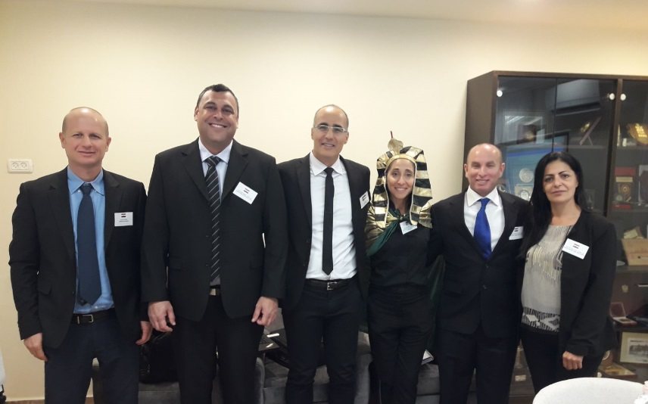
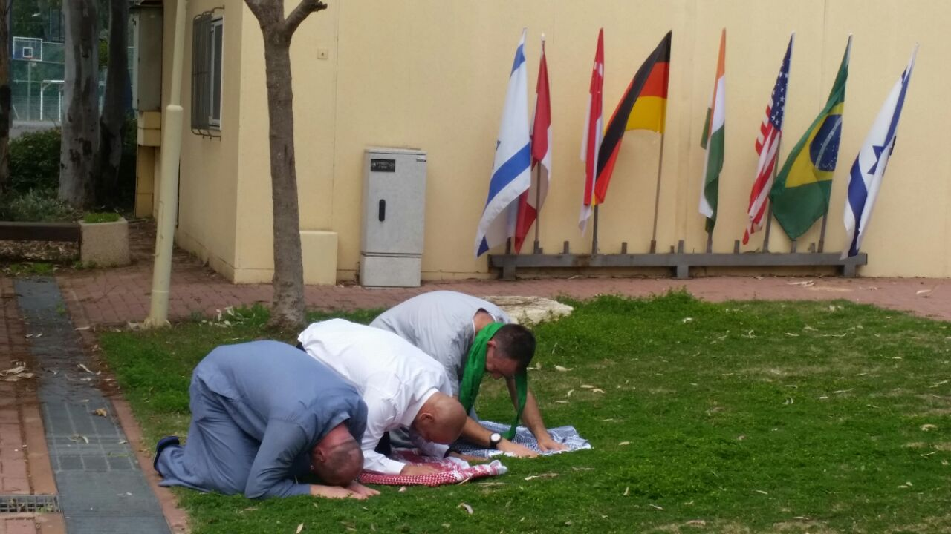
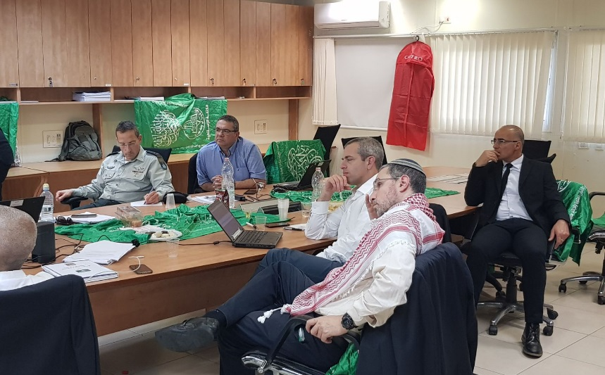
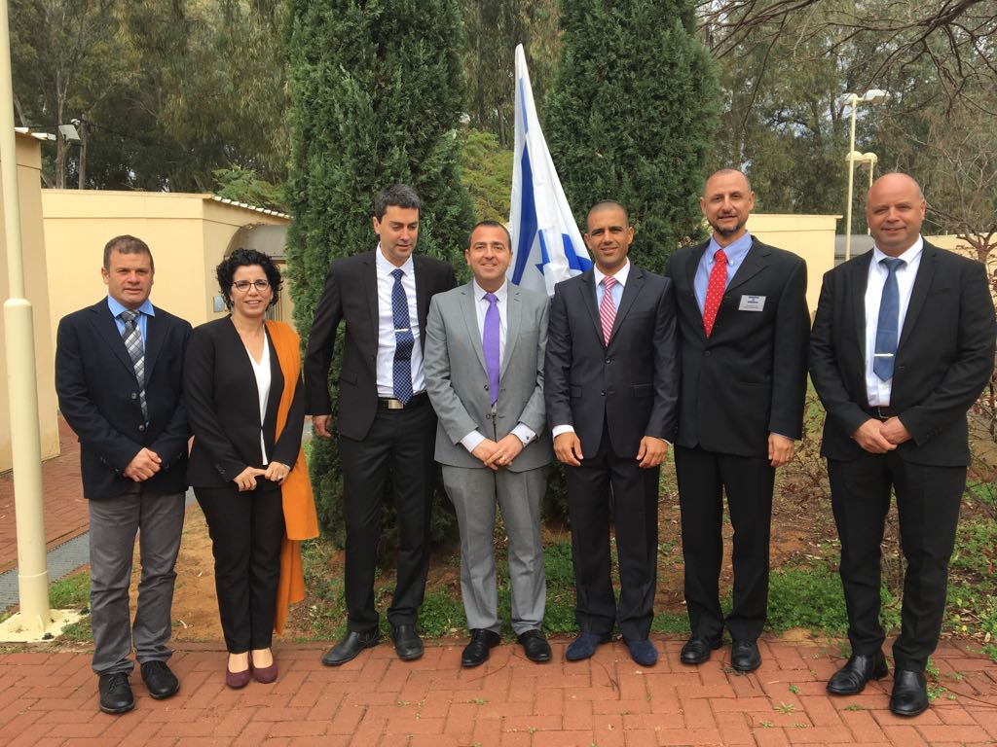
Political-Security Simulation – the Palestinian Arena

Slide 14
Political-Security Simulation – the Palestinian Arena
Days | No. of Days | Comments
21.01, 03.02 ,05.02, 06.02, 09.02,10.02.20 | 20 | Prep Days
11-12.02.20 | 2 | Simulation
13.02.20 | 1 | Final Presentation and summary
Total | 8

Slide 15
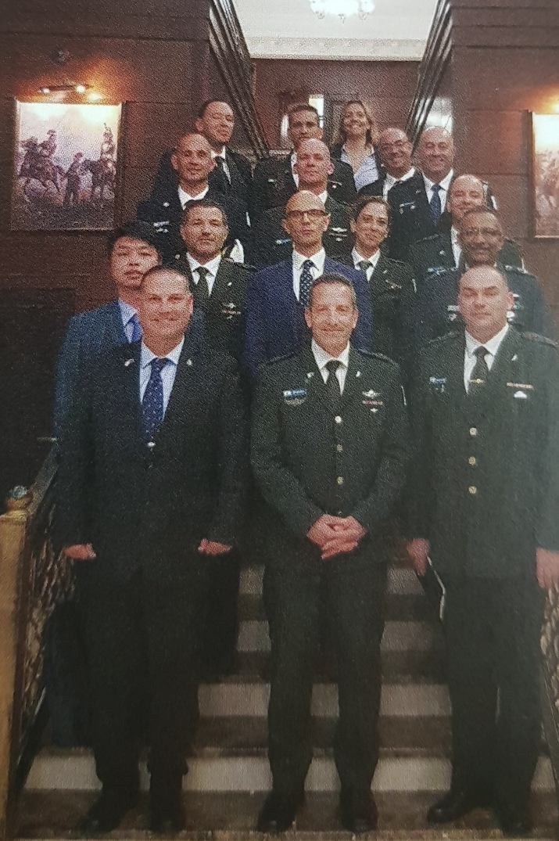
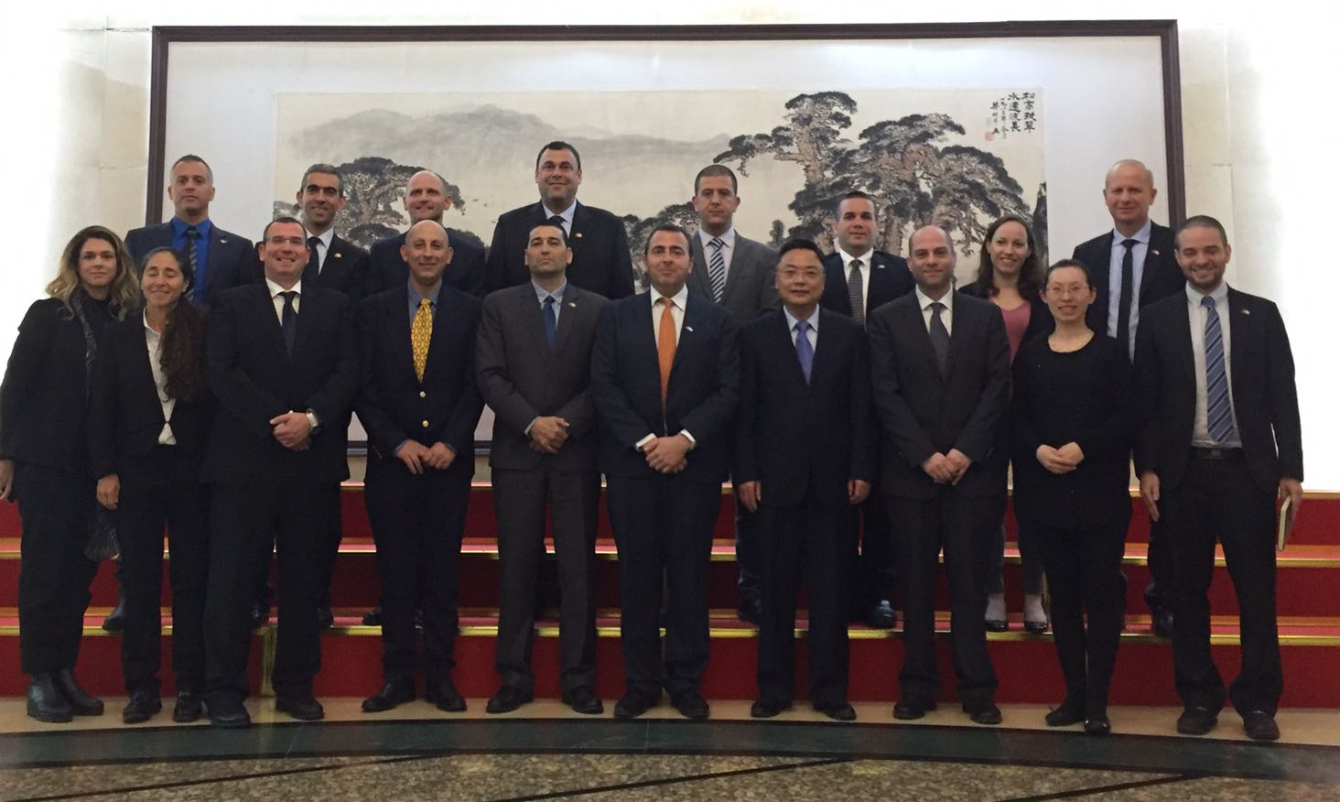
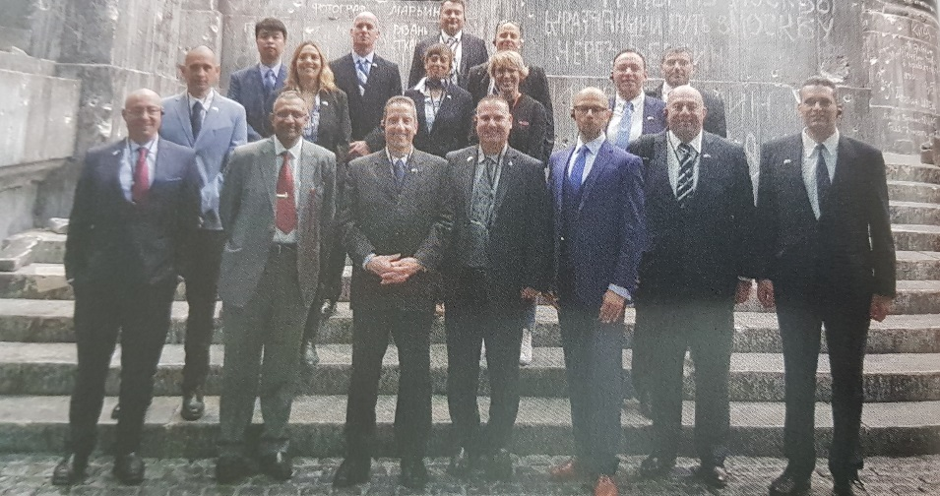
Third Strategic Experience – East Tour

Slide 16
Summary Experience – East Tour
Date | No. of days | Comments
17.03,24.03,31.03,21.04,22.04,23.04,27.04.20 | 16 periods | Prep days
03-07.05.20 | 5 days | East Tour
12.05,14.05.20 | 4 | East Tour summary
TOTAL | 20 periods and 5 days

Slide 17
At the End of the Year
Graduate of strategic thinking, tools and skills for acting in the strategic environment with context of national security

