Slide 1
Literacy in the
National Defense College –
What is it?

Slide 2
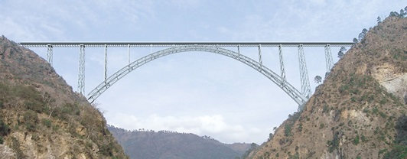
A bridge between the industrial world to the INDC academic world
A bridge between thoughts and ideas to clearly articulate them
A bridge between you and the lecturer in the process of writing and creating the final project

Slide 3
And in further detail….
Shortening of the thought and writing process
Improving wording and language
Adjusting the writing to the academic standards
Learning long-term writing skills

Slide 4
What Do We Write at the
INDC?
Opening project- submitted
Projects at the end of courses
Final Projects
Advanced projects for second and third degrees

Slide 5
Personal Development Timeline
Practical Writing for the Senior Officials

Slide 6
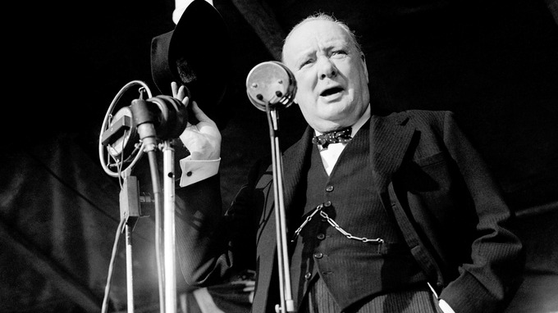
Speechwriting and letters as a Senior Practice
When you are giving speeches, whether during festivities or routines, you have our full attention.
An inspiring speech that honors the speaker and the public who he is aiming at. A mediocre speech is an opportunity to make a difference.
Letters can also be used by the seniors to
emphasize important and urgent messages.

Slide 7
What Will You Learn with Me?
How to define meaningful and accurate messages
How to plan the text structure and length
How to maintain standard formulation while preserving your personal style
How to find the balance between emotion and intellect in choosing the means of expression
How to use quotes from relevant sources

Slide 8
Writing Position Paper - as a Senior Practice
Writing position paper is a daily need for senior executives who want to influence the organization's moves.
A position paper that isn’t focused and written in negligence doesn't receive the desired reaction

Slide 9
What Will You Learn with Me?
How to set up meaningful and accurate messages
How to write accurately and quickly, clearly and comprehensively
How to direct the way of expression to the recipient and the needs, to make the best impact

Slide 10
Academic Writing Principles for
Thesis and Doctoral Work

