Slide 1
The theater of Militarism
The commander's learning space and influence on the captain
Director: Udi Sheila, Roman Goffman
Moderator: Dr. Shimon Naveh

Slide 2
מטרת המחקר לבחון את מישורי ההשפעה השונים שבתווך בין דרג "מצביא מערכתי" לדרג "קברניט אסטרטגי"
The purpose of the study
is to examine the different levels of influence that mediate between the rank of "systemic military" and "strategic captain"
The Research Question
What are the ways of influence and ways of operation with which the commander can influence the captain

Slide 3
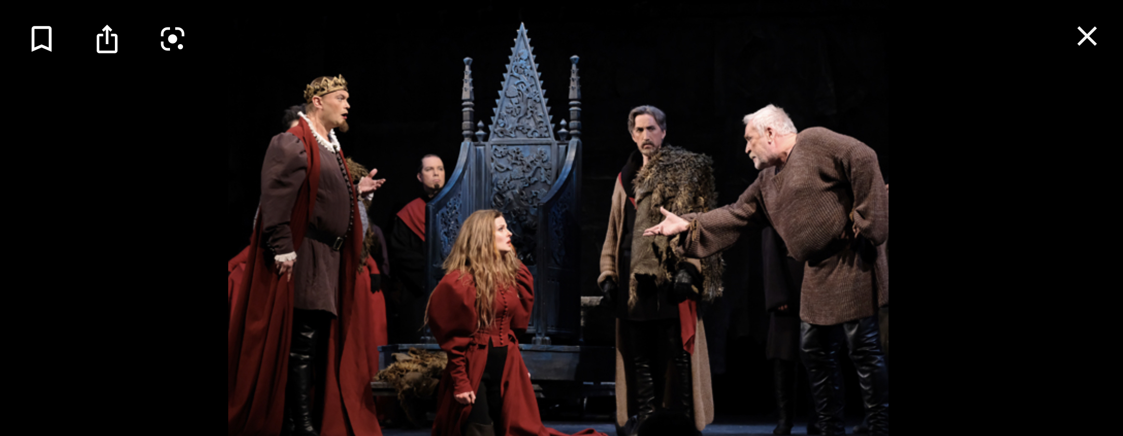
Journey: Case studies, in-depth interviews, literature
Ronnie Nome, Tamir Hyman, Itai Virov, Amiram Levin, Henry, Shay Avital, Giora Highland, Amos Gilad, Itzik Mordechai, Gideon Tadmor, Meir Finkel, Shimon Naveh

Slide 4
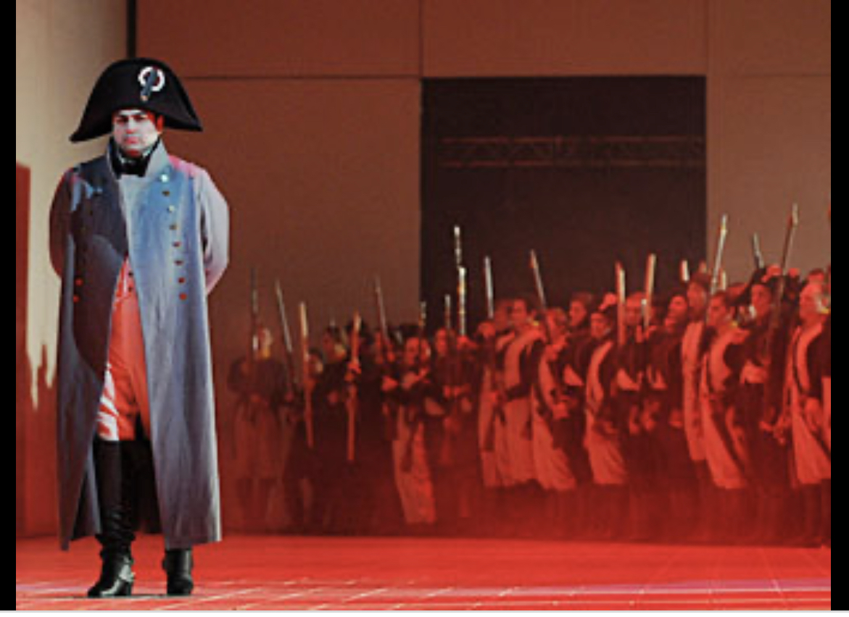
The Play - Outline
Prologue
First act: What can you learn from the relationship of Zhukov and Stalin?
Second act: "Don't trust the champion" The ratio between the political and senior levels
Third act: Spaces of Transformation in the Relations between Warlords and Commanders
Fourth act: Analyze Three Case Studies - Time Size /
Frontier against the war in Syria / The war on gas
Discussion: The commander's learning space and influence on the captain
Epilogue

Slide 5
Discourse Space
Personal
Discourse within the paradigm
Captain
Maneuvering through networking
Direct discourse
תמרון באמצעות פעולה
Personal
The glocal environment
Discourse outside the paradigm
Warlord

Slide 6
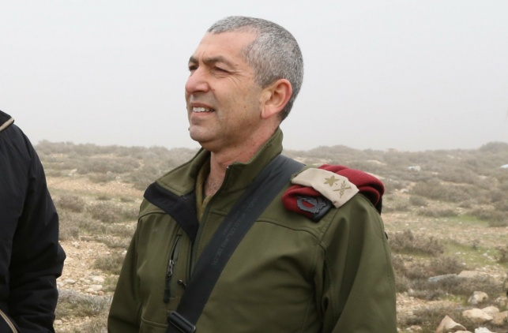
Discourse Space
Personal
Discourse within the paradigm
Captain
Maneuvering through networking
Direct discourse
תמרון באמצעות פעולה
Personal
The glocal environment
Discourse outside the paradigm
Warlord

Slide 7
Insights so far
"Invalidating own imperfection invalidates", allowing militarism
Impact involves risk, contact rowing, determination and courage are a necessary but unsatisfactory condition, 'free market' thinking is required
Looking at reality in an "auditory" and not just "visual" way, the world is not linear
There are areas in which a combat doctrine cannot be manufactured, there is room for "bigotry" alongside its risks (risks from action as well as risks from prevention)

Slide 8
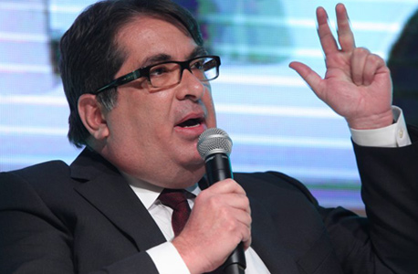
Discourse Space
Personal
Discourse within the paradigm
Captain
Maneuvering through networking
Direct discourse
תמרון באמצעות פעולה
Personal
The glocal environment
Discourse outside the paradigm
Warlord

Slide 9
Insights so far
Legitimacy - pumped from the super-purpose, restrained by hierarchy and external / public criticism
The personal and environmental dimension - a critical component of realizing influence, learning about actors
Has the generation diminished? The variability of reality produces other tools for implementing influence
The art of friction and willingness to take personal risks
When? "A voice called me and I went ..."

Slide 10
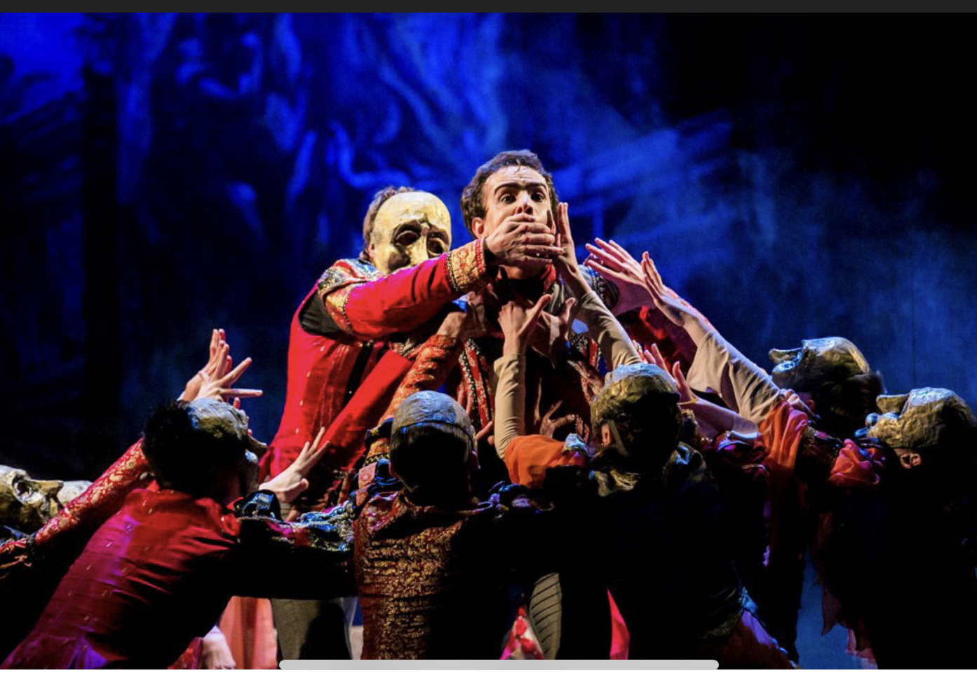
Done but not finished…

