Slide 1
THE UN AND ISRAEL
A SHORT INTRODUCTION
MABAL
10/5/17

Slide 2
International Organizations
System’s point of view:
Habits of Cooperation (WHO)
Information and monitoring (IAEA)
Conflict resolution (WTO, PEACEKEEPING)
Operational activities (Vaccination), Health crisis coordination, Assistance to countries
Arena for Bargaining
International Regimes and regulations (food safety, Working Standards)
Actor’s point of view:
Instrument of foreign policy (Aid, Punishment, Peacekeeping)
Legitimization (First Gulf War)
Information (small states)
Introducing norms (Tobacco Control Treaty)

Slide 3
A System of Systems
44.000
Employees
The UN - Introduction

Slide 4
Main Organs
העצרת הכללית
General Assembly
בית הדין הבינ"ל לצדק
ICJ
מזכירות האו"ם
SECRETARIAT
מועצת הביטחון
Security
Council
מועצת הנאמנותTrusteeship
Council
המועצה הכלכלית חברתית
ECOSOC

Slide 5
GA
The UN - Introduction
The UN - Introduction
THE GENERAL ASSEMBLY
193 Member States
2 Permanent Observers
6 Standing Committees
5 Regional Groups

Slide 6
THE SECURITY COUNCIL
The UN - Introduction
PERMANENT 5
RUSSIA
CHINA
FRANCE
USA
UK
Bolivia
Kazakhstan
Sweden
Ukraine
Ethiopia
Italy
Egypt
Uruguay
Japan
Senegal

Slide 7
Israel and the UN
Notes:
פלסטינים, איראן (ועדת סנקציות), ירושלים, אפלייה, חמאס וחיזבאללה, סוריה, כוחות שלום, בק"נ,
אגנדה חיובית – תרומה ליעדי הפיתוח, הובלת נושאים
(אנשים עם מוגבלויות), אנטישמיות, תרבות ישראלית

Slide 8
MILESTONES
1947 Partition Plan (GA Res 181)
1949 Israel admitted to UN (GA Res 273)
1967
(SC Res 242, 338)
1973
1975 “Zionism is Racism” (GA Res 3379)
1978 UNIFIL established (SC Res 425)
2005 Holocaust Remembrance (GA Res 60/7)
2006 End of Hostilities in (SC Res 1701) Southern Lebanon
2007 Agricultural Technologies (GA Res 62/190) for development
A framework for peace
Notes:
The Partition Plan - Resolution 181, Resolution 194
UNEF withdraws from Sinai on the eve of the Six-day War
SC Resolutions 242, 338
Zionism is Racism Resolution 1975, 1991
Israeli Withdrawal from Lebanon and application of SC Resolution 425
Special Assembly and GA decision on Holocaust Remembrance, 2005-6
Israeli Resolution in GA on Agricultural Technologies for Development 2007,2009
SC Resolution 1701 and the establishment of second UNIFIL, August 2006
Other important events:
Israel joins the WEOG Regional Group in 2000
ICJ Advisory Opinion on the Wall in 2004

Slide 9
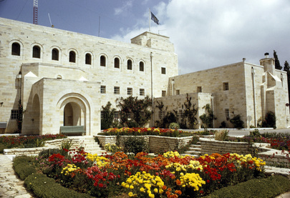
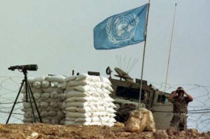
THE UN AROUND US
SG EMISSERIES
UNSCO (ירושלים)
UNSCOL (ביירות)
הנציג ליישום 1559
PEACE KEEPING
UNIFIL
UNDOF
UNTSO
DEVELOPMENT
UNDP - UNPP
UNICEF
UNEP
AID
UNRWA
OCHA
WFP
UNHCR
Notes:
UNSCo - שליח המזכ"ל לתהליך השלום – היה סרי ועכישו מלדנוב

Slide 10
Israel and the UN
DOUBLE STANDARD
Human Rights Council
Agenda
Item 1. Organizational and procedural matters
Item 2. Annual report of the United Nations High Commissioner for Human Rights and reports of the Office of the High Commissioner and the Secretary General
Item 3. Promotion and protection of all human rights, civil, political, economic, social and cultural rights, including the right to development
Item 4. Human Rights situations that require the Council‘s attention (Rest of the World)
Item 5. Human Rights bodies and mechanisms
Item 6. Universal Period Review
Item 7. Human rights situation in Palestine and other occupied Arab territories (Palestine)
Item 8. Follow-up and implementation on the Vienna Declaration and Programme of Action
Item 9. Racism, racial discrimination and xenophobia and related forms of intolerance, follow-up and implementation of the Durban Declaration and Programme of Action
Item 10. Technical assistance and capacity-building
-----

Slide 11
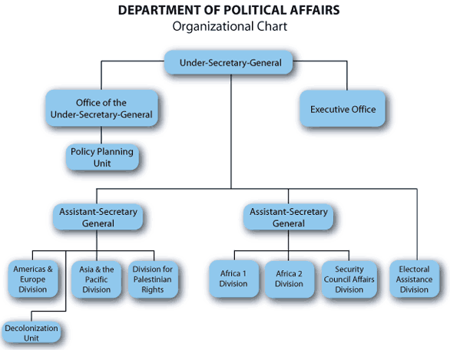
Institutional Bias

Slide 12
Israel and the UN
INSTITUTIONAL POLITICIZATION
Middle East
5%
Lebanon
2%
Syria/ Golan
7%
Israel /Jerusalem
5%
Rest
47%
Palestinians
28%

Slide 13
הרוב האוטומטי- Au הרוב האוטומטי-,, Automatic Majority
22
Member states - 193
הליגה הערבית
Arab league
ארגון המדינות המוסלמיות OIC
57
הבלמ"זG77/
120/134
Canada
Australia
NZ
3
28
USA
ISRAEL
EU

Slide 14
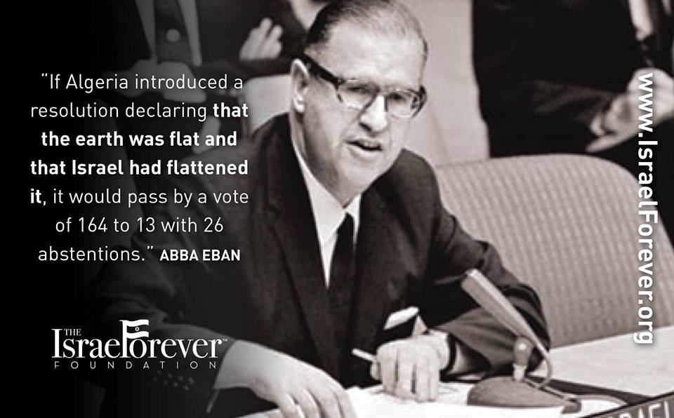

Slide 15
יום זכרון השואה הבינ"ל

Slide 16
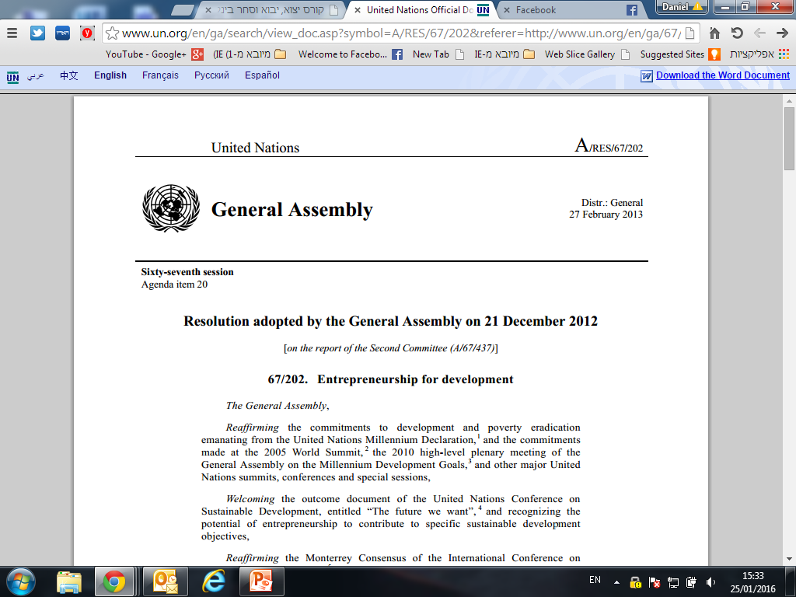
The Positive Agenda

Slide 17
NEW BEGINNING?

