Slide 1
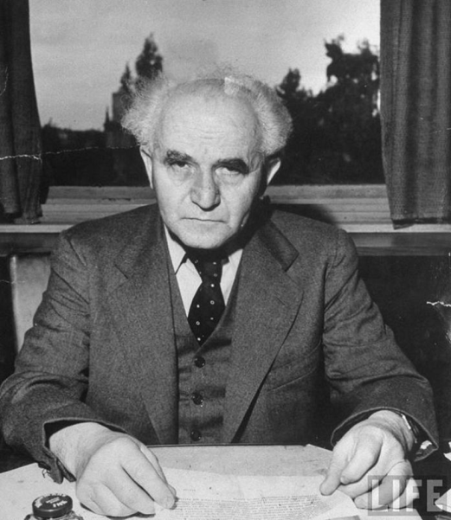
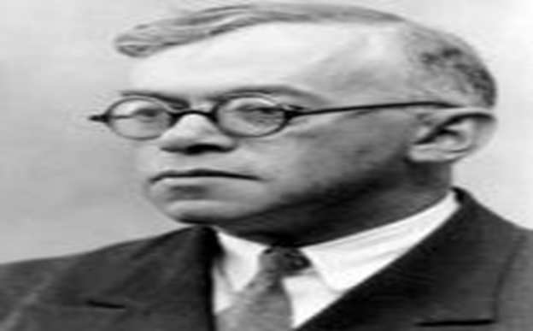
Right wing and left wing founding fathers?
David Ben-Gurion and ze’ev jebutinsky,
On the role of Zionism and the image of the Jewish state
The presentation is based on first-hand sources and on many different materials of Zionist scholars
Prof’ Amir Goldstein
Tel Hai Academic College
November 2019

Slide 2
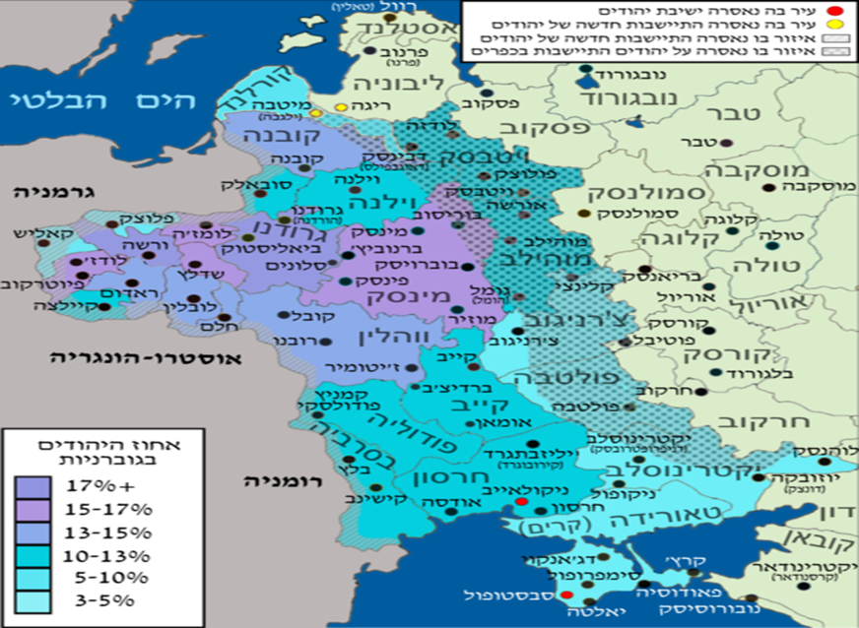
Section 1:
Habitat and maturing aspects
In the Russian Empire
Area of Settlement:
The area where nearly six million Jews were concentrated

Slide 3
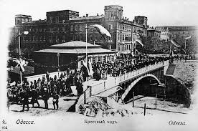
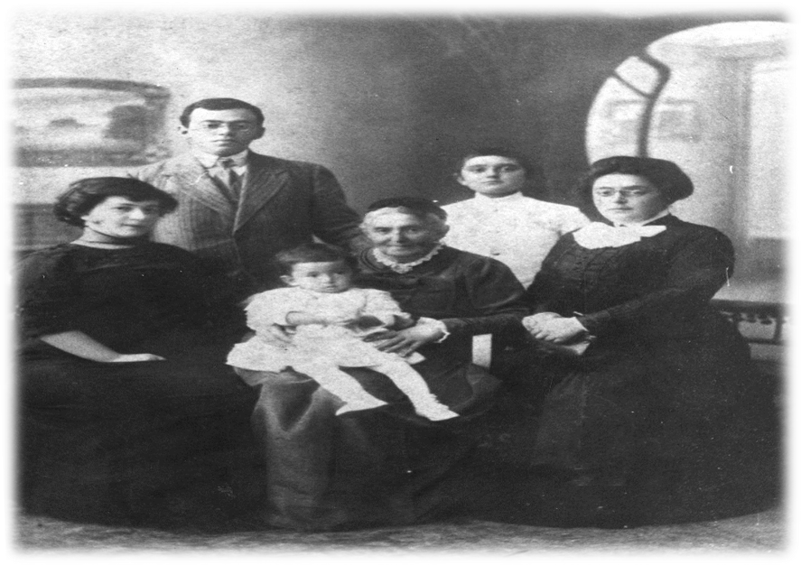
Odessa, 1910
Ze'ev Jabotinsky was born in 1880 in Odessa to a family undergoing an advanced Russification process.
Ze'ev Jabotinsky, Joana, Ari, his mother Eve, his sister Tamar and her son Yona Kopp

Slide 4

Jabotinsky, youth in Odessa
The most interesting phenomenon of our lives in those days was the sense of peace between the nations. All eight or ten of the old Odessa peoples met in the same club, and no one thought it was worth mentioning, even if only by the thought of the heart, what his nation is(...) and deep down we thought (...) that the Common Forum's colorful Babylon style – to symbolize the wonderful Tomorrow.
‘Even stranger, even in our Hebrew "circle“ no Hebrew Spirit was blown. If we read together - we read foreign literature, we debated Nietzsche and the questions of morality, morality in general or sexual morality, not the fate of Judaism or even the state of Russian Jewry, which was burdensome to each of us.’

Slide 5
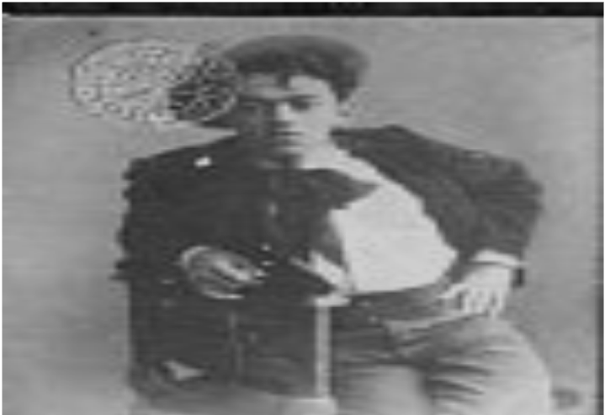
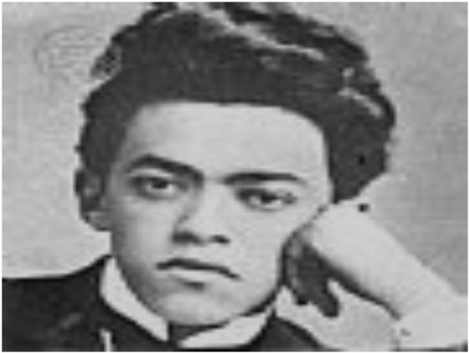
Childhood and youth in Odessa's turn of the century
Before he turned 18, Jabotinsky left high school and traveled to Western Europe, following his dream of becoming a Russian writer.
A prominent journalist in Russia, a playwright who would sign his name as “Altalena".
Began his Zionist activity at the age of 23.
From Cosmopolitanism to Nationalism: Modernity at the turn of the century, the National Era.
Nationalism - at the heart of the Jewish question - the way to a solution.

Slide 6
The Zionist Project – Creating the New Jew and Internalizing the anti-Semitic discourse
Let us erase from this figure all the attributes that are so typical of the ‘Jid', and replace them with all the qualities whose absence is so typical of it.
Because the ‘Jid’ is ugly, sickly and unadorned, we will give the idea ‘Jid' figure of the Hebrew men manly beauty, stature, great shoulders, vigorous movements, a glitter of colors and shades.
The ‘Jid’ is frightened and humiliated, and the other one must be proud and independent.
The Jid’ is despises by everyone, and the other one must charm them.
The ‘Jid’ is used to surrendering to others, and the other one has to know to command.
The ‘Jid’ likes to hide with held breath, and the other one needs the courage to march towards the entire world, to look straight and deep into the eyes of all, and to raise his flag before them: "I am Hebrew!"
(Jabotinsky, Dr. Herzl, 1905).

Slide 7
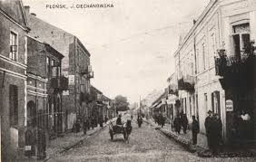

Slide 8
David Green’s Childhood
David Green was born in Płońsk on the outskirts of Warsaw from Gdansk in 1896, a small, remote town, the railroad had yet to be connected, running water as well. About 8,000 people, of whom about 5,000 are Jews. Although the spirits of Enlightenment were captivated in Płońsk, most of its Jewish inhabitants were devout in their religion.
Most of the Jews of Płońsk were craftsmen, carpenters, shoemakers and more. The Green family belonged to the relatively educated middle class which was open to new influences and read the newspapers ‘HaMelitz’ (lit. ‘The Advocate’) and HaTzfira (lit. ‘The Siren’).
Avigdor Green joined Hovevei Zion (a group of organizations ) with its first appearance, and after Theodor Herzl's dramatic appearance became a loyal Zionist. He passed on this belief to his eldest son Abraham and his youngest son - David.
David Green studied in the ‘heder’ (elementary Jewish school) and then in the seminary. He aspired to graduate, but did not have a high school diploma. In the meantime, he left the beit midrash (a school for learning Torah), learned Russian, read a lot and assisted his father in writing petitions and applications near the court.

Slide 9
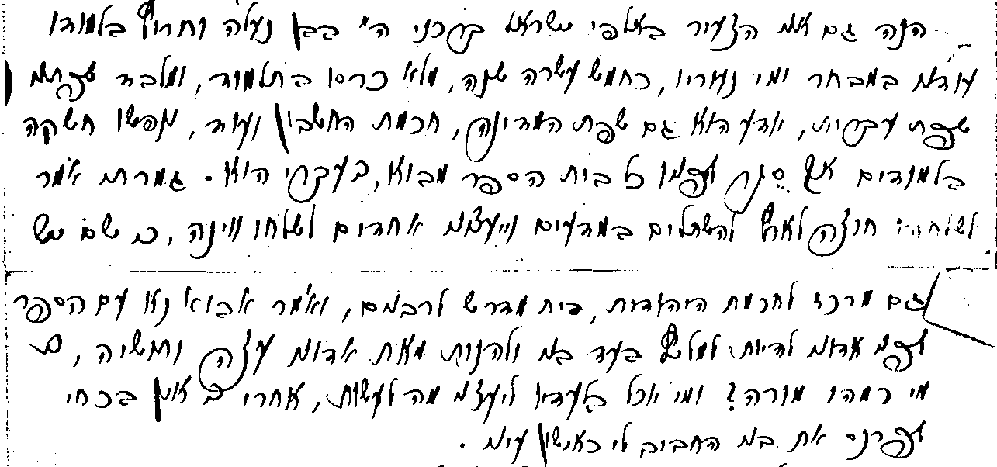
David Green’s Father (David Ben-Gurion) Writes a Letter Addressed to Herzl

Slide 10
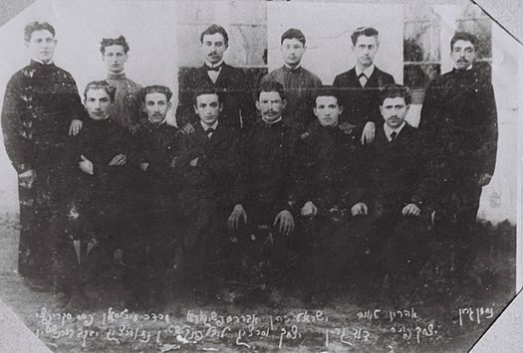
David Green’s Childhood
At the age of 14, he established a national organization with his older friends Shlomo Fox, and Shlomo Tzemach, called - Ezra Association: "At fourteen, I felt like an adult for every purpose. Together with other friends [...] I founded a Zionist association called "Ezra"... I was the youngest of the group. Tzemach was a few months older than me and Shmuel Fox a few years [...] Shlomo and I would gather the youths in the synagogue, between the noontime and evening prayers, and teach them improved Hebrew. Over time, we also forced the elders to speak Hebrew by answering them in Hebrew and addressing them in Hebrew. And here you see a very weird thing: the whole town was speaking Hebrew”.
Shlomo Fox, the older of the three, left town.
He traveled to London, and from there sailed to New York.
18-year-old David Green arrived in Warsaw in the summer of 1904 for the
purpose of studying in an advanced Technical High School so he
studied Russian and mathematics.
But his attempts at admission did not go well.
He dropped the bekishe (traditional Hasidic coat), put on short
student clothes. And was forced, as hundreds of thousands of his
contemporaries to cope hard with the experience of moving to the
foreign and alienated city.

Slide 11
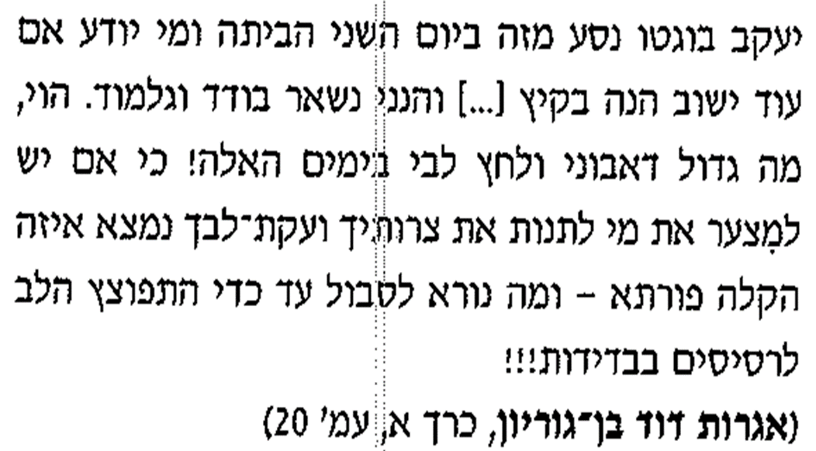
David Ben Gurion’s Letter to Shmuel Fox 1904 –
A short time after he arrived at Warsaw
Yaakov Bogetto drove home away from this on the second day and who knows if he will return this summer (…) and I am left here alone and lonely. Alas, how big is the size of my lonesomeness and stress inside my heart in these days! Because if it is unfortunate for those who have to condone your troubles and griefs, there is some formidable relief - and what a terrible thing it is to endure to the point that the heart has exploded to pieces in solitude!!!
(David Ben-Gurion's Letters, Vol. 1, Page 20)
A few days passed. My condition has worsened. What added to that was my concern about you. No letter arrived. At night, I dreamed you were caught and dragged by ropes to Plonsk. And not only at nights. In the morning terrible thoughts regarding you filled my mind. All day I was only waiting for your letter. And here on the second day (of Sivan), before the evening, on my return from Mordechai to my residence, our home-owner the tailor handed me two letters. One was sealed, the other opened.
The first is from you, and other from Chazon Ish. I open your letter and there, instead of a long letter, for which I hoped, there is some “short little letter” in scribbled handwriting. I was very angry at you, but after I finished reading (this thing cost me great difficulty, because the handwriting is scribbled) Instead of anger, a different emotion takes on completely.
(David Ben-Gurion's Letters, Vol. 1, Page 6)

Slide 12
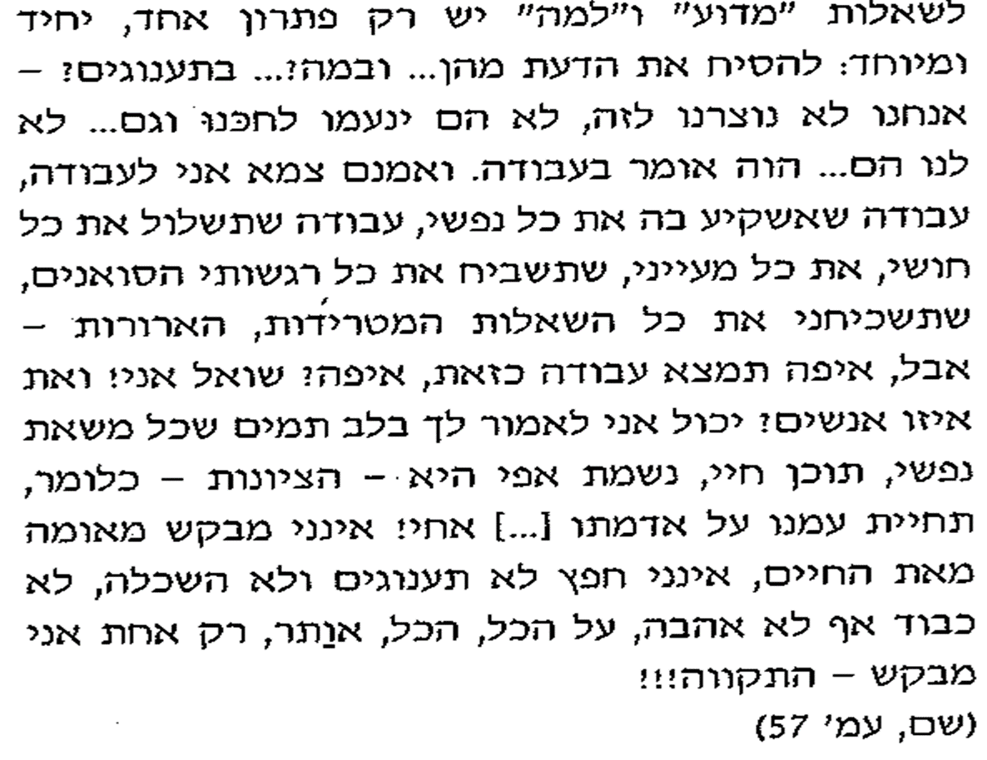
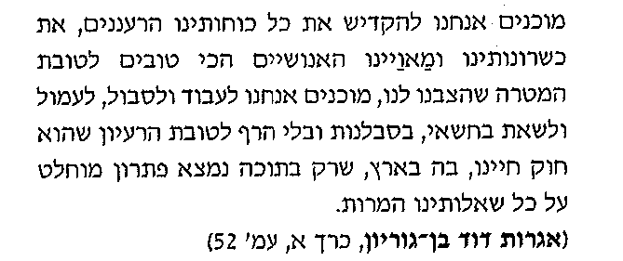
David Green’s Letter to Menachem Ussishkin 1905, the Appearance of the Political Virus
The “why and “how come” questions have only one single special solution: to forget about them… and with that?... Pleasures? - we were not made for that, we would not enjoy them, they are not for us, not like work. And I am indeed thirsty for work, work which I will put my whole self into, work that will cover all my senses, all my thoughts, that will make my stormy emotions silent, that will make me forget the bothering questions – but where will you find such a job, where? I ask? And which people? I can honestly tell you that all the burden of my life, its content, is my essence and wish – Zionism – meaning, the rebirth of our nation on its land […] brother! I never ask for anything for anyone, I seek not pleasures nor education, not respect nor love, on it all I would give up, only one thing I ask – hope!!!
(David Ben-Gurion Letters, Vol. 1 Page 57)
We are ready to dedicate our fresh energy, our talents and best human traits, for the purpose of our goal. We are prepared to work and to suffer, to take the load on us, with patience and non-stop for the idea that is law for us, that only in this land is the perfect solution to all of our bitter questions.
(David Ben-Gurion Letters, Vol. 1 Page 52)
In 1905 he joined The Poale Zion Party. His life was given direction and meaning. He participated in meetings, traveled and spread propaganda material.
It appears as though Green's vigor, which will be there for the future, seemed to be lethargic and untapped until he had discovered political activity. He found his way in life. From now on it will be his preferred route.

Slide 13
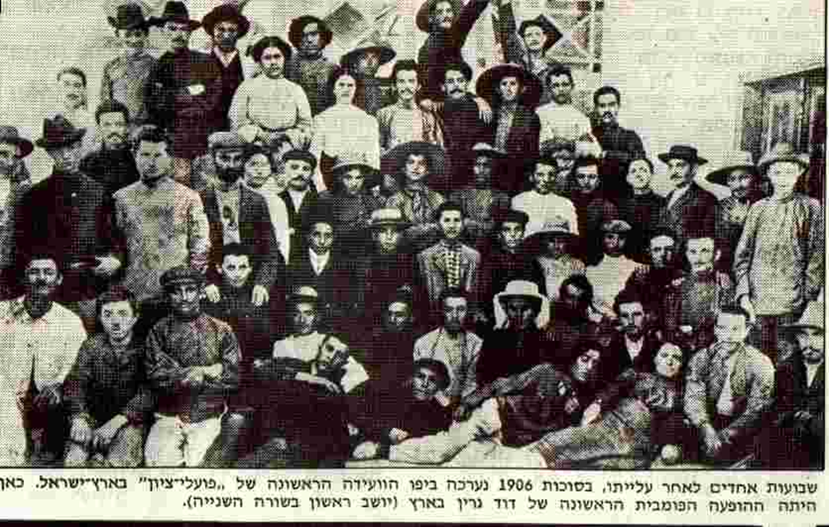
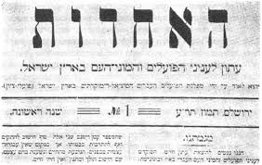
Man of The Second Aliyah, Active and Influential but Not One of the Most Prominent Amongst the People who Shaped it
He immigrated to Israel in 1906, first working in farm work in Petah Tikva, Kfar Saba and Sajara, as well as in Rishon Lezion's winery. At that time he lived in Sajara. David Ben-Gurion said these were the most beautiful days of his life.
He was not accepted into the Hashomer organization and later developed firm opposition to any attempt to establish a militia without political authority.
From Sajara he moved to Jerusalem to write in the weekly, ‘HaAchdut’ (lit. ‘The Unity’). He signed his articles with the Hebrew surname: 'Ben-Gurion‘ Instead of the foreign name - 'Green' and it became his official name.

Slide 14
Section 2:
Meeting Paths
The Beginning of a Conflict Between ‘Political Zionism’ and ‘Practical Zionism’
from the World War to Political Rivalry

Slide 15
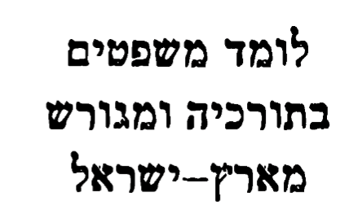
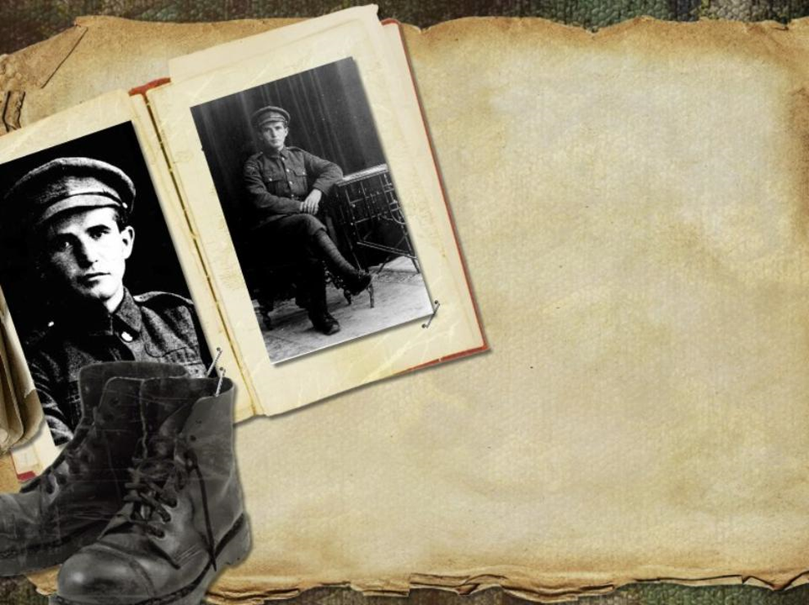
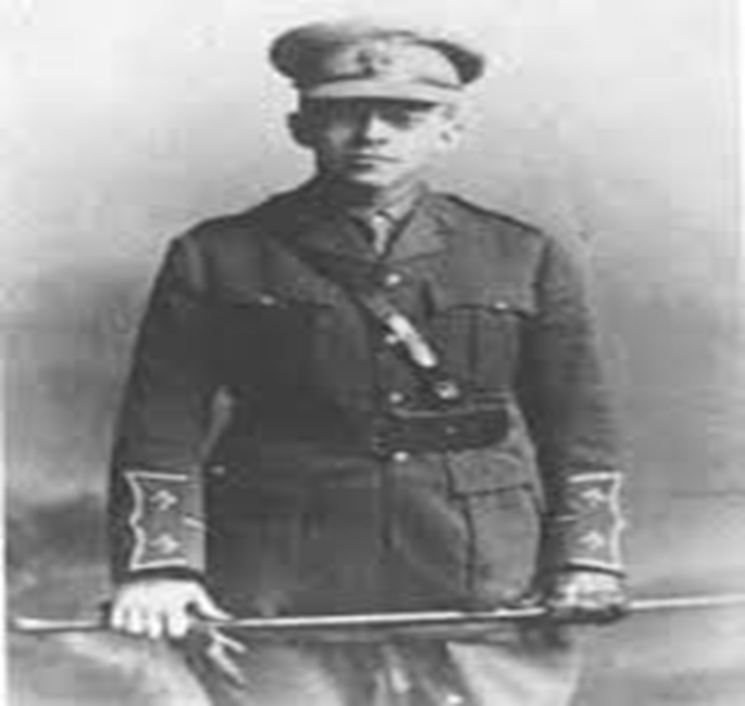
First meeting between the two,
Alexandria 1915,
A second meeting at the Hebrew battalions.
Jabotinsky, the senior of the group, tends to seek political contact with the British.
Ben-Gurion lives in a tent with his partners from the workers party
Zionist activity in the US – the establishment of the Hebrew battalions
Learning Law in
turkey and exiled
from the Land of Israel
David Ben-Gurion and Itzhak Ben Tzvi left to America and became activists there. During this period, Ben-Gurion met Paula Monbez in New York and married her.

Slide 16
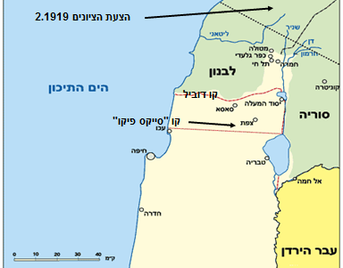
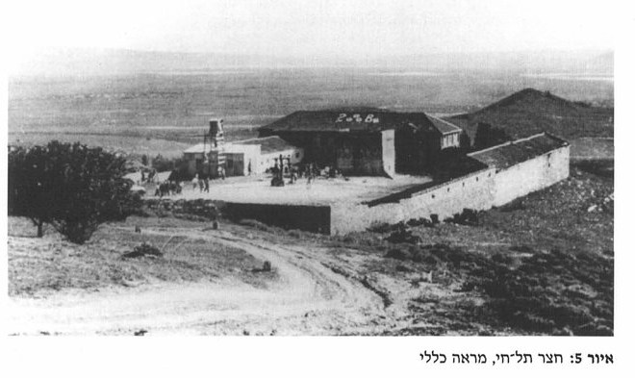
Third Meeting: Conflicting Perceptions in the Tel Hai Affair
The Zionist Proposal 2.1919
Mediterranean Sea
Lebanon
Jabotinsky the officer and a holder of status
What is the Zionism’s independent ability to act?
What is the role of Britain in fulfilling the Zionism?
What is the value of an agricultural Jewish settlement?
How can I produce effective protection?
Sykes-Picot Line
Syria
Trans-Jordan

Slide 17
The words of Ze'ev Jabotinsky at the Provisional Committee meeting, February 1920
'I'm just a guest here, and I have no permission to express my opinion. Still, I think that everyone in the French area should return to Israel. I'll explain my tastes. I don't want to deceive myself, as other people do here [...]
When I wrote my articles on the Upper Galilee, I heard that the number of defenders must be about 200. I said then and say even now, that in hundreds of people we will not be able to stand on our land. There is a danger that they will not be killed, for if they are stripped they will leave nothing on them, and send them back; And that would be ridiculous. Now they talk about 500. But the Arabs have a lot of weapons, and 500 people can't stand them ...
And now the political side of this matter. We are constantly demanding that the British government be all over Israel, and if we ourselves want to stand and defend these places, nothing will come of it [...]
I ask you, as your friend, to tell the young defendants the bitter truth. And maybe we'll save the situation.
What to do? I will say: We have one political institution, and this is the regiment!
He is idle but needs to build a second, third battalion, etc. Another way is not!
You have to tell your friends: Return back there and build the existing one here!

Slide 18
Ben-Gurion and party leaders working against the withdrawal from the Upper Galilee, partly from a perception of Zionist independence in Britain
David Ben-Gurion: "It is clear to us that every place where a Jewish worker works must be protected.“ They say this is an Arabic question. This is a diplomatic question. But the question is neither diplomatic nor Arab. The question is only Zionist, and very serious. Ostrich says that the entire Upper Galilee, and not just the small settlement that lives there, is in danger of losing it to the Jewish people.
Ben-Gurion wrote a few days after the Balfour Declaration: "Only in our labor will our country be. England did not return the land to us. It is precisely now, at the moment of the great triumph of victory, that this particular thing must be emphasized with special force: England is unable to return the land to us, nor because the land does not have it, or does not yet have it." ...] There is no clean country for the people but labor and creation torments, building and settlement efforts. "

Slide 19
Jabotinsky’s Legion Concept and the Lack of Self-Defense Value
Jabotinsky put the Jewish regiments at the center of his security concept. He did not believe in the self-esteem of the Jews to organize a worthy protective force for his name, but rather endeavored to establish a Jewish force for visible and professional Jewish waves, with the agreement of the British, whose commanders were Jews:
"And here one must beware of one beautiful but dangerous illusion: It is an all-too-common exaggeration that, in a state of danger, our peasants will be able to defend themselves even without regiments. Simple: one stick to the sixth nation [...] The only and most purposeful form of the Hebrew defense is - a Hebrew battalion. "
The concept of British regiments established and operated by the British was integrated into Jabotinsky's overall view of the importance of the British to Zionism. In 1921 he said:
"I believe that 5,000 Jewish soldiers constitute a force if they are part of the British army, and represent the British power behind them. If they are not part of the British army, I do not believe in them."

Slide 20
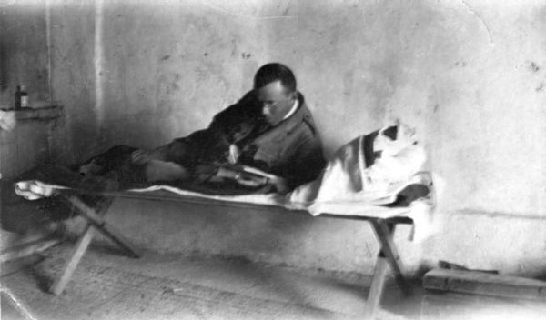
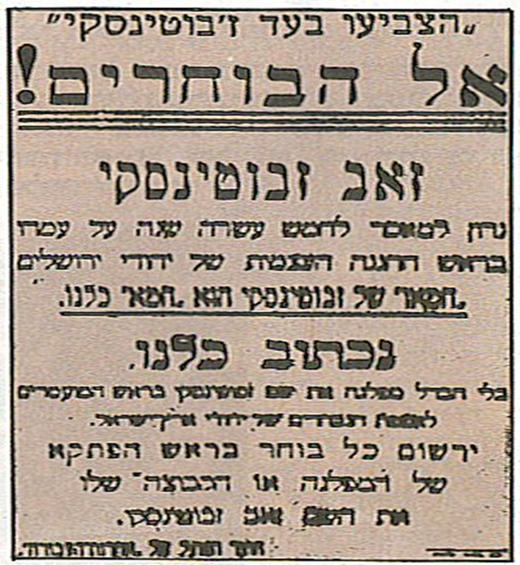
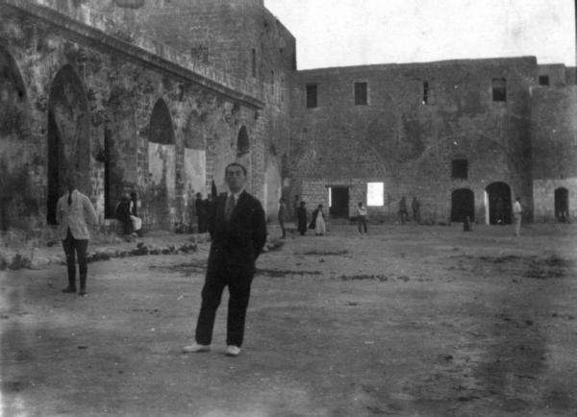
Jerusalem, April 1920, was charged with carrying a weapon and sentenced to 15 years in prison with hard labor in Acre Prison. After one year in prison, he was granted a pardon and released.

Slide 21
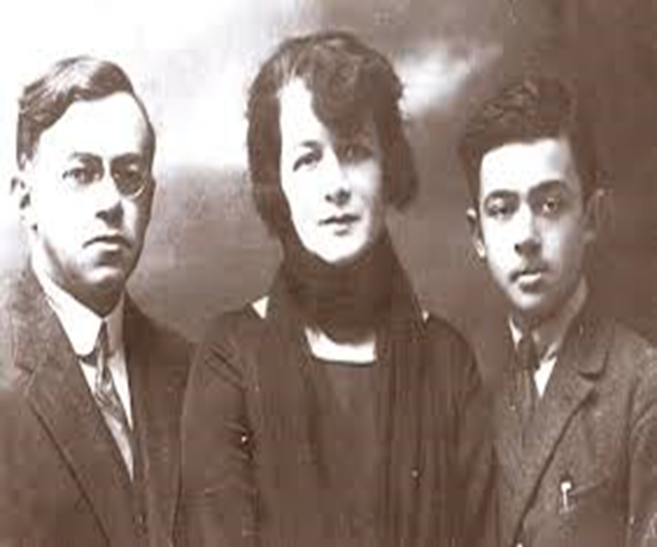
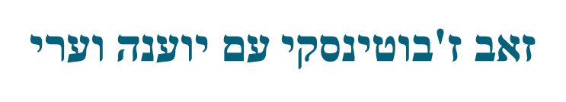
During the elections to the elected Assembly 1920
"In the National House we will declare those Jews who will not remove the stainless steel from the exile and refuse to shave the beard and wigs as second class citizens. We will not give them the right to vote "
Ari Jabotinsky on his father
There is another side to my father's relation to religion: his family life. Will I testify that never once in my life did my father take me to the synagogue and when I turned 13 did not bother to arrange a traditional "bar mitzvah" but satisfied that he took me for a tour (cinema was not yet) and gave me some books as a gift. [...] Finally, to the last of his life he lived as a free man for everything, did not keep kosher, did not pray, did not fast on Yom Kippur and did not observe the Sabbath.
Ze’ev Jabotinsky with
Yoanna Vaari

Slide 22
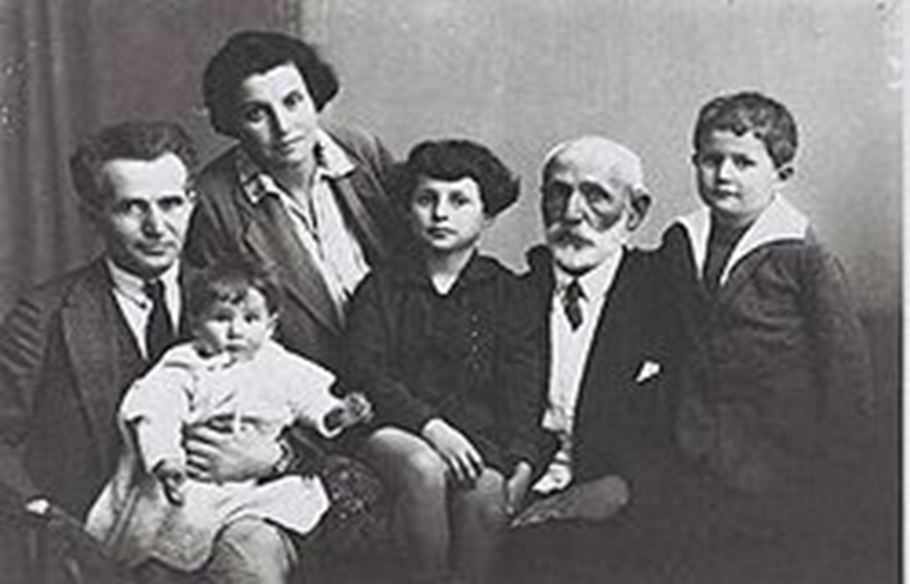
Third Section:
Facing the Arabic Question
David Ben-Gurion and His Family

Slide 23
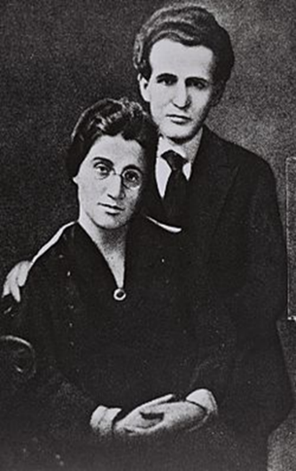
Ben-Gurion and the Workers' Parties: Defensive Ethos and Hope for the Recession of Conflict
In the 1920s, the concept of the labor movement's reference ethos dominated the defensive ethos that sought to obscure the danger of confrontation between peoples. According to this, it is possible to settle in the Land of Israel without using military force, which is used against the Arabs
"And as far as the relations between us and the Arab people are concerned, we can be absolutely and surely declare aloud: It is a lie that the Arabs, the Arab masses,
are against our work in the country. All of these shouts are the result of political
intrigues that the working Arab crowd there is no relation to them. "
At this stage of the development of the locality,
it is not wise to deal with the question of the Arabs.
Ben-Gurion rejected the inevitable conflict theory presented by Jabotinsky
(1928): "We will not accept Jabotinsky – this is a world war between us and the Arabs.
This is a death drug for us. "

Slide 24
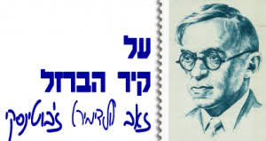
Ze’ev Jabotinsky’s Iron Wall Concept
Zionism settles the Land of Israel against the will of the natives.
The natives’ opposition is national and unpreventable, and cannot be eliminated through deception or money.
There is no bridge between the minimal demand of the moderate Arab and the minimal demand of the moderate Zionist.

Slide 25
Ze'ev Jabotinsky's letter to Frederick Kisch
I am convinced, no less than anyone else, that we should reach an agreement with the Arabs on coexistence. They will always be in Israel and around it, and we can not afford a prolonged conflict with them.
But I do not believe that they will accept a Jewish Land of Israel in return for bribes in the form of economic success or by means of blurred or false information about the aims of Zionism.
I do not despise Arabs like those who think they will ever sell us the future of their country, as long as there is the slightest hope of getting rid of us in any way. Only when they lose hope will the moderates gain the upper hand, and they will try to achieve the best conditions in a deal that will be bad for them.
But until then, and precisely because I am interested in peace, the task is to make them lose all glimmers of hope. They must be brought to the realization that not by force, not by means of constitutional arrangements, nor by a miraculous miracle can it be possible to prevent the formation of a Jewish majority in the Land of Israel.
They must recognize this fact, otherwise peace will never prevail.

Slide 26
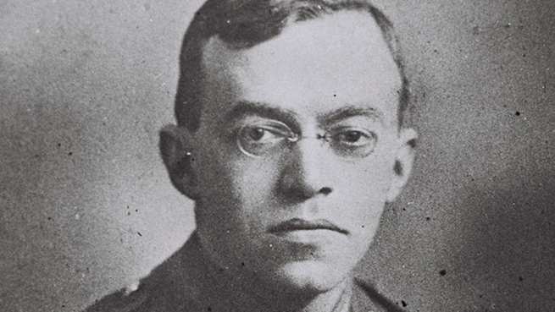
Ze’ev Jabotinsky’s Iron Wall Concept
The Jewish settlements will be able to develop only within British colonialism and difficulty.
The Jews depend on the Iron Wall because the Arabs won’t be able to break it.
We should set up a Jewish legion within the British military with the goal of keeping watch over the Jewish settlements in the land of Israel.
Only after the Arab hope to topple Zionism is shattered will it be possible to create an agreement with them.

Slide 27
Ze’ev Jabotinsky’s Iron Wall Concept
"It is not to be seen as a mob, but as a people, even if a backward people, but a living people.
A living people agrees to make concessions on such grand and fateful questions only when there is no hope left, when no more cracks are seen in the iron wall.
Only then do extremist groups whose slogan is "absolutely not" lose their magic, and the influence is transferred to the moderate groups. Only then will these moderates come to us with a proposal for mutual concessions [...]
And I believe and hope that then we will be able to give them such guarantees that will calm them down, and that the two peoples will be able to live side by side in peace and in a relationship of fairness.
However, the only way to achieve such an agreement is the Iron Wall, that is, the strengthening of the government in Israel, which will not be subject to any Arab influences, that is, the very rule against which the Arab fighters are fighting.
In other words, for us the only way to reach an agreement in the future is to withdraw completely from all attempts at reaching an agreement in the present. "

Slide 28
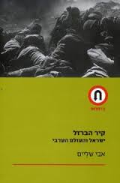

Slide 29
The attitude towards the Arab minority in the future Jewish state
‘The East Bank of the Jordan’:
‘Two Banks has the Jordan –
This is ours and, that is as well.’
‘From the wealth of our land there shall prosper
The Arab, the Christian, and the Jew;
For my flag is pure and just
It will illuminate both sides of my Jordan.’
The Arabs should not be pushed away and their expulsion from the country should not be initiated –
"This is beyond any argument [...] There is enough room in the Land of Israel."
A future constitution in which the Arab minority serves civil and military service and wins the Jewish state with personal and cultural / national rights. The prime minister or his deputy will both be Arab.

Slide 30
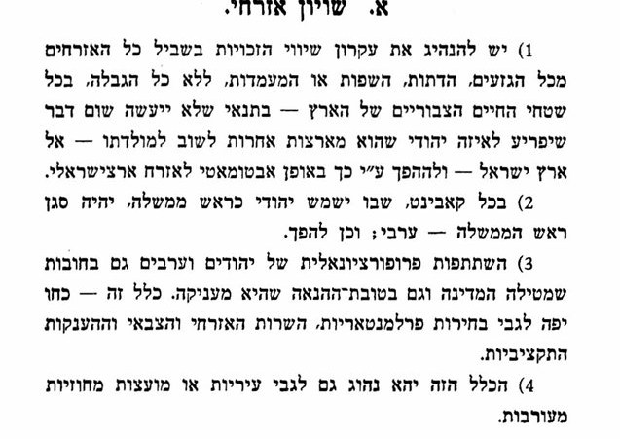
The Status of Israeli Arabs in the Jewish State According to Jabotinsky (1940)
Jabotinsky's position was based on a real-political conception of peoples' relations and on an orientation towards the supremacy of European culture as opposed to Eastern culture. Jabotinsky, however, represented liberalism on the relations between peoples in one state and expressed it with regard to the rights of the Arab minority in the Land of Israel in the future.

Slide 31
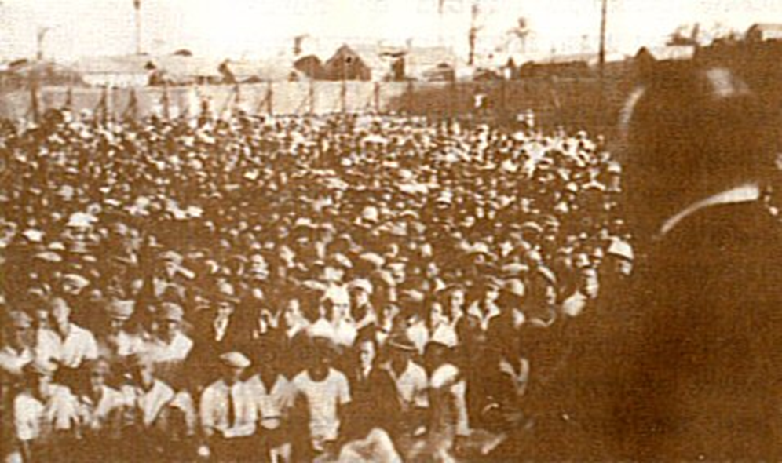
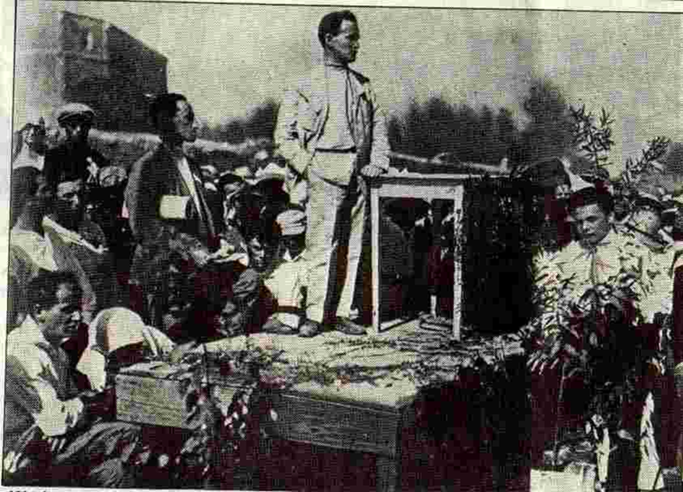
The fourth part:
The struggle for political hegemony

Slide 32
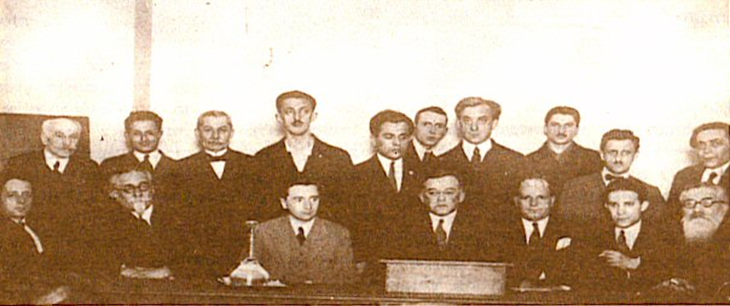
Opposition on the right: the struggle for hegemony in the Zionist movement
Founding of the Revisionist Zionist Alliance in April 1925, Paris.
The Trumpeldor Histadrut youth movement (later Betar) was founded half an hour earlier.
Goal: Most Jews on the two banks of Jordan.
'One miracle: Jabontisky’s concept of anti-class and anti-classism capitalism
'I am bourgeoisie, son of bourgeoisie, for the Grace of G-d bourgeoisie.”
During the 'Promin' strike, Jabotinsky wrote an article called 'Yes, Break', in which he called for breaking the monopolistic power of the Labor Federation.

Slide 33
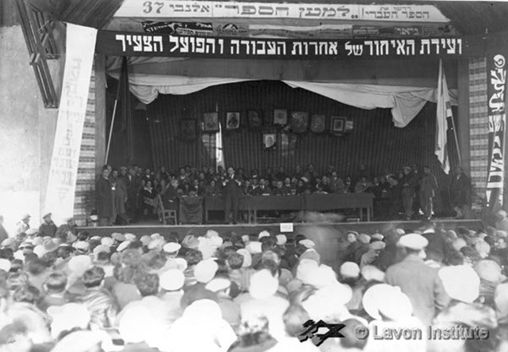
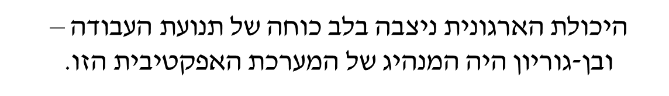

Organizational ability was at the heart of the labor movement - and Ben-Gurion was the leader of this effective system.
A sharp turn and even violent political period on a world scale). The murder of Arlozorov. “Vladimir Hitler”.1933 Widespread support for the League for the Working Land of Israel, which was Ben-Gurion's party. -
Close to half of all votes (45%).

Slide 34
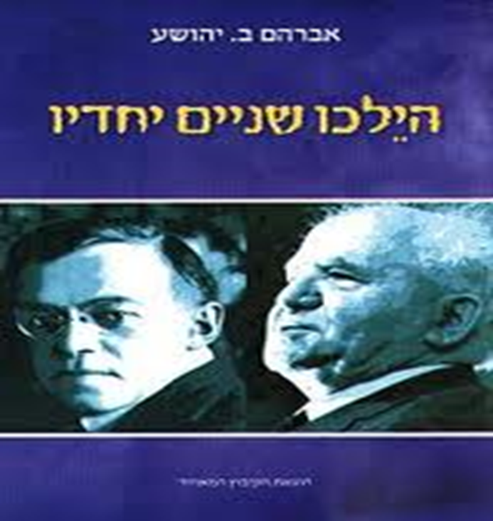
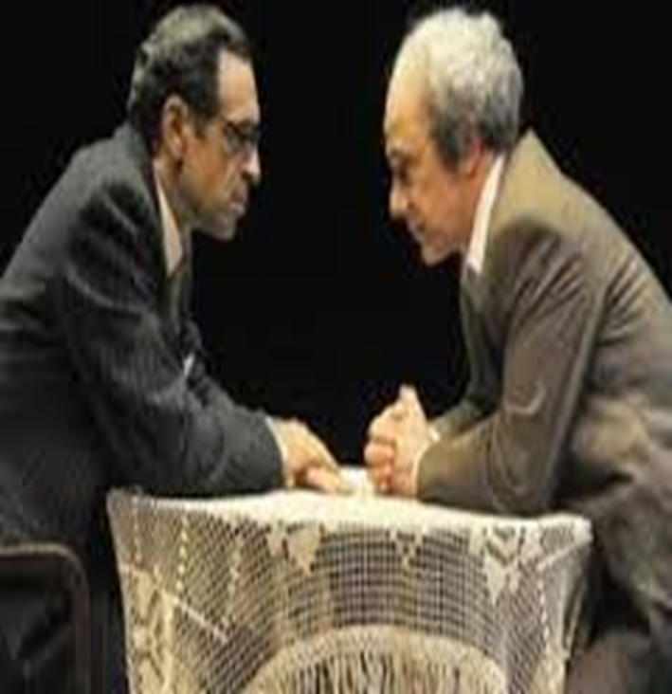
The fifth part
A reconciliation attempt

Slide 35
Peace was Achieved in Zionism
Agreement between Ben-Gurion and Jabotinsky
Immediately cease all acts of violence - establish working relationships
The Affair of the Agreement is Not Over Yet
Phone conversation with Ben Gurion in London. - The Council of the Israeli Workers' Party will meet. First Impressions in the Country - Satisfaction in America

Slide 36
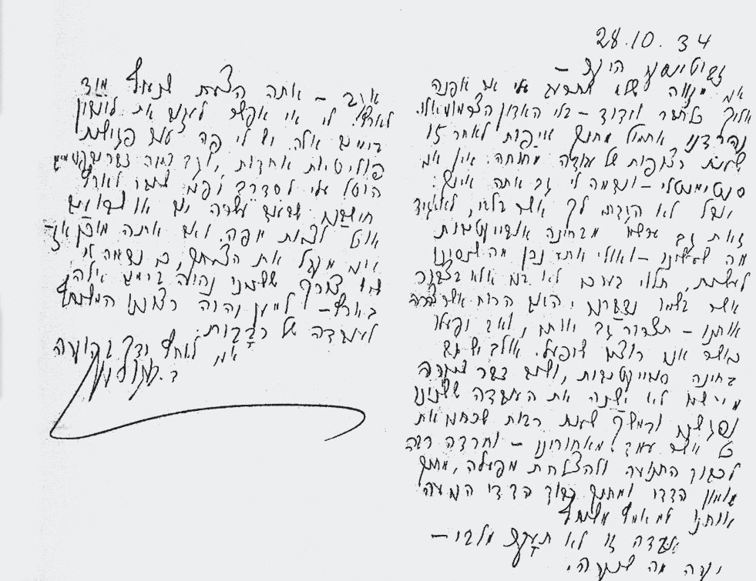

Slide 37
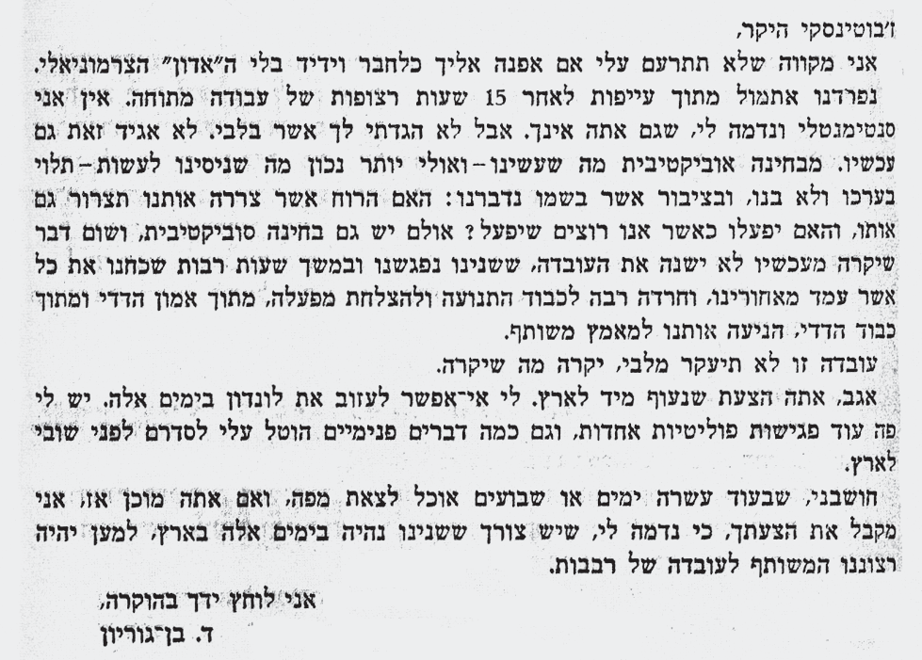
Dear Jabotinsky,
I hope you will not resent me if I refer to you as my friend and friend without the ceremonial “Mister". We broke up yesterday from fatigue after 15 straight hours of tense work. I'm not sentimental and I don't think you are either. But I didn't tell you what's in my heart. I won't say that now either. Objectively what we did - and perhaps more accurately what we tried to do - depended on its value and not ours, and on the public who spoke on its behalf: Will the spirit that has troubled us create it as well, will it act when we want it to act? However, there is also a subjective examination, and nothing that will happen from now on will change the fact that we both met and for many hours forgot all that was behind us, and much thanks to the movement and the success of its operation, out of mutual trust and mutual respect, motivated us to a joint effort.
That fact will not be upset by my heart, whatever happens.
By the way, you propose we fly immediately to Israel. I can't leave London these days. I have several other political meetings here. And this is how I was ordered to do things before returning to Israel. I think in ten days or two weeks I can get out of here, and if you are ready then, I accept your suggestion, because I think we both need to be in Israel these days, for the sake of our common desire for tens of thousands.
I shake your hand in appreciation,
D. Ben Gurion

Slide 38
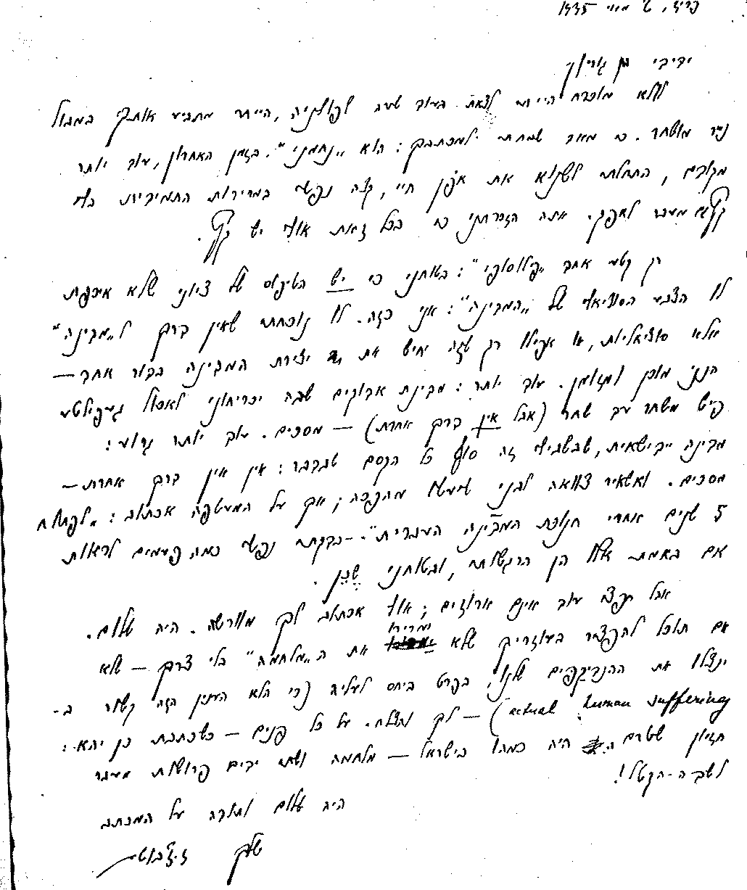
Letter from Ze'ev Jabotinsky to David Ben-Gurion, May 2, 1935
My friend Ben Gurion,
[...] I was very pleased with your letter: He is "Nahmani". Lately, even more than before,
I began to hate my life, my endless bitterness endlessly beyond the horizon. You mentioned that there might be an end anyway.
Only one 'philosophical' section:
I am sure that there is a type of Zionist who does not care about the social color of the "state": I am.

Slide 39
Ze'ev Jabotinsky letter to David Ben-Gurion, May 2nd, 1935
My dear friend Ben Gurion,
[...] I was very happy to receive your letter: It is comforting. Lately, even more than before, I had begun to hate my life, I am sick of the constant bitterness beyond the horizon. You reminded me that maybe there was an end to it after all.
Just a single ‘philosophical’ moment: I am confident that there is the type of Zionist who does not care for the socialist character of the ‘state’: I am such a Zionist.
Had I found that there was no way to have a ‘state’ besides socialism, or even just that it would hasten the building of the state in another generation – I would be willing and ready.
Furthermore, I would even agree to an observant state that would force people to eat gefilte fish from dawn to dawn (if there was no other way) – I would agree to it.
Or even worse: A “yiddishe” (Eastern European Jewry) state, which for me takes the magic out of it: if there was no other way- I would agree to it.

Slide 40

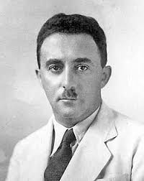
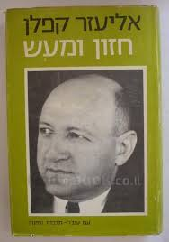
Part Five: Leadership and Movement, State and Retirement
At the Zionist Congress held in 1935, David Ben-Gurion was elected to head the Zionist administration, which led the settlements until the establishment of the state.
Ben-Gurion made decisions proving that he understood the weight of national responsibility that lays on his shoulder.
He formed a broad coalition that represented all parties in Congress, including religious ones, although it was necessary to ensure kosher and Sabbath observance in kibbutzim.
When asked why he did not talk about class war in Congress, he explained that in contrast to other labor movements operating in an existing state, the Zionist-Socialist movement is supposed to establish a state, economy, society and culture, and these cannot be done without cooperation with all the forces in the nation.

Slide 41
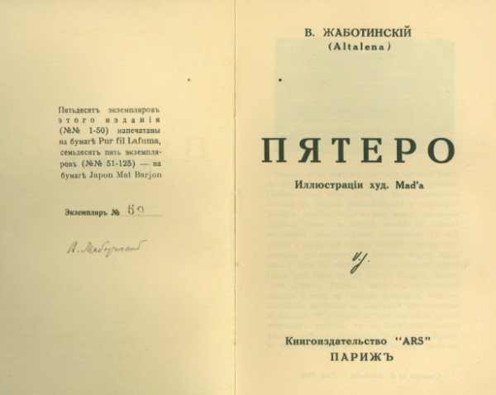
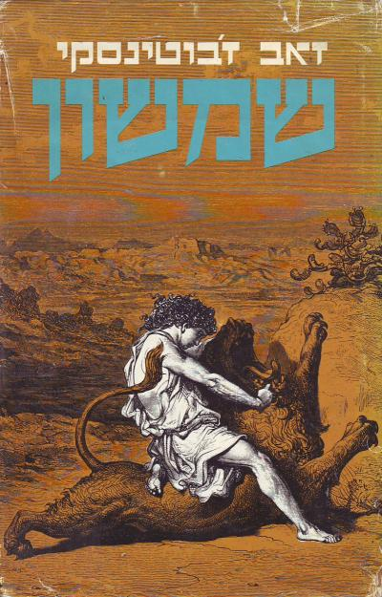
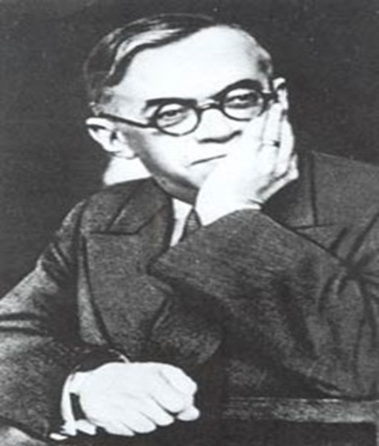
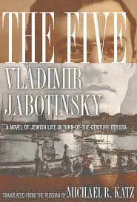
Far from the land of Israel – the decrease in energy versus the focus of ben gurion
Spring-Summer 1935: Final retirement from the Zionist Movement and the establishment of the New Zionist Organization.

Slide 42
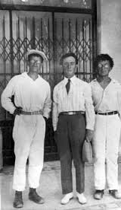
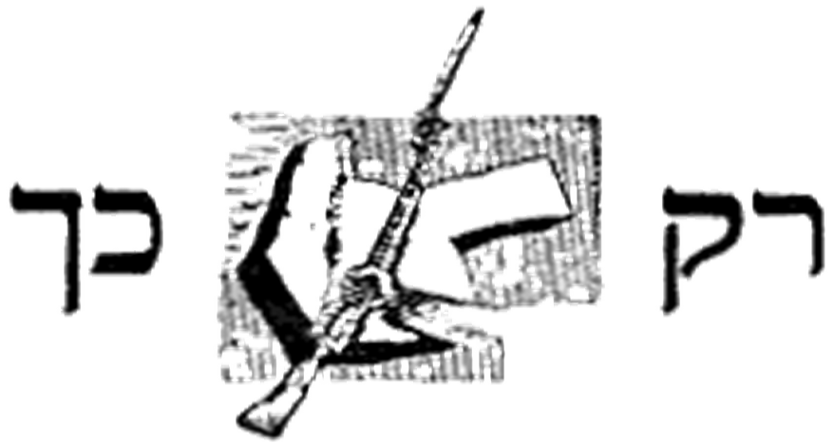
Heads of the strongmen alliance: Ahimeir, uri zvi Greenberg and Yelvin
Jabotinsky from esteemed leader to his loosening grip on the youth in his movement
The Strongmen Alliance
Radical influence on the Betar Movement
An increasing rift within the Revisionist movement.
The Irgun did not fit the Jabotinsky theory that was gradually perceived as out of touch and irrelevant.

Slide 43
The debate about the relation of democracy, liberalism and the Parliamentary system
ABA Ahimeir (1928, 'From the Notebook of Fascist):
" Do not fall into the spirit of the Duce under whose flag only a handful gathered. This is the way of the world, so that the few will rule the majority. Will rule by force of arms or by force of faith. The Hebrew duce must organize the handful of people capable of obeying him. To create the ‘national guard‘ and he should not put his time with the majority. "
His command must be obeyed and he should be addressed with the words "will we do, and obey." "In particular, our" Duce "must be guarded" because the idea of the state has many enemies among us. "
Jabotinsky refused to be called the Duce (leader): “Animals have leaders, people have heads."

Slide 44
Jabotinsky letter to Miriam Leng, August 27, 1930
I hate the cult of personality with all my heart, it disgusts me. Fascism has a lot of good ideas, but I can't judge it quietly and honestly - the cult of duchy disgusts me, it's like rude behavior in the Pershas. I see a real danger in dealing with this issue with us. There are countless times I have spoken orally and in writing against the nickname 'leader' [...] The current generation probably has to turn someone into a myth [...]
And in a letter to the People's Front system - he warned:
“The articles and notes on Hitler on the front of the people are like a knife sticking in the back and back of us all. I demand that I completely stop this abomination. This point of view, which in Hitlerism finds signs of a national liberation movement, is ignorance ... This chatter is a disgrace to my work and paralyzes it. I demand that this dirty hysteria disappear completely over the front pages of the people without leaving any trace ...
If even one word appeared in the paper [thanks to Hitler and his regime] ... I would have to disassociate the whole system from the party and sever my personal relations with the people who impede me with cheap and arrogant language (17 May 1933).

Slide 45
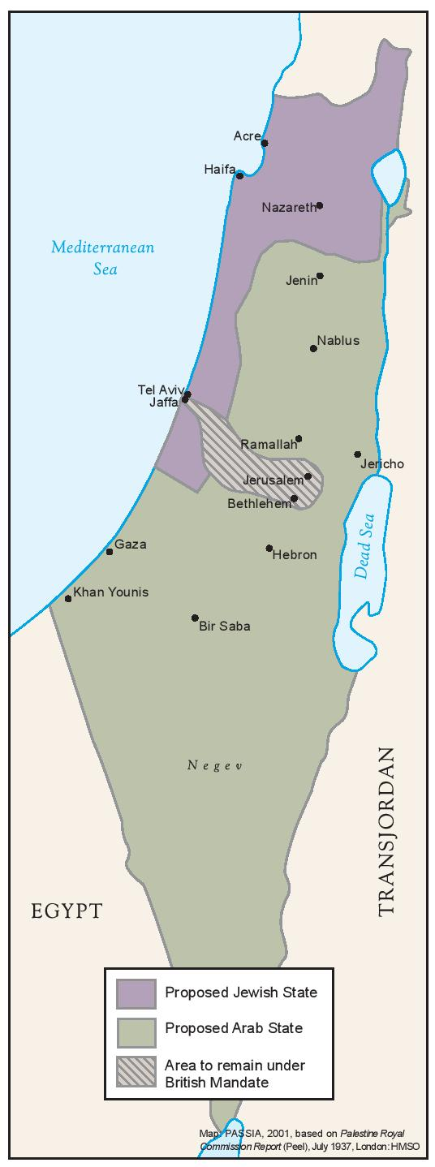
The Partition plan
Jabotinsky pauses for a moment but stands up against me.
David Ben-Gurion brings the Zionist Organization in principle to support the idea of partition, despite much opposition within the Israel’s Workers' Party and the labor movement in general.
And all your imagination
The response to the Arab revolt - conceptual or political differences?
The response to the White Paper and the outbreak of World War II - shared

Slide 46
Artistry is possible with bursts of the impossible and willingness to return to the pragmatic
Ben-Gurion was obsessed with data collection. In the 1930s, he talked about solutions with the Arabs, but at the same time he recorded in his journal every month, quietly and secretly, statistics comparing the number of men of the age of recruitment - Jews and Arabs. How many more do we need so we can stand against them.
When he decided, as early as 1945-6, that going to war as a result of the establishment of the state, he realized that it would be a war not only with the Arabs in the country, but with all Arab states. The Arab states have not yet figured that out.
The British were still in the country and did not intend to evacuate it, but Ben-Gurion sat and learned the capabilities of the militia called the HaHagana (The Defense).. He forced his will on reality through reality.
Eventually in 1948 much of what was available to the Jewish community was built through the practical and constructive Zionist concept of the labor movement.
Ben-Gurion was there to make the decisions under the most difficult conditions and to reach the peak of his leadership in 1948-1953 (at the end of his term as prime minister).

Slide 47

Everyone and their jabontinsky. Everyone and their ben-gurion
If ben gurion and others actualized the perceptions of jabontisky?
The Zionist movement is prominent in the high level of leadership that characterized it for many years.
Two leaders, two movements, overlap and disagreement.
The passion of leadership and politics - and the difference in the degree of status enhancement.
Intellectuality - a trait that provides a useful by-product of leadership
Between effective and missed leadership, between retirement and statehood.
Ben-Gurion: Infrastructure for the state and its foundation.
Jabotinsky: Infrastructure for a stream of thought that will become dominant for years to come.

Slide 48



Epilogue: Raising Jabotinsky’s Bones in 1964

