Slide 1
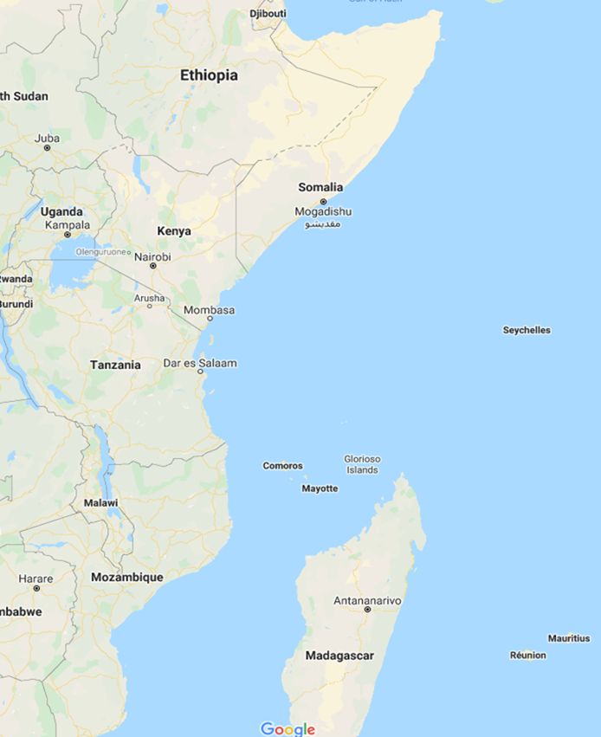
CUTLASS EXPRESS 22 (IMX 22 CTF-W / CTF-SW)
Who: Djibouti, Somalia, Kenya, Seychelles, Mozambique, Madagascar, Comoros, Mauritius, Tanzania, Ethiopia, Uganda, Sudan, Rwanda, Canada, France, Georgian, India, Azerbaijan, United Kingdom, UNODC, Interpol, SOCAF, CTF-68 USCG MET Bahrain.
What: Based off the Djibouti Code of Conduct framework, CUTLASS EXPRESS (CE) Is an annual U.S. AFRICOM maritime exercise designed to assess and improve maritime law enforcement capacity, promote national and regional security in Eastern Africa, inform planning and operations in Eastern Africa, and shape security force assistance (SFA) efforts. Additionally, CE seeks to improve U.S. military capability to interoperate with the armed forces of Eastern African nations, Western Indian Ocean Island Nations, Indo-Pacific, and European Allies.
When:
Initial Planning Event (IPE): 08-11 March 2021, Bahrain/Virtual
Main Planning Event (MPE): 14-17 June 2021, Bahrain
Final Planning Event (FPE): 1-5 November 2021
Senior Leadership Symposium (SLS): 10-13 January 2022, Ethiopia
Academics/Staff integration: 30 January-02 February 2022, Bahrain
Maritime Training Exercise (MTX): 6-20 February 2022
Where:
Djibouti (Host Nation, Primary Dive site, Primary VBSS site)
Mombasa, Kenya (VBSS site)
Madagascar (VBSS site)
Mauritius (VBSS site)
Seychelles (VBSS site)
Why: To assess and improve maritime law enforcement capability and capacity and promote national and regional security in Eastern Africa and the Western Indian Ocean
CTF-W
CTF-S
CTF-SW
Participating MOCs
Regional Information Sharing Centers
DIVE
VBSS
Notes:
OPAREA 2:
3718N 01004E
3721N 00952E
3727N 00952E
3724N 01004

